Slide 1
Comparing datasets for the Autumn Report - October 2019
National Numeracy are launching a report in the late autumn looking at the barriers to individuals improving their numeracy. A significant part of that report will be analyses of our National Numeracy Challenge data (skills, attitudes and improvement and key demographic data on over 40,000 people albeit a largely self-selecting group) along with a YouGov survey, representative of the UK population - c.2,000 UK adults, to gather comparable skills, attitudes and demographics (not improvement) data and a comparison of the two data sets. From here on in, National Numeracy Challenge data will be referred to as “Challenge” and the YouGov data as “UK”.
Both data sets contain individual level information on Gender, Age Group (broadly 10 year groups), Numeracy (Skills), 7 attitudinal factors (Value, Belief, Effort, Confidence with Numbers, Confidence with Money, Self-Confidence and Appetite for Learning).
By comparing the results of each of the 8 outcomes, (7 attitudinal factors plus the numeracy skills score), we were expecting a set of results that show that the UK scores are mostly lower than Challenge users, but the gender / age differences are the same. The following comparative analysis shows this to be true.
We have separately conducted logistic regression analyses on the Challenge data, indicating which factors are significant in predicting whether an individual is likely to improve their numeracy. Because the data is from a largely self-selecting and demographically skewed group, we aim to show that the underlying trends / differences compared to a representative sample of the UK are the same; ergo our logistic regressions results will still hold true for the UK at large. Having conducted this comparative analysis, we believe this last statement also to be true.

Slide 2
UK (2,172)
Challenge (43,374)
In the Challenge data, F are over-represented, especially in 35-44 and 45-54 year olds.
55-65 males are under-represented, and 65+ are greatly under-represented for both genders.
Deeper analysis of individual factors showed that the 65+ age group had markedly different results across the 2 data sets. For example, the mean score for numeracy (skills) was much higher for Challenge data (78.5) than UK data (70.7). Three other factors (Belief, Appetite for Learning and Confidence with Numbers) differed greatly between the two sets, and indeed the Challenge data ‘bucked the trend’, by increasing (from 55-64) when the UK data showed either a plateauing or decrease.
It is also true to say that National Numeracy are focussing mainly on working-age adults. It was therefore decided to remove the 65+ age group from further comparisons, and indeed any regression analysis results in the main report.

Slide 3
The testing approach
Having removed the 65+ age group, the same approach was followed for each of the 8 outcome measures. A 2-tailed, two-sample unequal variance (heteroscedastic) t-test was used to compare various cuts of the two populations. UK = YouGov data. C = NN Challenge data, essentially testing the significance of the gaps between the pairs of lines shown on the illustrative graphs below. Each line has a set of confidence intervals (95%) for each data point.
To compare UK v C for Males
To compare UK v C for Females
To compare UK v C

Slide 4
The testing approach (continued)
Mean differences were calculated to help quantify any differences, and how they might be meaningful to an individual. These differences vary across the measures, as explained below.
Numeracy (skills) – a score out of 100, a 5 point change would signify a quarter of a level difference.
Attitudinal Questions : Value, Confidence With Money, Effort.
4 items on a 5 point Likert scale (Strongly Agree, Agree, Neutral, Disagree, Strongly Disagree). Each item is worth 0 – 4 points. The maximum possible score is therefore 16. This score is scaled to be out of 100. A 1 point improvement in the raw score is equivalent to 6.25 (100/16) in the scaled score. (i.e. one item being answered 1 step more positively).
Attitudinal Questions : Belief, Confidence with Numbers, Self Confidence, Appetite for Learning.
3 items on a 5 point Likert scale (Strongly Agree, Agree, Neutral, Disagree, Strongly Disagree). Each item is worth 0 – 4 points. The maximum possible score is therefore 12. This score is scaled to be out of 100. A 1 point improvement in the raw score is equivalent to 8.33 (100/12) in the scaled score. (i.e. one item being answered 1 step more positively).

Slide 5
Summary of Results
LITTLE OR NO DIFFERENCES AT ALL
(a maximum of 1 p value <0.01 for both the overall and gender comparisons)
Confidence With Money
Very little difference, either at the overall level, or when comparing same gender data sets.
Effort
No difference, either at the overall level, or when comparing same gender data sets.
OVERALL DIFFERENCES but SIMILAR GENDER GAPS
(3-5 p values <0.01, a similar pattern comparing gender, gender gaps for UK & C are of a similar magnitude)
Value
The UK and C data sets are different, but the gender splits are very similar. Both analyses report similar mean differences (mostly of borderline significance to an individual)
Belief
The UK and C data sets are different, but the gender splits are very similar. Both analyses report similar mean differences (mostly of very little significance to an individual)
Appetite for Learning
The UK and C data sets are different, but the gender splits are very similar. Both analyses report similar mean differences (mostly of very little significance to an individual)

Slide 6
Summary of Results (continued)
OVERALL LITTLE DIFFERENCE but GENDER DIFFERENCES
(a maximum of 1 p value <0.01 for the overall comparisons, but 3-5 p values <0.01 for the gender comparisons)
Numeracy (skills)
Overall, very little difference. Females (UK vs C) are the same. Males are different. The C data has Males with higher numeracy (skills) scores.
OVERALL DIFFERENCES and GENDER DIFFERENCES
(3-5 p values <0.01 for the overall comparisons, 3-5 p values <0.01 for the gender comparisons, gender gaps for UK & C are of a similar magnitude)
Confidence with Numbers
The UK and C data sets are different. UK Females are more confident that C Females. UK Males are less confident than C Males. The gender splits are very similar. Both analyses report large mean differences (almost all of great significance to an individual)
Self Confidence
The UK and C data sets are different. UK Males are more self confident that C Males. There is no difference between UK and C Females. The gender splits are quite similar. Both analyses report similar mean differences (mostly of borderline significance to an individual)

Slide 7
LITTLE OR NO DIFFERENCES AT ALL
(all p values >0.1 for both the overall and gender comparisons)

Slide 8
Confidence with Money
UK mean = 68.2
C mean = 67.2
Overall, there is a significant difference,
but only for 16-24 year olds
There are no Male differences for any age group
UK mean = 68.4
C mean = 68.9
There are slight Female differences (16-24 and 45-54)
UK mean = 68.1
C mean = 66.3

Slide 9
Effort
UK mean = 63.2
C mean = 62.9
Overall, no significant difference, and no difference
at any age group
There are no differences between the two Male populations
UK mean = 62.8
C mean = 62.9
There are no differences between the two Female populations
UK mean = 63.7
C mean = 62.9

Slide 10
OVERALL DIFFERENCES but SIMILAR GENDER GAPS
(3-5 p values <0.01, a similar pattern comparing gender, gender gaps for UK & C are of a similar magnitude)

Slide 11
Value
UK mean = 67.7
C mean = 74.4
Overall, there is a significant difference,
across all age groups, except 16-24
There are Male differences across all age groups (except 16-24)
UK mean = 70.1
C mean = 78.1
There are Females differences across all age groups (except 16-24)
UK mean = 65.4
C mean = 72.4

Slide 12
Value (continued)
UK mean = 67.7
C mean = 74.4
Overall, there is a significant difference,
across all age groups, except 16-24
There are differences across all age groups (except 35-44)
M mean = 70.1
F mean = 65.4
±6.25 would denote a significant average difference
There are differences across all age groups,
M mean = 78.1
F mean = 72.4

Slide 13
Belief
UK mean = 63.6
C mean = 68.9
Overall, there is a significant difference,
across all age groups, except 16-24
There are male differences across all age groups (except 16-24)
UK mean = 63.8
C mean = 70.1
There are Female differences across all age groups (except 16-24)
UK mean = 63.5
C mean = 68.3

Slide 14
Belief (continued)
UK mean = 63.6
C mean = 68.9
Overall, there is a significant difference,
across all age groups, except 16-24
There are no UK gender differences across all age groups
M mean = 63.8
F mean = 63.5
± 8.33 would denote a significant average difference
There are C gender differences across all age groups (except 55-64)
M mean = 70.1
F mean = 68.3

Slide 15
Appetite for Learning
UK mean = 72.3
C mean = 73.6
Overall, there are significant differences, at the
opposite ends of the age ranges.
There are significant differences at opposite ends of the age ranges.
UK mean = 73.1
C mean = 75.0
There are significant differences at opposite ends of the age ranges.
UK mean = 71.6
C mean = 72.8

Slide 16
Appetite for Learning (continued)
UK mean = 72.3
C mean = 73.6
Overall, there are significant differences, at the
opposite ends of the age ranges.
For UK data, M and F are the same (from all age groups)
M mean = 73.1
F mean = 71.6
±8.33 would denote a significant mean difference
There are significant differences for all of the age ranges, but the difference in average terms is minimal.
M mean = 75.0
F mean = 72.8

Slide 17
OVERALL LITTLE DIFFERENCE but GENDER DIFFERENCES
(a maximum of 1 p value <0.01 for the overall comparisons, but 3-5 p values <0.01 for the gender comparisons)

Slide 18
Numeracy (skills)
UK mean = 71.3
C mean = 72.4
Overall, no significant difference
(only sig diff at 25-34 and 55-64)
There is a significant difference between UK and C (at all age groups, except 16-24)
UK mean = 74.3
C mean = 80.6
There is no difference in the female populations (across all age groups)
UK mean = 68.6
C mean = 67.9

Slide 19
OVERALL DIFFERENCES and GENDER DIFFERENCES
(3-5 p values <0.01 for the overall comparisons, 3-5 p values <0.01 for the gender comparisons, gender gaps for UK & C are of a similar magnitude)

Slide 20
Confidence with Numbers
UK mean = 65.0
C mean = 60.7
Overall, there is a significant difference,
across all age groups, except 55-64
There are Males differences but only at 55-64
UK mean = 69.5
C mean = 70.9
Overall, there are no female differences, but there are differences across each of the age groups
UK mean = 60.8
C mean = 55.2

Slide 21
Confidence with Numbers (continued)
UK mean = 65.0
C mean = 60.7
Overall, there is a significant difference,
across all age groups, except 55-64
There are gender differences across all age groups
Male mean = 69.5
Female mean = 60.8
± 8.33 would denote a significant average difference
Overall, there are no female differences, but there are differences across each of the age groups
Male mean = 70.9
Female mean = 55.2

Slide 22
Self-Confidence
UK mean = 69.1
C mean = 72.4
Overall, there is a significant difference,
across all age groups, except 16-24
There are male differences across all age groups
UK mean = 70.7
C mean = 77.4
There are no Female differences across all age groups
UK mean = 67.7
C mean = 69.7

Slide 23
Self-Confidence (continued)
UK mean = 69.1
C mean = 72.4
Overall, there is a significant difference,
across all age groups, except 16-24
There are male differences across all age groups
M mean = 70.7
F mean = 67.7
± 8.33 would denote a significant average difference
There are no Female differences across all age groups
M mean = 77.4
F mean = 69.7

Slide 24
Which data sets scored HIGHER ?
UK
Challenge
Numeracy
(Attitudes)
Numeracy
(Skills)
Value
Confidence
with Numbers
Effort
Self Confidence
Confidence
with Money
Belief
Appetite
for Learning
Summary: Challenge users score either the same or slightly higher that the UK for all measures,
except Confidence with Numbers. People with lower confidence is our target audience.

Slide 25
Are there GENDER differences (all showing M > F) ?
UK
Challenge
Shown near the edge
to denote a t-test difference
but a small arithmetic mean difference
Appetite
for Learning
Numeracy
(Attitudes)
Self
Confidence
Numeracy
(Skills)
Belief
Confidence
with Numbers
Confidence
with Money
Value
Effort
Summary: The majority of measures show the same gender differences. Of the 3 that show a difference, it is always in the Challenge data, and is often questionable, as the arithmetic mean is quite similar.

Slide 26
Are there generally positive AGE correlations ?
(i.e. do average scores increase as age group increases)
UK
Challenge
Appetite
for Learning
Numeracy
(Attitudes)
Self
Confidence
Appetite
for Learning
Belief
Numeracy
(Skills)
Belief
Confidence
with Money
Confidence
with Numbers
Confidence
with Money
Value
Effort
Value
Summary: All age correlations match up.
Effort

Slide 27
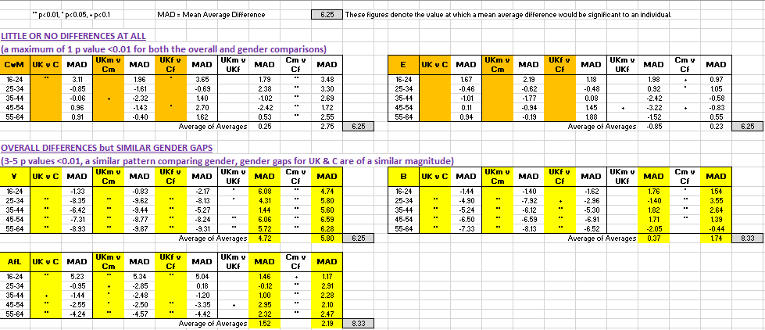
Appendix 1 – Tables of Results of T-Tests

Slide 28
Appendix 1 (continued) – Tables of Results of T-Tests

