Slide 1
Confidence with Numbers

Slide 2
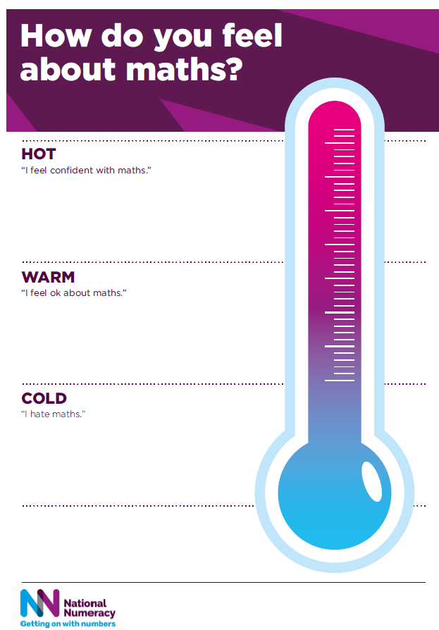
How do you feel about maths?
Why do you think that is?

Slide 3
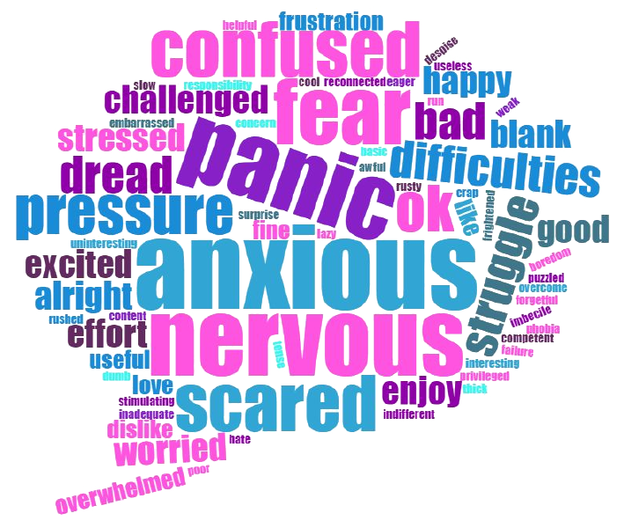
How do you feel about maths?

Slide 4
Maths anxiety
Maths anxiety has been defined by Tobias and Weissbrod (1980) as,
“the panic, helplessness, paralysis,
and mental disorganisation that arises among some people when they are required to solve a mathematical problem.”
Research by the University of Cambridge has found that, “many children and adults experience feelings of anxiety, apprehension, tension or discomfort when confronted by a maths problem.”

Slide 5
What causes maths anxiety?
Negative experiences at school
Feeling under pressure
Fear of failure
Being told you’re not a maths person
Lack of support
Dyscalculia

Slide 6
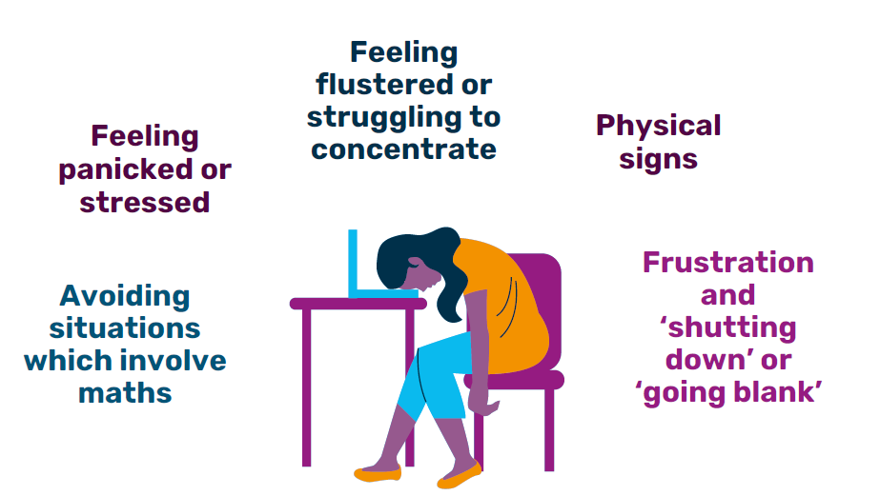
What does maths anxiety look like?

Slide 7
Tips to overcome maths anxiety
Talk about your feelings about maths
Challenge your own beliefs
Try not to compare yourself to others
Reduce pressure
Set realistic goals

Slide 8
The Essentials of Numeracy

Slide 9
Value, Belief and Persistence

Slide 10
The Myth Buster
Six statements that explore myths and mindsets around maths.
Do you agree or disagree with the following statements. Why?

Slide 11
The Myth Buster
Everybody uses maths every day whether they think about it or not.

Slide 12
The Myth Buster
Learning maths as an adult is just like going back to school.

Slide 13
The Myth Buster
Some people are maths people and others are not.

Slide 14
The Myth Buster
Many people feel anxious about maths.

Slide 15
The Myth Buster
You don’t need maths if you have a calculator.

Slide 16
The Myth Buster
Everybody can improve their maths with effort.

Slide 17
National Numeracy Challenge

Slide 18
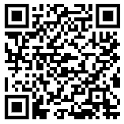
National Numeracy Challenge
Scan the QR code or follow the link to register
https://www.nationalnumeracy.org.uk/challenge/numeracychampions

Slide 19
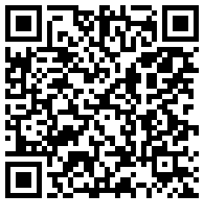
Confidence with Numbers: Feedback
Thank you for attending this Confidence with Numbers session.
We would be very grateful if you could complete the feedback form either on paper, by scanning the QR code or following the link.
https://nn.typeform.com/to/fp2hTQAf

