Slide 1

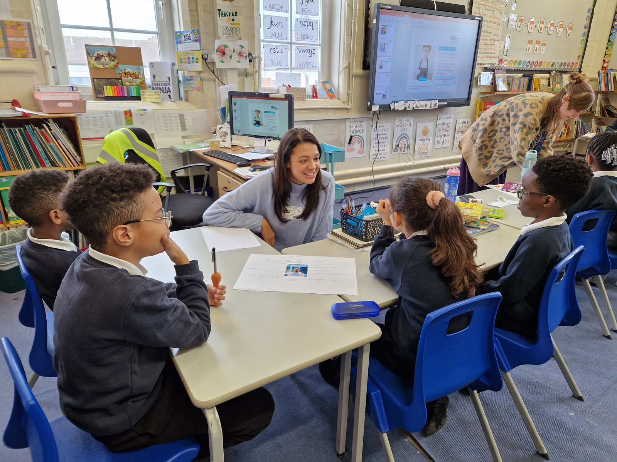
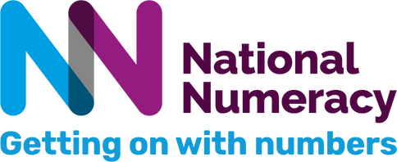

Numeracy Volunteers
Maths in the Real World
(Session to be led by the class teacher)
nationalnumeracy.org.uk
Notes:
1

Slide 2
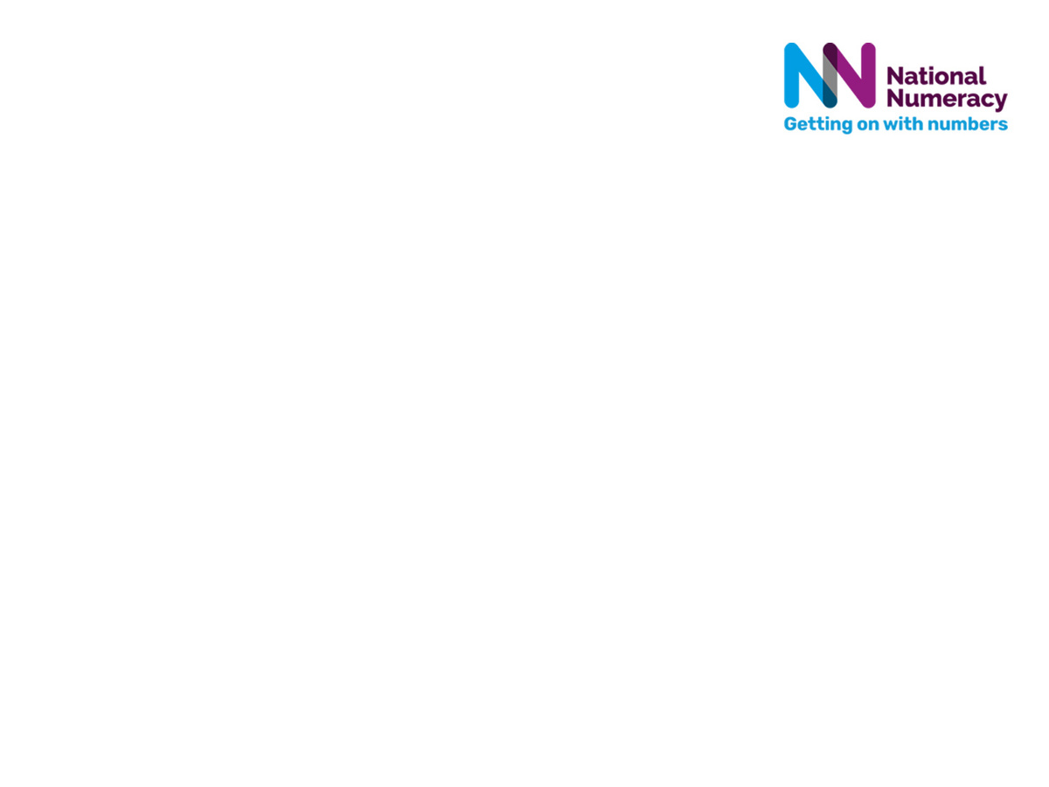
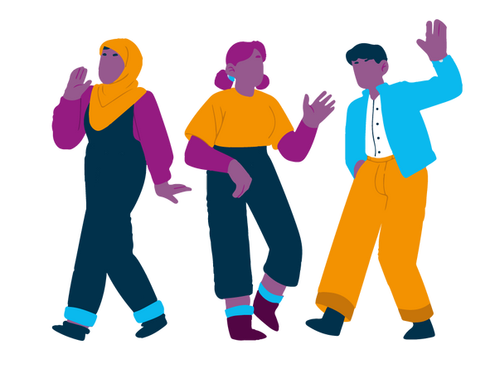
Today we are going to:
  Meet some new people (some in real life and some pretend) and explore how they use maths in their jobs and hobbies.
  Find out how using maths makes their lives easier and more fun.
  Think about how we all use maths in everyday life outside school.
Let’s meet our real-life visitors and find out a bit about their jobs and hobbies – do you have any questions for them?
nationalnumeracy.org.uk

Slide 3
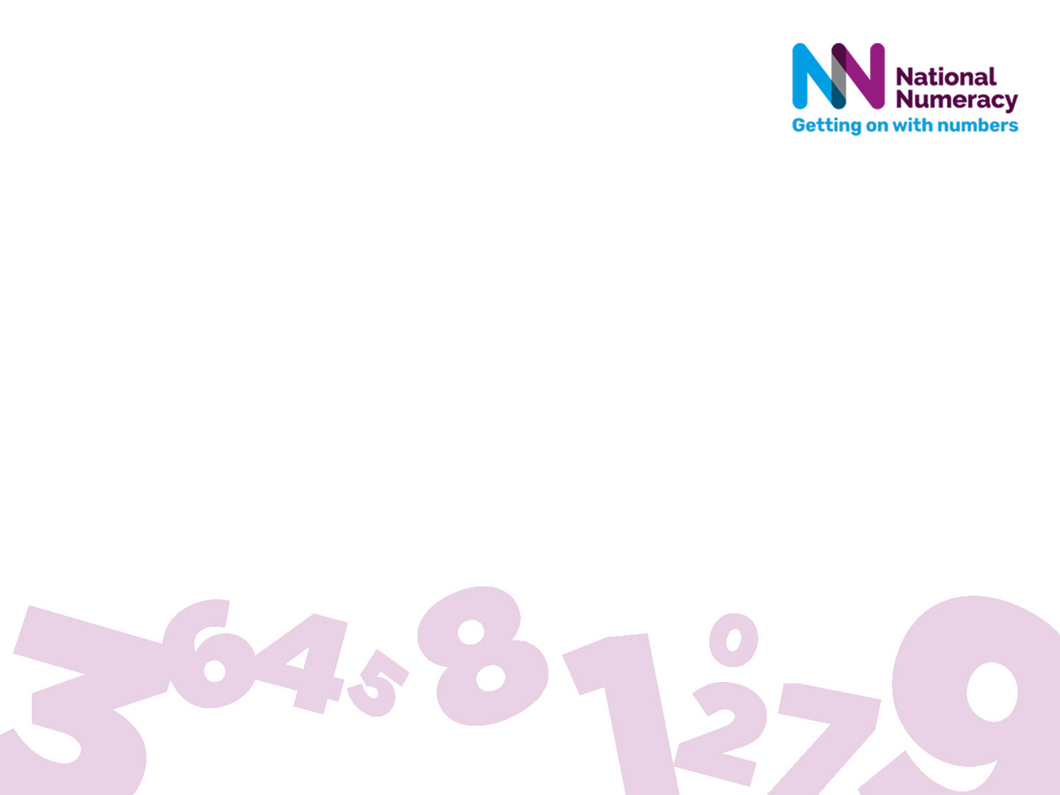
Group activity – Let’s meet our characters!
  We’re going to meet some characters and think about how each person uses maths in their job and hobby.
  In your groups write your ideas on the big sheet.
  When your teacher tells you to, move on to the next character.
At the end or between characters your teacher will read out all the ideas written on each character’s sheet, or they will ask each group for ideas.
nationalnumeracy.org.uk

Slide 4
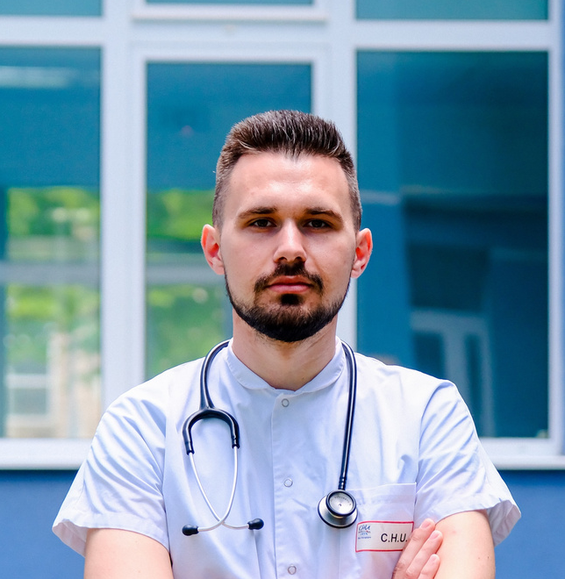
Let’s meet our characters!
Think about how they use maths in their jobs and hobbies
Jamie is a Nurse
  Cares for people suffering from illnesses and injuries
  Checks and gives medicines
  Helps with x-rays and blood tests
  Watches and writes down patients’ progress
Jamie
He also loves to bake yummy cakes and biscuits for his friends!
nationalnumeracy.org.uk

Slide 5
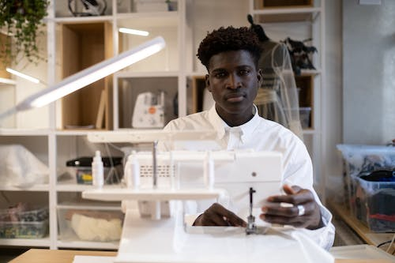
Sid is a Fashion Designer
Researches current fashion trends
Develops ideas and designs for new products
Selects fabrics, patterns, colours and textures
Creates original clothing, accessories and footwear
Sells to suppliers
Jessie
Sid
He’s also busy decorating his flat – he needs to wallpaper his bedroom and build some shelves!
nationalnumeracy.org.uk

Slide 6
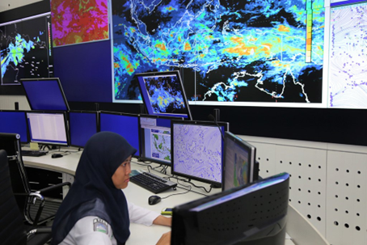
Maryam is a Weather Forecaster
Studies the weather and climate
Collects data from the land, sea and atmosphere
Forecasts the weather
Maryam
Maryam
She also loves painting pictures of people using lots of different coloured paints.
nationalnumeracy.org.uk

Slide 7
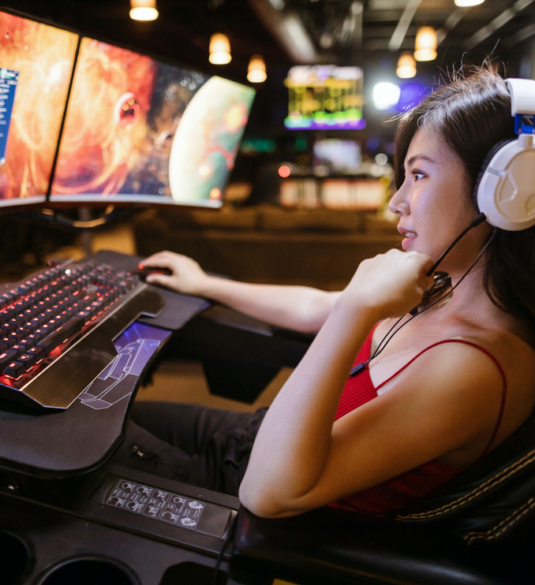
Mei is a Video Game Designer
  Produces exciting new games
  Designs games for different consoles
  Considers and plans in detail every element of a new game
She also loves to host dinner parties for her friends and family.
Mei
nationalnumeracy.org.uk

Slide 8
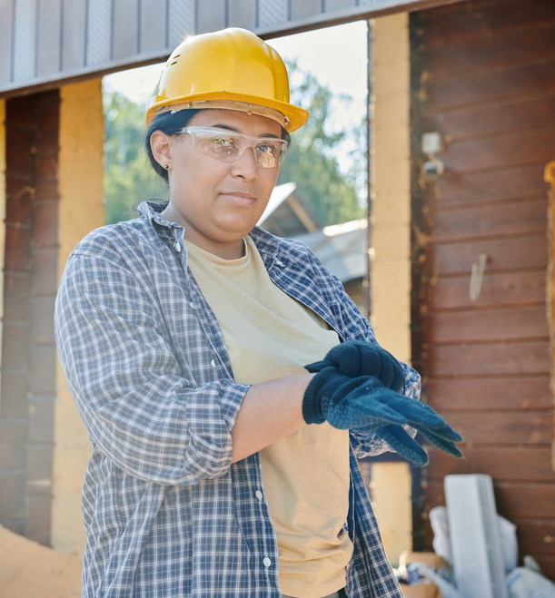
Monica is a Builder
  Constructs, maintains, repairs and renovates buildings
  Follows rules to make sure buildings are safe
  Makes sure walls are built straight across to ensure they are level and stable
  Installs electricity, water and gas connections
Monica
She also likes to watch football
nationalnumeracy.org.uk

Slide 9
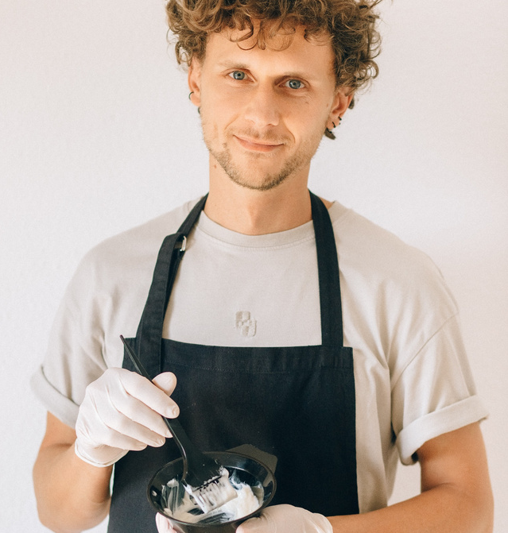
Michael is a Hairdresser
  Manages hair appointments
  Shampoos, cuts, colours and styles hair
  Talks to the customer about what style they want
  Recommends hair products to customers
Michael
He also likes to play board games
nationalnumeracy.org.uk

Slide 10
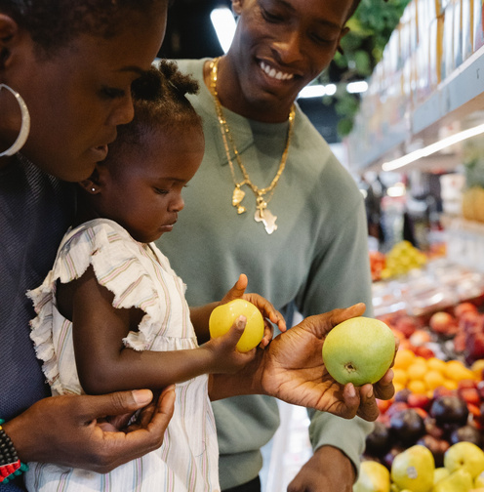
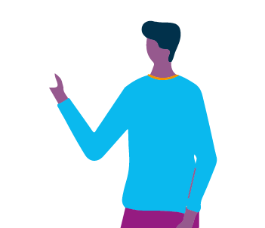
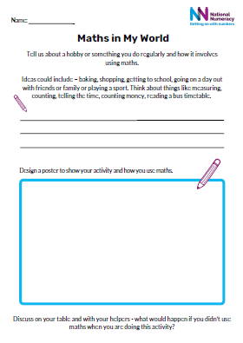
Individual activity or class discussion
Maths in Your World
Tell us about a hobby or something you do regularly.
For example - baking, shopping, getting to school, going on a day out or playing a sport.
How does it involve numbers or maths?
What would happen if you didn’t use numbers or maths when you did it?
Use our sheet to write and draw how you use numbers or maths
nationalnumeracy.org.uk

Slide 11
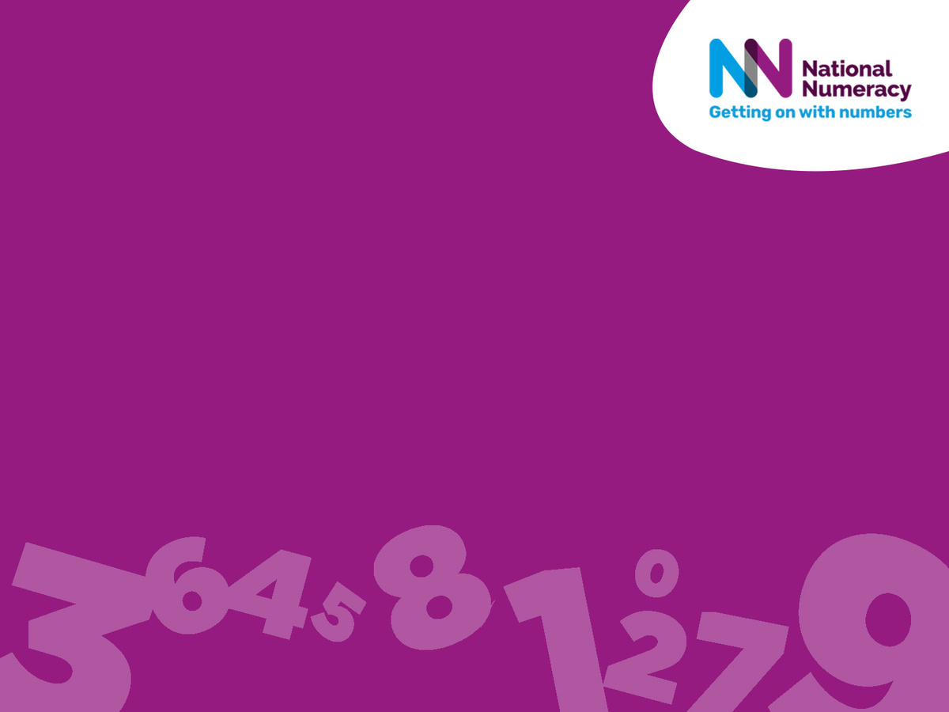
Everyone uses maths every day!
We hope you enjoyed today’s session. Thank you for taking part.
nationalnumeracy.org.uk

