Slide 1

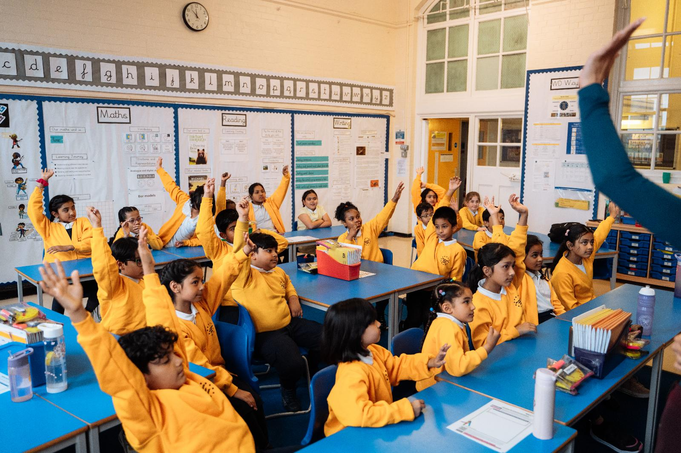

My Maths Story
EXAMPLE OF WHAT NOT TO DO!
nationalnumeracy.org.uk
Notes:
Welcome to My Maths Story
Introduce yourself, what your job title is and where you work.
Ask if anyone knows what your company does.
Explain what your company is, keep the language simple
Eg for Capital One you could say it is a credit card company that enables people to pay for things and then pay the money back later.
Capital One helps people make good decisions about money.
Please don’t ask the children questions like ‘Who loves maths?’, ‘Who is good at maths?’ or ‘Who finds maths hard?’.

Slide 2
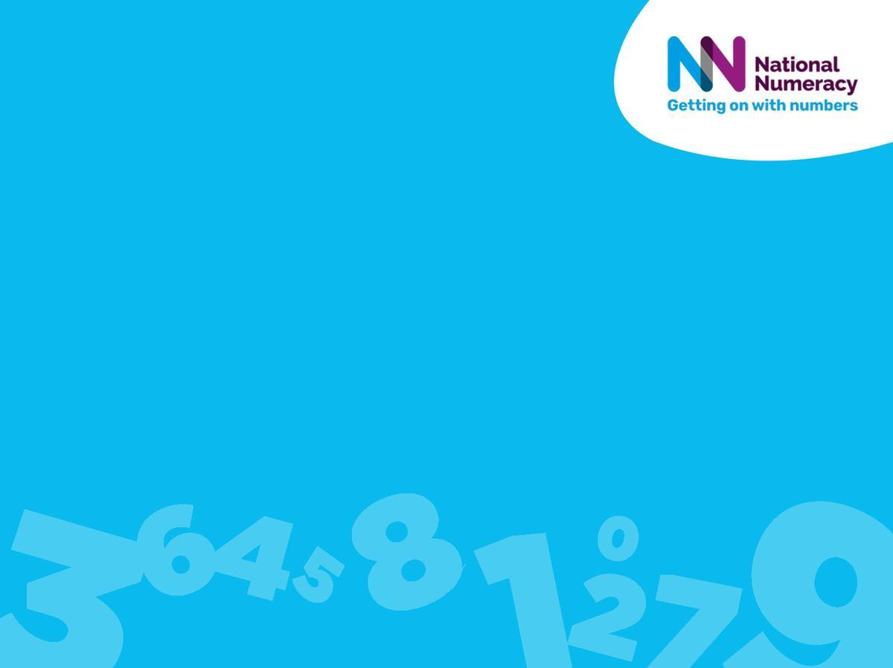
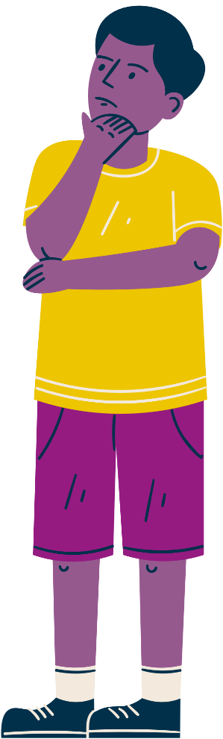
Before I start…
Can anyone tell me how they use maths or numbers outside of school?
?
We’ll come back to this question later.
?
nationalnumeracy.org.uk
Notes:
Please repeat the children’s answers out loud so everyone can hear what they said before answering them.
The children may say they did their maths homework, or played a maths game – they are good answers for now. Thank them and say you’ll come back to this question later.

Slide 3
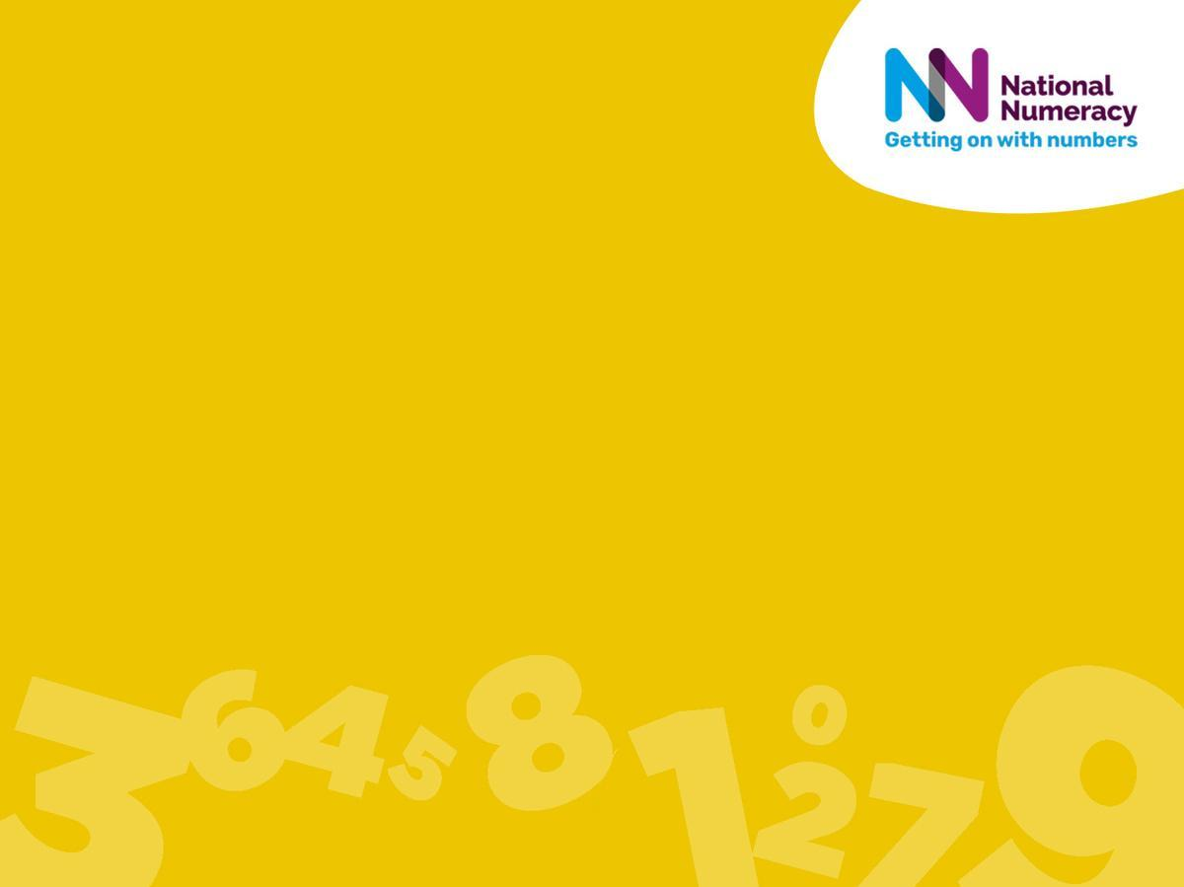
Maths and me
nationalnumeracy.org.uk
Notes:
Today I’m going to tell you about my maths story - how I felt about maths at school, how I feel about maths now and how I use it every day.

Slide 4
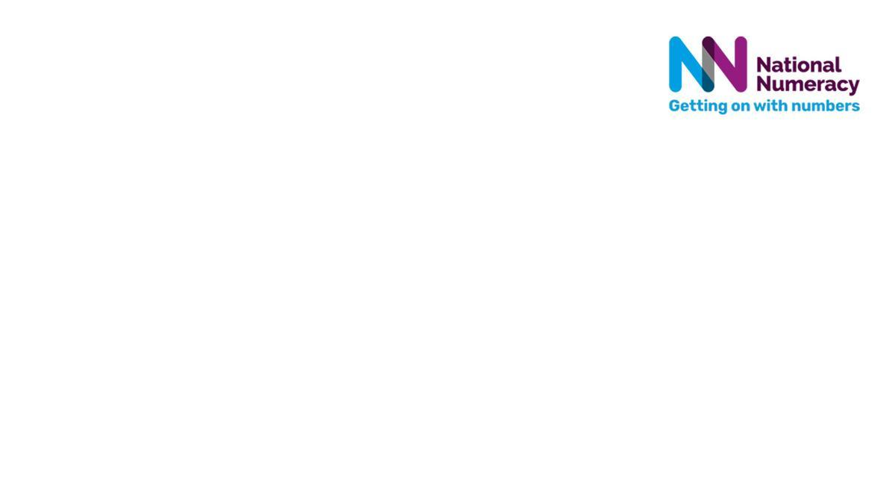

When I was at school, this is how I used to think about maths:
I hated maths, it was my worst subject! There were certain things like percentages and trigonometry that I couldn’t quite comprehend so quite often I got very frustrated and just wanted to give up. I felt like I could never get past this hurdle and everyone around me was getting to the answers much faster, so I felt like I was doing it all wrong and felt too embarrassed to ask for help.
Now I’m an adult, this is how I feel about maths:
I still find maths hard sometimes, but I don’t hate it now! I feel much more confident now that I know I can ask for help and it’s not something I should be embarrassed about. It’s surprised me how many different ways I actually use maths as an adult, and how essential and fun it can be! For example, calculating how much things cost, budgeting my spending and using it in my hobbies.
nationalnumeracy.org.uk
Notes:
Explain briefly why you felt this way and if it changed over time - eg. “I enjoyed maths at primary school but I found it tricky sometimes as I got older. Luckily my teacher at secondary school took the time to explain things to me and I passed my exams.” or “Sometimes I didn’t enjoy maths at school because I didn’t see how it related to my life, but that’s changed as I’ve got older.” or “I was lucky that I had a great teacher at school and I really enjoyed maths – and that’s stayed with me.”
“I use maths every day now for my job…”
“I still find maths tricky sometimes, but I ask friends to help me if I need to.”
Try to talk positively about maths. Children learn from example, so avoid saying things like “I hated maths at school” or “maths was boring”. You can be honest in that you may have found it tricky but try to make it into a positive eg you had to ask for help, had to work hard.
Try not to use very negative words, eg use tricky rather than hard or difficult.

Slide 5
Maths in my job
nationalnumeracy.org.uk
Notes:
Now I’m going to tell you about how I use maths in my job

Slide 6



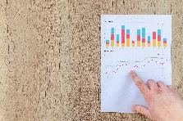
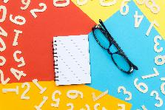
Maths in my job
I am a Data Analyst. I work with lots of different types of data from various sources to identify statistical patterns and help organisations make informed decisions. I perform lots of analytical processes to identify key trends and insights, I use specialised software to generate reports and data visualisations so our stakeholders can interpret the metrics (numbers).
I use maths everyday:
Does anybody want to ask me anything about how I use maths in my job?
By using comparative techniques to evaluate performance across different processes. This often involves using ratios and percentages to see where we could optimize productivity.
By identifying statistical patterns and determining which variables have the most significant impact on outcomes.
By predicting future behavior of statistical trends based on historical data. These projections (guesses) help us to make strategic recommendations across the organisaiton.
nationalnumeracy.org.uk
Notes:
Give your job title & explain briefly & in simple terms what you do.
Give 2 examples of ways you use maths in your job & explain a little bit about them – eg. an example could be ‘To manage budgets for projects I work on’ – explain that this means you need to keep track of the money being spent and make sure you’re not spending more money than you have. So you might need to be able to work with pounds and pence, add up, subtract, compare value, work with percentages etc – don’t go into complicated detail but just give a headline.
We will add some photos that reflect your job. If you have photo that you’re happy to share please do add your own.
Stop for questions after giving your examples.
The schools will have been asked to have the children ready to ask questions. Children should know to put their hands up and not shout out. Ask children with their hand up for their answer (don’t forget the ones at the back). Repeat the children’s questions and answers out loud so that everyone can hear what they said. If there are more than four or five questions you could say ‘I need to move on now but there will be more time for questions later’.
Please don't include examples of actual maths calculations or ask the children any maths questions. There will be too wide a spread of abilities and some children won’t be able to follow the examples or questions. Also we’re not maths teachers!

Slide 7
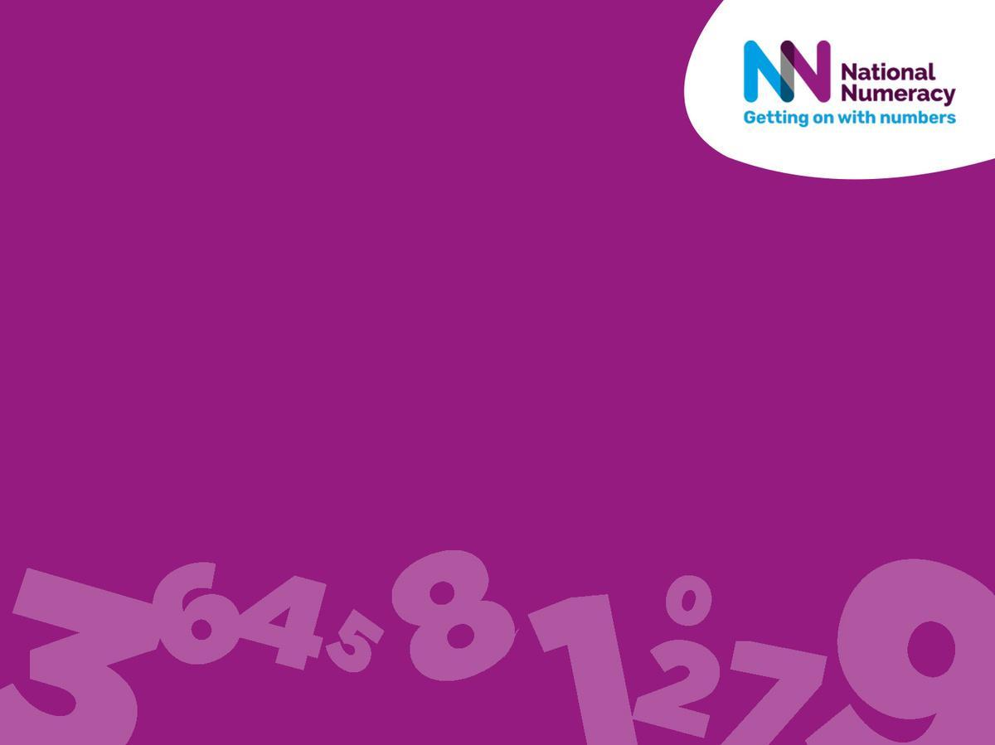
Maths in my life outside work
nationalnumeracy.org.uk
Notes:
Now I’m going to tell you about how I use maths in my life outside work

Slide 8
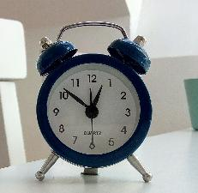
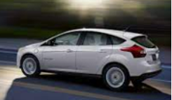
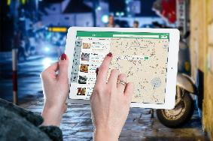
I use maths to get to places I need to be
For example, today…
What could have happened if I didn’t use maths today?
I had work out what time to wake up, giving myself enough time to take the dog on a walk before I left the house to start the journey to your school.
I did my research last night to find out that it will take me 20 minutes to drive here. So I left at 8:30am and allowed 10 minutes to park to ensure I wouldn’t be late and get told off by your teachers!
I also had to fill up my car with petrol, which added on some extra time. I had to use maths to subtract the estimated time of how long I’d spend at the petrol station from the original time I was going to leave. I also had to make sure I had enough money on my card to afford the petrol!
I also had to use directions to get here – so maths really is everywhere, and sometimes you use it without realising!
nationalnumeracy.org.uk
Notes:
Give some examples of how you used maths already today. Please amend as relevant.
We will add some photos that reflect your examples.

Slide 9
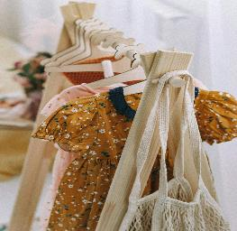
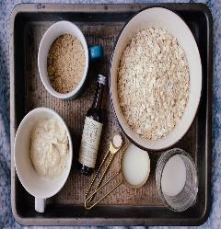
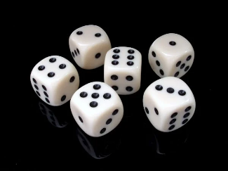
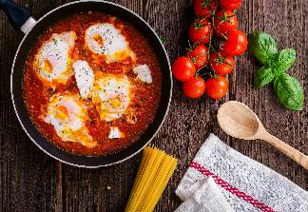
Maths in my life outside work
I use maths in a lot of my hobbies and everyday life!
Does anybody want to ask me anything about how I use maths outside of work?
Baking is one of my favourite hobbies, but to do it right, you have to have the correct amount of ingredients. This might mean being able to successfully do conversations between different measurements.
I must budget and set monthly allowances on how much I can spend on clothes. I also need to be able to add up the prices of the items when I’m there to make sure I’m not exceeding this number. If my allowance is £40 and I’ve got two items that are £25, I’ve spent too much!
I love playing board games with my family, and when you play a game where you have multiple dice, you will need to be able to work out the sum of the 2 numbers shown on the dice to know how many spaces to move!
I also need to budget for doing the food shop, making sure I have enough money to get food to last a week to feed my family full of hungry growing children!
nationalnumeracy.org.uk
Notes:
Give 2 or 3 examples of ways you use maths in your everyday life outside of work – eg. things that involve timings, measuring, money – and explain a little bit about the maths involved. There are some more ideas in the slide 10 notes.
We will add some photos that reflect your examples. If you have photos that you’re happy to share of you doing your hobby please do add!
Stop for questions after giving your examples.

Slide 10
Let’s see how some other people use maths - can you spot any examples they give that I haven’t?
I will embed the Everyday Maths video in here before sending over to the school as you may have trouble opening this template with the embedded video in it.
This is the You Tube link https://youtu.be/KDnjSlyaFjc, for your information. Some schools block You Tube and embedding it makes it easier to play. You just need to click play.
nationalnumeracy.org.uk
Notes:
Say ‘let’s see how some other people use maths’ – look out for examples they give that I haven’t
After the video you could ask the children to put their hand up if they spotted any new ways people use maths?

Slide 11
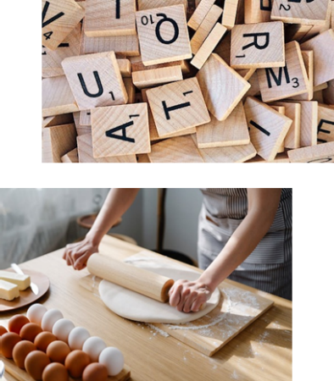
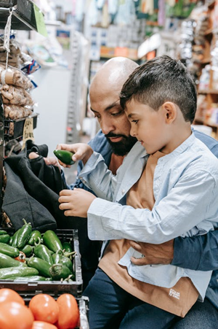
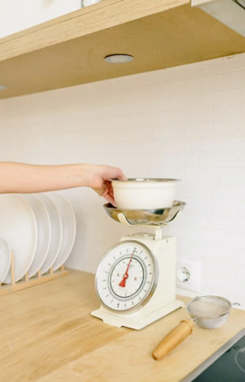

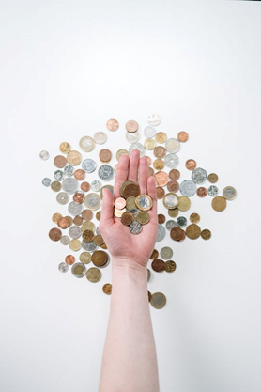

Who can think of some more ways that you use maths or numbers outside of school?
nationalnumeracy.org.uk
Notes:
Ask the children to give you examples of where they use maths in their life outside of school. Hear from at least 3 or 4 children if possible.
If they are stuck, ask them if they ever do things like cooking or shopping or playing football. Where do they think there are numbers involved in things like that? We’ve included some ideas below.
Football
Understanding time, using the 90-minute game-time
Understanding distances on the pitch
Recognising shapes on the pitch
Using the league table to work out how many points a team might need to win the league
Probability in a cup draw
Looking at statistics – e.g. possession percentages
Baking/Cooking
Using complex timings to ensure everything is ready at the right time
Weighing and measuring ingredients
Understanding recipes
Multiplying ingredients to bake products for the right number of people
Board games
Keeping score in Scrabble
Using money in Monopoly – knowing when to buy a property and if you can afford it
Understanding probabilities – what are the chances you would roll a double?
Using coordinates in Battleships
Swimming
Using time to measure how fast you can go
Using distance to understand lengths and widths to achieve your badges
Estimating to set your targets
Making sure you get to the gala on time with enough time to get changed
How long do you allow to prepare for the race?
Music
Counting beats and keeping time
Understanding fractions used to indicate lengths of notes
Planning and scheduling rehearsals
Planning how many songs can be played at a show

Slide 12
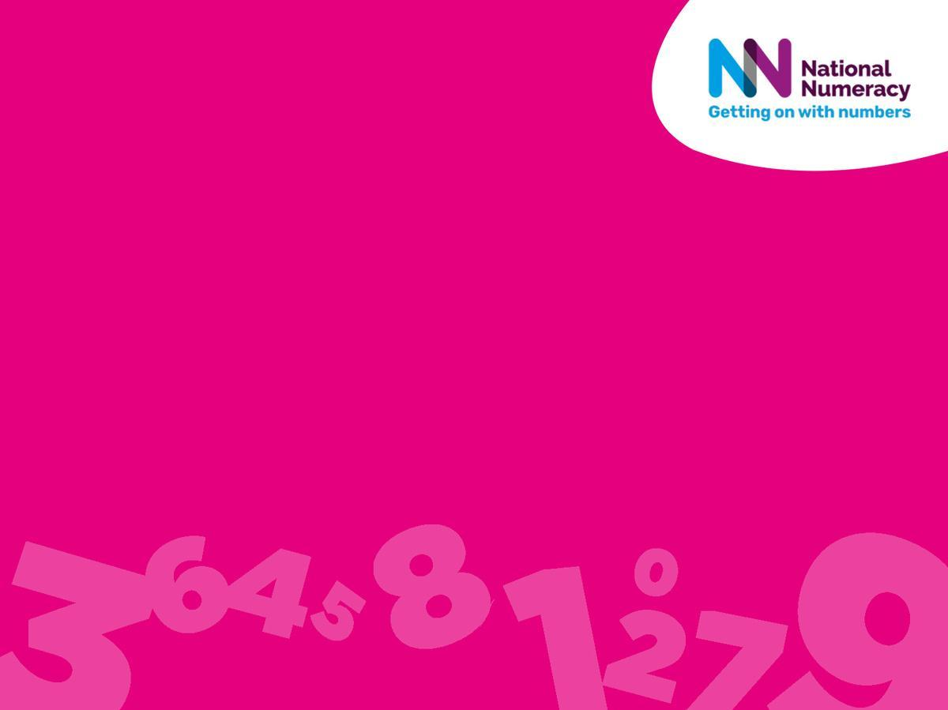
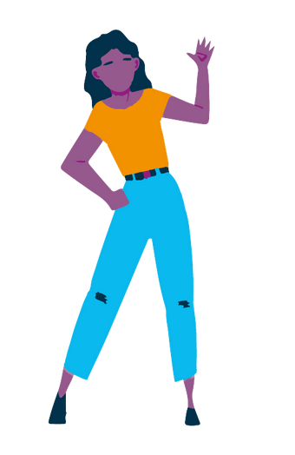
Thank you!
Any questions?
Notes:
You could ask if anyone has any other questions about your job, hobby or maths.
If there are still many questions you could say ‘that’s all we have time for now but your teachers can send me any questions you still have’.
Thank them for listening well and asking lots of interesting questions.

