Slide 1



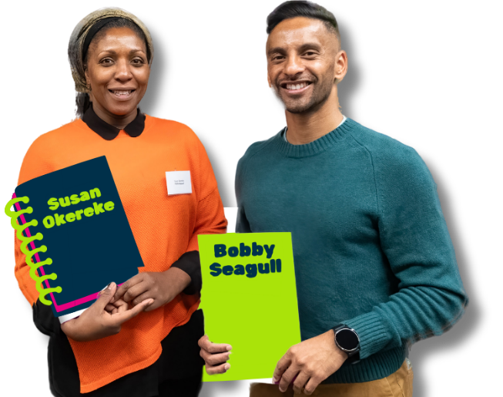

National Numeracy Day KS1/ 5-7 Years
By Bobby Seagull & Susan Okereke from the Maths Appeal podcast

Slide 2
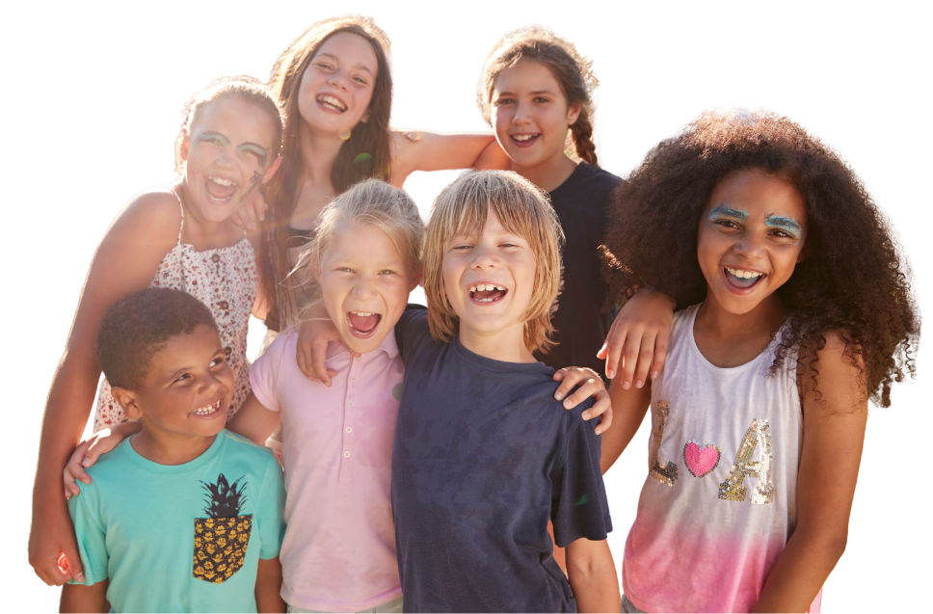
Your school is putting on a summer fete and your class is helping to organise it
What is a fete?
Why put on a fete?
Who is coming?
How do we invite them?
What else?
Notes:
Think, pair, share activity
Discuss fete introduction questions
What is a fete? It's a giant school party!
Who is coming? Everyone! (Students, parents, neighbours).
How do we invite them? Posters, social media or a giant countdown clock.
What other things do we need to thing about when putting on this event? Budget, dates, timings, space for activities, etc.

Slide 3
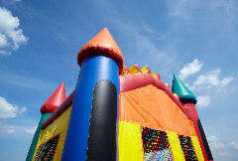
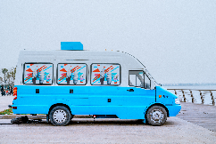
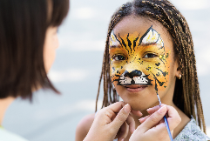
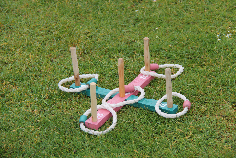

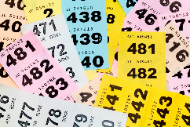
Starter Task – Fete Activity Ideas
Item | Cost
Bouncy Castle | £50
Ice Cream Van | £30
Face Painting | £15
Hoopla Game | £10
Music/DJ | £25
Raffle Prizes | £20
Task
Work in small groups to purchase the best fete activities
There is £100 available
Each group must choose a combination that adds up to a maximum of £100
Give reasons for your choices
Notes:
Additional discussion points
How could the school generate income from the fete?
What other activities would students like for the fete?

Slide 4
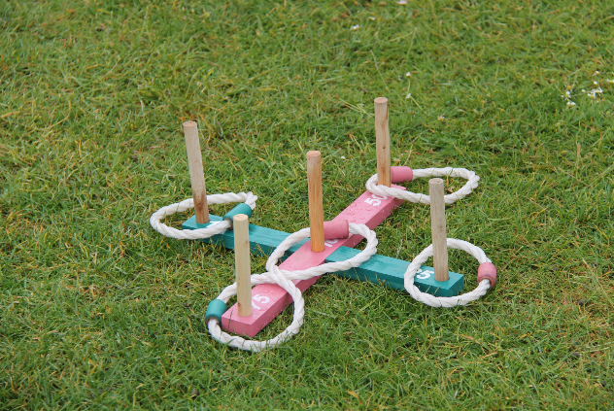
Task 2 – Hoopla Game
Your class is in charge of games at the summer fete. One activity will be the Hoopla game.
Hoopla game instructions
This is the classic carnival game where you throw rings to win prizes.
Place 6 poles on a table, typically 4–5 feet from a throwing line
1, 2, 5 or 10 points available
Each player gets 4 hoops per go
Aim to win points that add up to prizes
Notes:
Has anyone played a Hoopla game before?

Slide 5
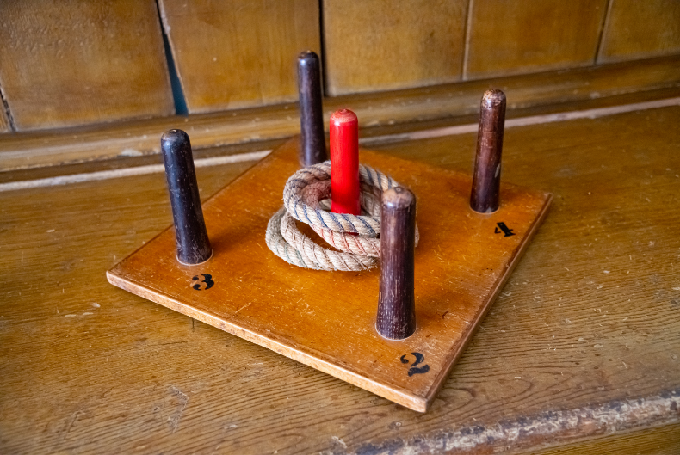
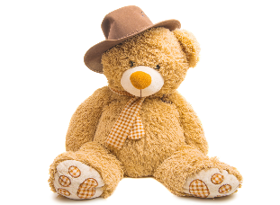
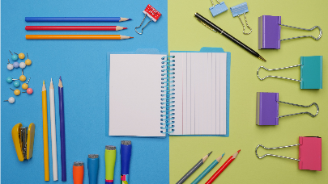
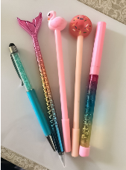
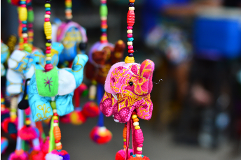

List of prizes 4 throws (you don’t have to use all 4 throws):
Points | Item
40 points | large cuddly stuffed toy
20 points | stationery set
15 points | fun pen
10 points | keyring
6 points | bookmark
1
10
2
5
1

Slide 6
Hoopla Maths Questions
What is the highest score you can get?
What is the lowest score you can get?
How many different ways can you get 10 points?
How many different ways can you get 20 points?
You really want the bookmark. You have thrown a 2 on your first throw. List the different ways you get the remaining points you need to win the bookmark.
You really want a fun pen. You have thrown a 5 on your first throw. List the different ways you can get the remaining points you need to win the fun pen.
Can you find all the different ways to win the different prizes?
Notes:
Ways to use slide
- print as a worksheet
- Mini-white boards to answer questions

Slide 7
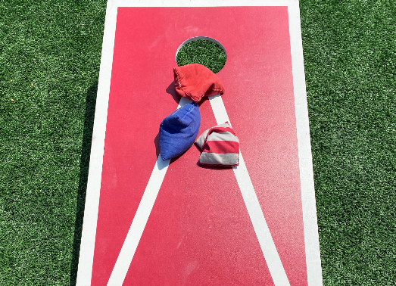
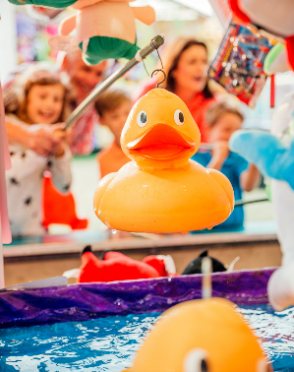
Task 3 – Design your own summer fete game
The Summer Fete is coming, and we need your help to design a brand-new game! Your mission is to create a game that is fun to play, helps people practice their maths, and gives them a chance to win a prize.
Step 1: Choose Your Game Idea
Think of a game where people have to throw, catch, or move something. Here are some ideas to get you started:
Beanbag Toss: Throw beanbags into buckets with different numbers on them.
Hook-a-Duck: Pick ducks out of a pool with numbers hidden on the bottom.

Slide 8
Task 3 – Design your own summer fete game
The Summer Fete is coming, and we need your help to design a brand-new game! Your mission is to create a game that is fun to play, helps people practice their maths, and gives them a chance to win a prize.
Step 2: Add the Maths!
Your game needs to use numbers. Think about how players will win:
Adding Up: Do they have to add the scores of two beanbags together? (e.g., 5 + 3 = 8).
Target Numbers: Do they need to hit an Even number or an Odd number to win?
Greater Than: Does their score need to be higher than 10 to get a prize?

Slide 9
Task 3 – Design your own summer fete game
The Summer Fete is coming, and we need your help to design a brand-new game! Your mission is to create a game that is fun to play, helps people practice their maths, and gives them a chance to win a prize.
Step 3: Pick the Prizes
Decide what people win for different scores.
Small prize: A sticker for a score between 1 and 5.
Big prize: A sweet or a small toy for a score over 10!

Slide 10
Your Design Sheet
On your paper, draw a picture of your game and answer these questions:
Name of the game: (What is it called?)
How to play: (Explain the rules in 3 simple steps).
The Maths Rule: (How do you work out the score?)
Equipment: (What items do you need? e.g., 3 hoops, 2 balls, a timer).
Remember: Make it colourful and exciting so people want to play!
Notes:
Teachers
- How would you like students to present their designs to the class - as a poster or a short presentation?

Slide 11
Summer Fete Game Planning Sheet
Game ideas | Add the Maths | Pick the Prize
Notes:
Optional ‘Summer Fete Game planning Sheet’ template to support students plan their game
- sheet can be edited

Slide 12
Summer Fete Game Design Sheet
Name of Summer Fete Game:
Draw a picture of your game | How to Play Game | Maths Rules
 |  | Equipment
Notes:
Optional ‘Summer Fete Game Design Sheet’ template to support students layout their work
- sheet can be edited

Slide 13
Task 3 – Design your own summer fete game
The Summer Fete is coming, and we need your help to design a brand-new game! Your mission is to create a game that is fun to play, helps people practice their maths, and gives them a chance to win a prize.
Step 1: Choose Your Game Idea
Think of a game where people have to throw, catch, or move something. Here are some ideas to get you started:
Beanbag Toss: Throw beanbags into buckets with different numbers on them.
Hook-a-Duck: Pick ducks out of a pool with numbers hidden on the bottom.
Step 2: Add the Maths!
Your game needs to use numbers. Think about how players will win:
Adding Up: Do they have to add the scores of two beanbags together? (e.g., 5 + 3 = 8).
Target Numbers: Do they need to hit an Even number or an Odd number to win?
Greater Than: Does their score need to be higher than 10 to get a prize?
Step 3: Pick the Prizes
Decide what people win for different scores.
Small prize: A sticker for a score between 1 and 5.
Big prize: A sweet or a small toy for a score over 10!

