Slide 1



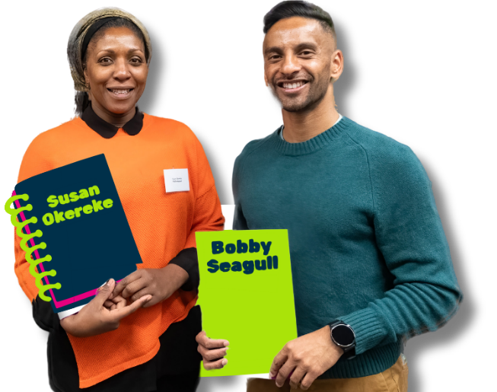

National Numeracy Day KS2/ 7-11 Years
By Bobby Seagull & Susan Okereke from the Maths Appeal podcast

Slide 2
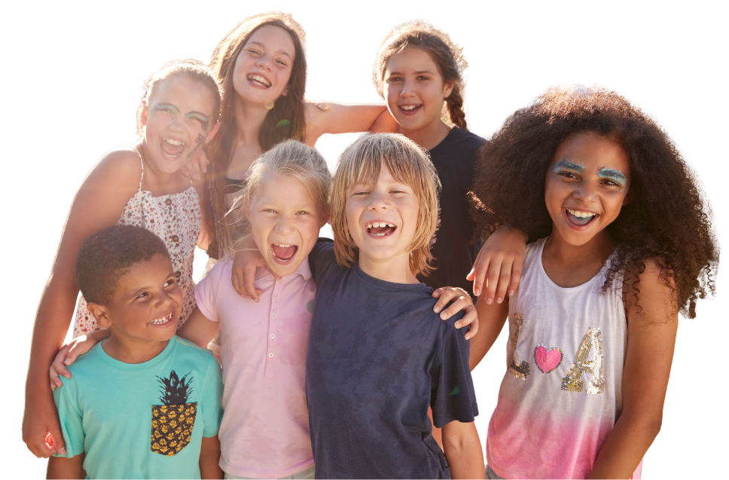
Your school is putting on a summer fete and your class is helping to organise it
What is a fete?
Why put on a fete?
Who is coming?
How do we invite them?
What else?
Notes:
Think, pair, share activity
Discuss fete introduction questions
What is a fete? It's a giant school party!
Who is coming? Everyone! (Students, parents, neighbours).
How do we invite them? Posters, social media or a giant countdown clock.
What other things do we need to thing about when putting on this event? Budget, dates, timings, space for activities, etc.

Slide 3
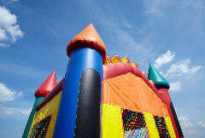
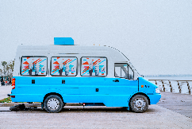
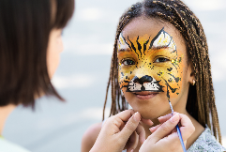
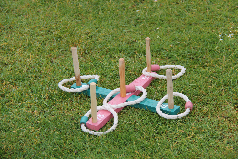
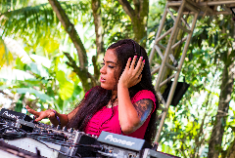
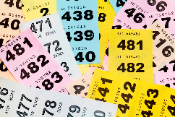
Task 1 – Fete Activity Ideas
Item | Cost
Bouncy Castle | £50
Ice Cream Van | £30
Face Painting | £15
Hoopla Game | £10
Music/DJ | £25
Raffle Prizes | £20
Task
Work in small groups to purchase the best fete activities
There is £100 available
Each group must choose a combination that adds up to a maximum of £100
Give reasons for your choices
Notes:
Additional discussion points
How could the school generate income from the fete?
What other activities would students like for the fete?

Slide 4
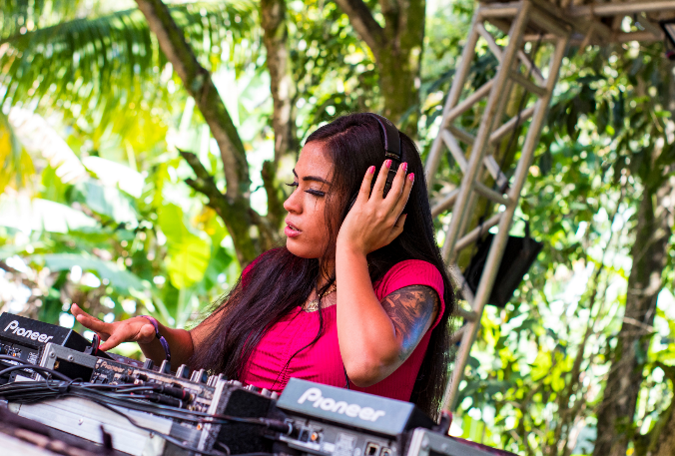

Task 2 – The DJ Battle: Beat the Budget
Your class is in charge of music and hiring the DJ for the summer fete.
What things do you need to think about when planning to book a DJ?
Notes:
This activity, "The DJ Battle: Beat the Budget," turns the hiring process into a fast-paced game of logic, addition, and time-telling.

Slide 5
Task 2 – The DJ Battle: Beat the Budget
Your class is in charge of music and hiring the DJ for the summer fete.
DJ fee
Budget
What things do you need to think about when planning to book a DJ?
Ways to make money
Event times
Technology & equipment
Playlist
Break times
Notes:
Did you get all the things suggested?
Did you think of things that were not suggested?

Slide 6
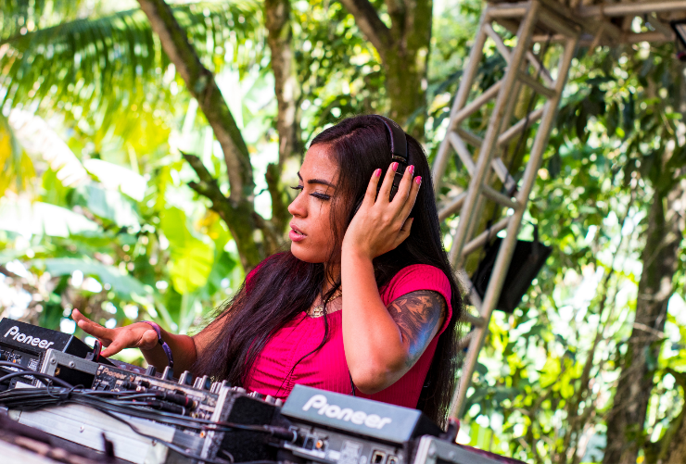
Task 2 – The DJ Battle: Beat the Budget
Your class is in charge of music and hiring the DJ for the summer fete.
Summer Fete Information:
The fete lasts 3 hours (1:00 PM to 4:00 PM).
You have £150 to hire a DJ for the Summer Fete.
You need to pick the best DJ without running out of money!
Notes:
This activity, "The DJ Battle: Beat the Budget," turns the hiring process into a fast-paced game of logic, addition, and time-telling.

Slide 7
DJ Pricing Information
DJ "Flat-Fee" Freddie:
Mix-Master Martha:
Shuffle Sam:
Cost: £140 for the whole afternoon.
Exclusive Bonus for this DJ:
Karaoke machine, customers pay £1 to the fete (not DJ) to sing a song.
Cost: £10 for every 15 minutes he plays.
Exclusive Bonus for this DJ: She plays all the latest hits.
Cost: £45 per hour.
Exclusive Bonus for this DJ:
Customers pay 50p to the fete (not the DJ) for each individual song request
Summer Fete Information:
The fete lasts 3 hours (1:00 PM to 4:00 PM)
You have £150 to hire a DJ for the Summer Fete.

Slide 8

Working Out Table: The DJ Battle
Calculate the cost of each DJ for the 3-hour fete. Which is cheapest? Which is most expensive?
DJ Names | DJ Cost
DJ "Flat-Fee" Freddie
Mix-Master Martha
Shuffle Sam:
Notes:
Optional ‘working out’ table to support students layout their working out
Can be edited

Slide 9

Task 3 – Scenario Cards
Now you’re going to practice managing ‘unknowns’, those surprise changes like last-minute discounts or bad weather. You will explore how these unknowns can change your total budget and help you pick the best deal.
Activity
Pick a Scenario Card and work out the new DJ costs
How does the New DJ cost compare to the Original DJ cost?
Pick another Scenario Card and repeat the process
Then as a group decide which DJ the school should hire.

Slide 10
Scenario cards – The DJ Battle: Beat the Budget
The ‘One more song!’
Song Request sales
The party is so good that the Headteacher asks the DJ to stay for an extra 30 minutes. | There are 26 people interested in making song requests at the fete.
There are 15 people interested in doing karaoke at the fete. | You booked the DJ six months ago, so they give you a 10% discount
A passing rainstorm means the fete is cut short by an hour. So you get a 50% refund for the final hour the DJ is unable to play. | Make up your own scenario.
Karaoke Sales
The Early Bird
Weather warning
Make your own scenario
Notes:
Can this slide please be animated so that the yellow/orange rectangles disappear when they are clicked?
Suggestions on ways to use the Chance Cards
- Display on board and pick one to work through
- Cards can be cut out and handed to student groups
- Scenarios can be picked at random using the animated

Slide 11
Scenario cards – The DJ Battle: Beat the Budget
The party is so good that the Headteacher asks the DJ to stay for an extra 30 minutes. | There are 26 people interested in making song requests at the fete.
There are 15 people interested in doing karaoke at the fete. | You booked the DJ six months ago, so they give you a 10% discount
A passing rainstorm means the fete is cut short by an hour. So you get a 50% refund for the final hour the DJ is unable to play. | Make up your own scenario.
Notes:
Suggestions on ways to use the Scenario Cards
- Display on board and pick one to work through
- Cards can be cut out and handed to student groups
- Scenarios can be picked at random using the animated

Slide 12
Working Out Table – The DJ Battle
DJ Names | Original Cost | Scenario 1: | Scenario 2: | Scenario 3:
DJ "Flat-Fee" Freddie
Mix-Master Martha
Shuffle Sam:
Fill out the Original Cost column by working out how much each DJ will cost for the day of the summer fete
Work through the different scenarios on the Scenario Cards and work out the new DJ costs
Then as a group decide which DJ the school should hire.
Which DJ is the best value for each scenario?
Notes:
Optional ‘working out’ table to support students layout their working out
Can be edited

Slide 13

The DJ Battle - Class Vote
Based on your calculations, which DJ should the school hire?
You must justify your choice using a "Maths Reason”
What does the class think?

