Slide 1





National Numeracy Day KS3/ 11-14 Years
By Bobby Seagull & Susan Okereke from the Maths Appeal podcast

Slide 2
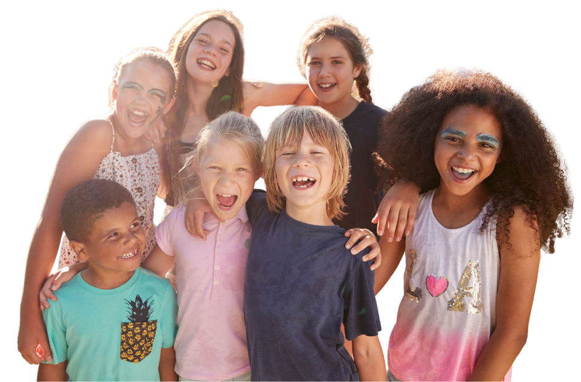
Your school is putting on a summer fete and your class is helping to organise it
What is a fete?
Why put on a fete?
Who is coming?
How do we invite them?
What else?
Notes:
Think, pair, share activity
Discuss fete introduction questions
What is a fete? It's a giant school party!
Who is coming? Everyone! (Students, parents, neighbours).
How do we invite them? Posters, social media or a giant countdown clock.
What other things do we need to thing about when putting on this event? Budget, dates, timings, space for activities, etc.

Slide 3
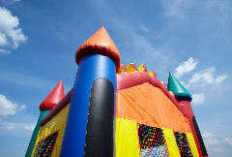
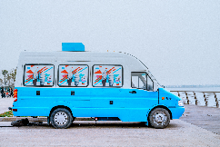
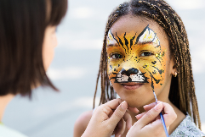
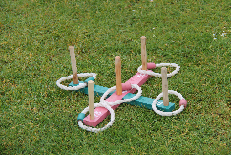
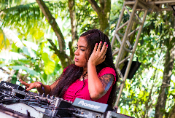
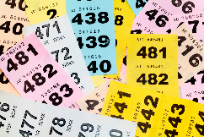
Starter Task – Fete Activity Ideas
Item | Cost
Bouncy Castle | £50
Ice Cream Van | £30
Face Painting | £15
Hoopla Game | £10
Music/DJ | £25
Raffle Prizes | £20
Task
Work in small groups to purchase the best fete activities
There is £100 available
Each group must choose a combination that adds up to a maximum of £100
Give reasons for your choices
Notes:
Additional discussion points
How could the school generate income from the fete?
What other activities would students like for the fete?

Slide 4
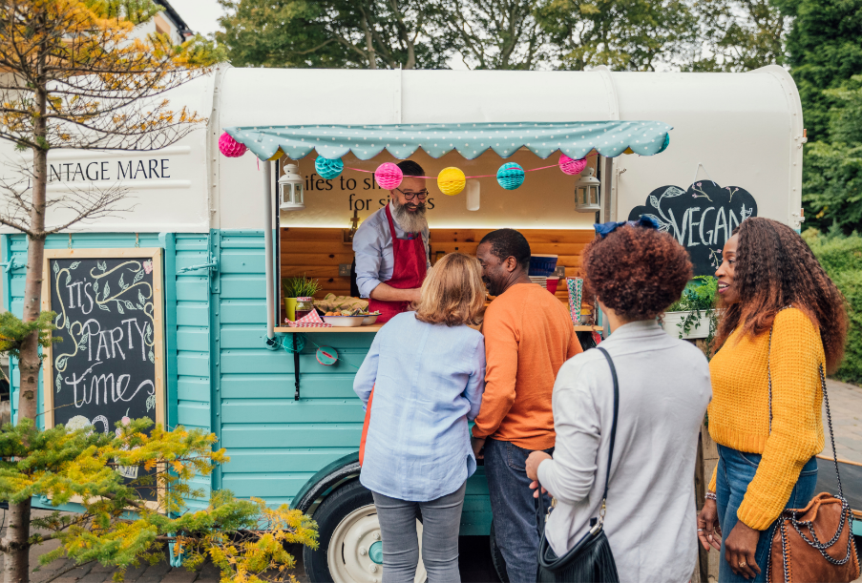
Task 2 – The Burger Boss Challenge
Your class is in charge of the food stall for the Summer Fete.
On the food stall you’ll be selling:
veggie burgers
ice cream
lemonade
Your goal isn't just to feed people - it’s to make as much money as possible for your school's new sports equipment.
Notes:
Did you get all the things suggested?
Did you think of things that were not suggested?

Slide 5


Task 2 – The Burger Boss Challenge
Your goal isn't just to feed people - it’s to make as much money as possible for your school's new sports equipment.
What information do we need to be able to plan for food stall?
Notes:
Did you get all the things suggested?
Did you think of things that were not suggested?

Slide 6
Task 2 – The Burger Boss Challenge
Your goal isn't just to feed people - it’s to make the biggest profit possible for the school's new sports equipment.
Cost of food supplies
Budget
What information do we need to be able to plan for food stall?
Potential number of attendees
Equipment needed
Spending habits
Notes:
Did you get all the things suggested?
Did you think of things that were not suggested?

Slide 7
Task 2 – The Burger Boss Challenge
Work in pairs or small groups as a catering business.
Your catering business needs to work out how many veggie burgers, ice creams and lemonades to buy to sell at the food stall.
The school is planning for 650 people to attend this year. Assuming that buying habits are the same as last year, how many:
Burgers
Ice creams
Lemonades
should the school stock to avoid buying too much or too little (affecting the overall potential profit).
Last year’s fete data
Buying Habits:
40% of people bought a veggie burgers
50% of people bought ice cream
60% of people bought lemonade
Use this information complete the
- Burger Boss budget tracker sheet
Notes:
Answers
If 650 people attend the fete based on last year’s data where:
40% of attendees bought veggie burger = 260 burgers needed
50% of attendees ice cream = 325 ice creams needed
60% of attendees bought drinks = 390 drinks needed

Slide 8
Task 2 – The Burger Boss Challenge – Table 1
Table 1 – Quantities of food and drink needed for Food Stall
How many people are the school expecting to attend the summer fete? _______________________________________
Now complete table 1 using the Last Year’s Buying Habits Data table.
Item | Unit Cost | Quantity | Total Cost (calculation)
Veggie Burger | £2.40
Ice cream | £0.80
Lemonade (per cup) | £0.15
 |  |  | Total Cost =
Notes:
Optional ‘working out’ table for ‘Initial profit prediction’ to support students layout their working out
Can be edited

Slide 9
Task 2 – The Burger Boss Challenge
Item | Unit Cost | Selling Price
Gourmet Veggie Burger | £2.40 | £5.50
Ice cream | £0.80 | £3.00
Lemonade (per cup) | £0.15 | £1.50
Unit Cost means the cost to make one item
Selling Price means the price the school is selling each item
Profit = income - costs
If 650 people attend the fete, based on last year’s buying habits data, use Table 2 to work out the potential profit with these prices.

Slide 10
Task 2 – The Burger Boss Challenge – Table 2
Profit = income - costs
How many people are the school expecting to attend the summer fete? _____________________________________________
Based on the quantities of food and drink that you worked out in Table 1, work out the potential profit the food stall could make using the prices given.
Assuming all the stock is sold on the day of the summer fete!
Item | Unit Cost | Quantity | Total Cost (calculation) | Selling Price | Quantity | Total Income (calculation) | Profit
Veggie Burger | £2.40 |  |  | £5.50
Ice cream | £0.80 |  |  | £3.00
Lemonade (per cup) | £0.15 |  |  | £1.50
 |  |  | Total Cost = |  |  | Total Income = | Total Income =
Notes:
Table 2 the ‘Initial profit prediction’ is to support students layout their working out
Input quantities worked out from The Burger Boss Challenge – Table 2
Work out Total costs for each food and drink item
Work out Total Income for each food and drink item (This is a prediction assuming all the stock is sold on the day of the summer fete)
Work out the potential Profit for each food and drink item

Slide 11
Task 2 – The Burger Boss Challenge – Table 2
Profit = income - costs
How many people are the school expecting to attend the summer fete? _____________________________________________
Based on the quantities of food and drink that you worked out in Table 1, work out the potential profit the food stall could make using the prices given.
Assuming all the stock is sold on the day of the summer fete!
Item | Unit Cost | Quantity | Total Cost (calculation) | Selling Price | Quantity | Total Income (calculation) | Profit
Veggie Burger | £2.40 | 260 |  | £5.50 | 260
Ice cream | £0.80 | 325 |  | £3.00 | 325
Lemonade (per cup) | £0.15 | 390 |  | £1.50 | 390
 |  |  | Total Cost = |  |  | Total Income = | Total Income =
Notes:
Partially filled in Table 2 with quantities if 650 people attend the fete
Table 2 the ‘Initial profit prediction’ is to support students layout their working out

Slide 12
Task 3 – Scenario cards
When events are organised, there’s always some uncertainty, things don’t always go to plan!
In this task you’ll explore how different situations can affect how much money your food stall might make.
Instructions
Work in pairs or small groups.
Select a scenario card.
Read your scenario carefully.
Discuss: Will this increase profit, decrease profit, or have no effect? Why?
Work out what the potential profit is for each scenario.
Be ready to share your ideas with the class.
Notes:
Suggestions on ways to use the Scenario Cards
- Display on board and pick one to work through
- Cards can be cut out and handed to student groups
- Scenarios can be picked at random using the animated
- Slide can be edited
Ideally, model the activity with class before starting the group work

Slide 13
Scenario cards – The Burger Boss
Heatwave!
Eco-Friendly Tax
It’s 30°C! Drink sales double, ice cream sales up by 25% but nobody wants a hot burger. Burger sales drop by 50%. | The school council insists on compostable plates, which cost 15p more per person than plastic ones. Plates are needed for every veggie burger sold.
A local supermarket donates 100 burger ingredients for free. | The weather turns cloudy and cooler. Ice cream sales drop by 40%, but hot food sales (veggie burgers) increase by 20%.
A sudden downpour stops the fete for 1 hour. Total attendance drops from 650 to 500 people. | Make up your own scenario.
Bulk Buy Bonus
Cloudy weather
Rainy day
Make your own scenario
Notes:
Suggestions on ways to use the Scenario Cards
- Display on board and pick one to work through
- Cards can be cut out and handed to student groups
- Scenarios can be picked at random using the animated
- Slide can be edited

Slide 14
Scenario cards – The Burger Boss
It’s 30°C! Drink sales double, ice cream sales up by 25% but nobody wants a hot burger. Burger sales drop by 50%. | The school council insists on compostable plates, which cost 15p more per person than plastic ones. Plates are needed for every veggie burger sold.
A local supermarket donates 100 burger ingredients for free. | The weather turns cloudy and cooler. Ice cream sales drop by 40%, but hot food sales (veggie burgers) increase by 20%.
A sudden downpour stops the fete for 1 hour. Total attendance drops from 650 to 500 people. | Make up your own scenario.
Notes:
Suggestions on ways to use the Scenario Cards
- Display on board and pick one to work through
- Cards can be cut out and handed to student groups
- Scenarios can be picked at random using the animated
- Slide can be edited

Slide 15
The Burger Boss Challenge – Table 3
Profit = income - costs
How many people are the school expecting to attend the summer fete? _____________________________________________
Based on the quantities of food and drink that you worked out in Table 1, work out the potential profit the food stall could make using the prices given.
Which Scenario Card is the best case scenario for the summer fete’s food hall?
Table 3 – profit prediction based on last year’s buying habits
Scenario Card title: ________________________________________________________________________
Assuming all the stock is sold on the day of the summer fete!
Item | Unit Cost | Quantity | Total Cost (calculation) | Selling Price | Quantity | Total Income (calculation) | Profit
Veggie Burger | £2.40 |  |  | £5.50
Ice cream | £0.80 |  |  | £3.00
Lemonade (per cup) | £0.15 |  |  | £1.50
 |  |  | Total Cost = |  |  | Total Income = | Total Income =
Notes:
Table 3 the ‘Scenario Card - profit prediction’ is to support students layout their working out
(This sheet can only be used for one scenario at a time)
Look at the quantities worked out from The Burger Boss Challenge – Table 2 – Work out how the Scenario Card information changes these quantities, then input information into table
Work out Total costs for each food and drink item
Work out Total Income for each food and drink item (This is a prediction assuming all the stock is sold on the day of the summer fete)
Work out the potential Profit for each food and drink item

Slide 16
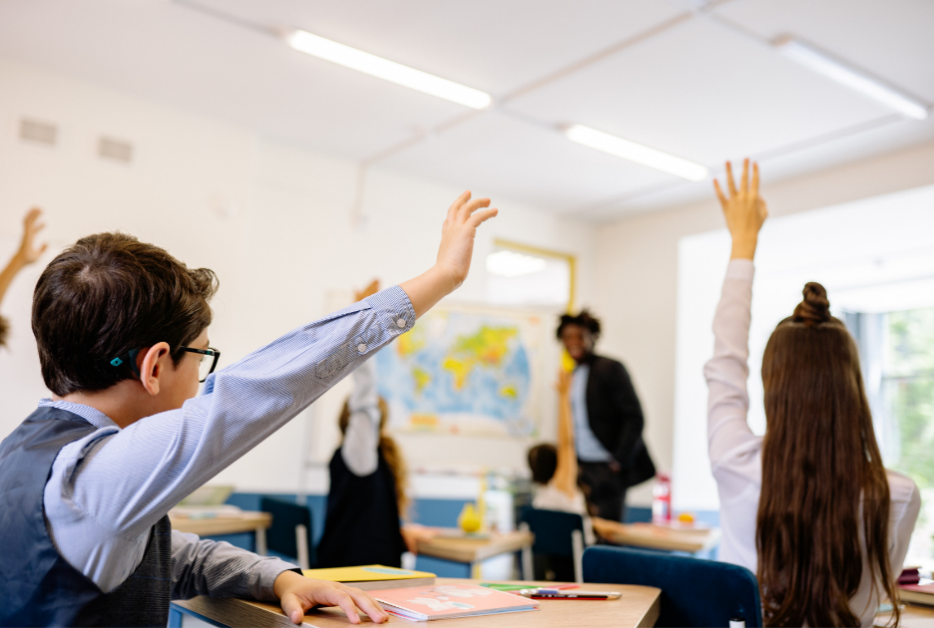
Best Case Scenario - Class Vote
Based on your group’s calculations, which Scenario Card gives the best case scenario for the summer fete’s food hall?
You must justify your choice using a "Maths Reason”
What does the class think?

Slide 17
Potential Profits for each scenario
Scenario Card Title: ___________________ ___________________ Potential Profit: ___________________ | Scenario Card Title: ___________________ ___________________ Potential Profit: ___________________ | Scenario Card Title: ___________________ ___________________ Potential Profit: ___________________
Scenario Card Title: ___________________ ___________________ Potential Profit: ___________________ | Scenario Card Title: ___________________ ___________________ Potential Profit: ___________________ | Scenario Card Title: ___________________ ___________________ Potential Profit: ___________________
Planned attendance:
_________ People
Initial Profit Prediction based on Last Year’s Buying Habits:
£_________________
Notes:
(Optional Slide)
- Can be used to collate the Potential Profits for each Scenario Card worked out by different groups in clss

Slide 18
Potential Profits for each scenario
Scenario Card Title: Heatwave! ___________________ Potential Profit: __£2349.20___________ | Scenario Card Title: Ecofriendly tax ___________________ Potential Profit: ___£2008.50 _______ | Scenario Card Title: Bulk buy bonus ___________________ Potential Profit: __£526.50 _________
Scenario Card Title: Cloudy weather ___________________ Potential Profit: ___£1911.71 ________ | Scenario Card Title: Rainy Day ___________________ Potential Profit: ____£1575 _________ | Scenario Card Title: ___________________ ___________________ Potential Profit: ___________________
Planned attendance:
__650___ People
Initial Profit Prediction based on Last Year’s Buying Habits:
£__2047.50______
Notes:
Solution Slide

