Slide 1
National Numeracy Day Lesson Plan for secondary schools
By Bobby Seagull & Susan Okereke from the Maths Appeal podcast

Slide 2
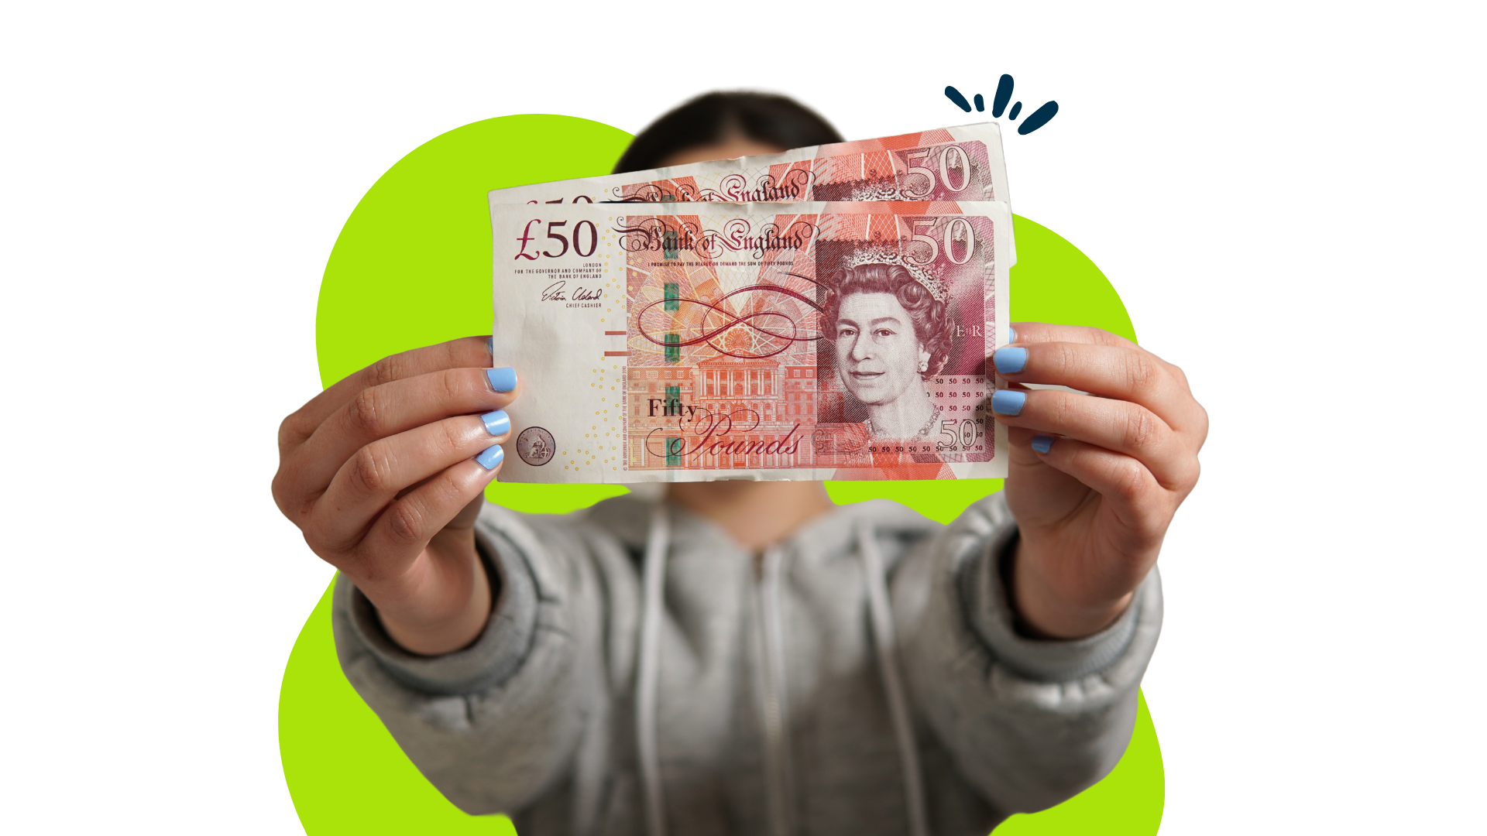
Starter Task
If you were given £100 what would you do with it and why?
Notes:
Think, pair, share activity
Discuss ‘needs’ vs ‘wants’
Needs are things that we require to survive and thrive. Our basic needs include food, water, clothing and shelter. Health care and education are also important needs.
Wants are things that we would like to have and might improve our life, but that we could live without.

Slide 3
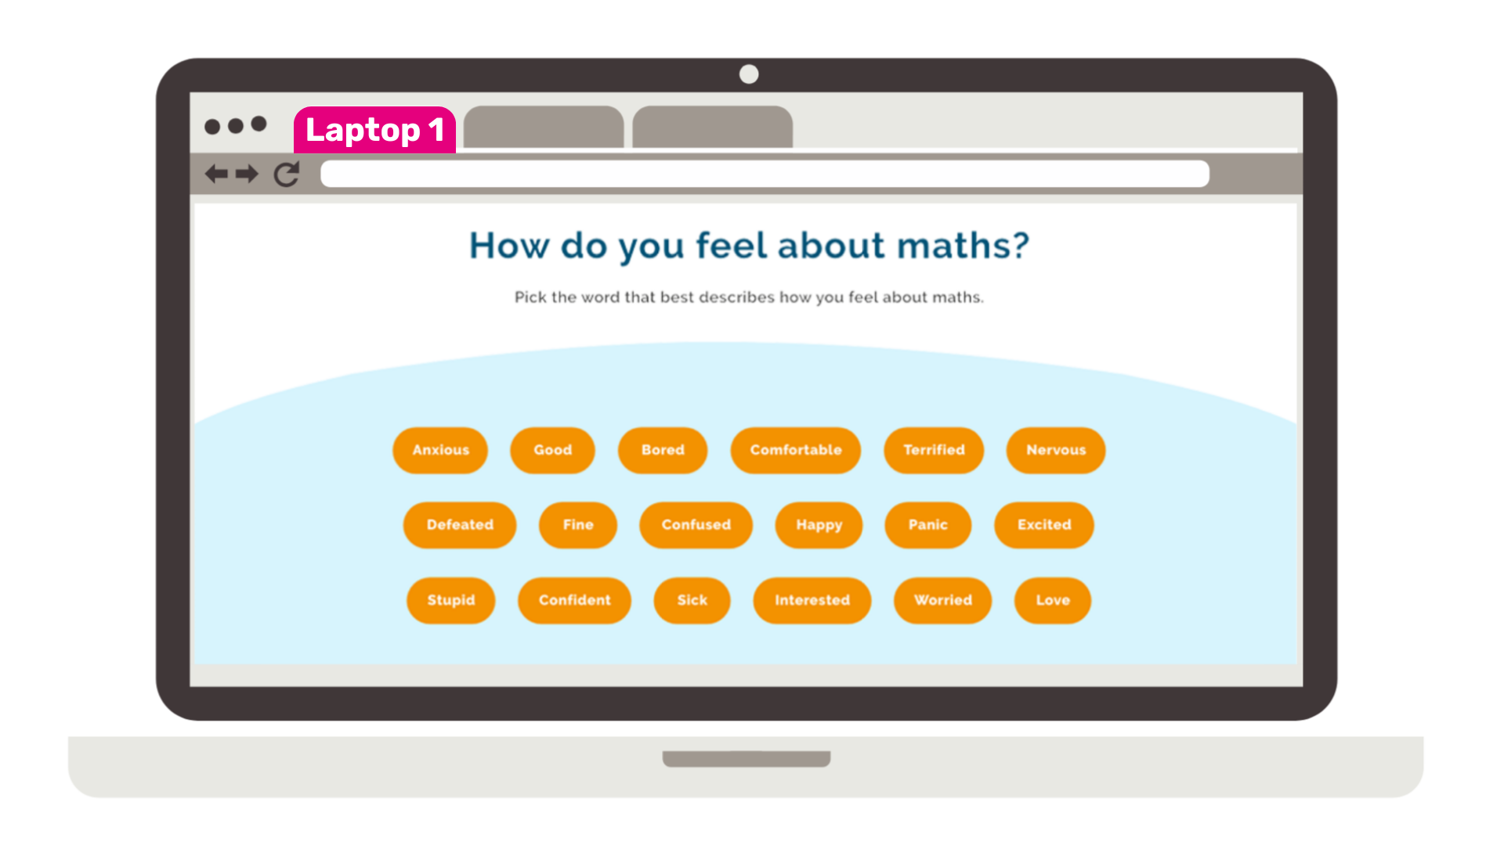
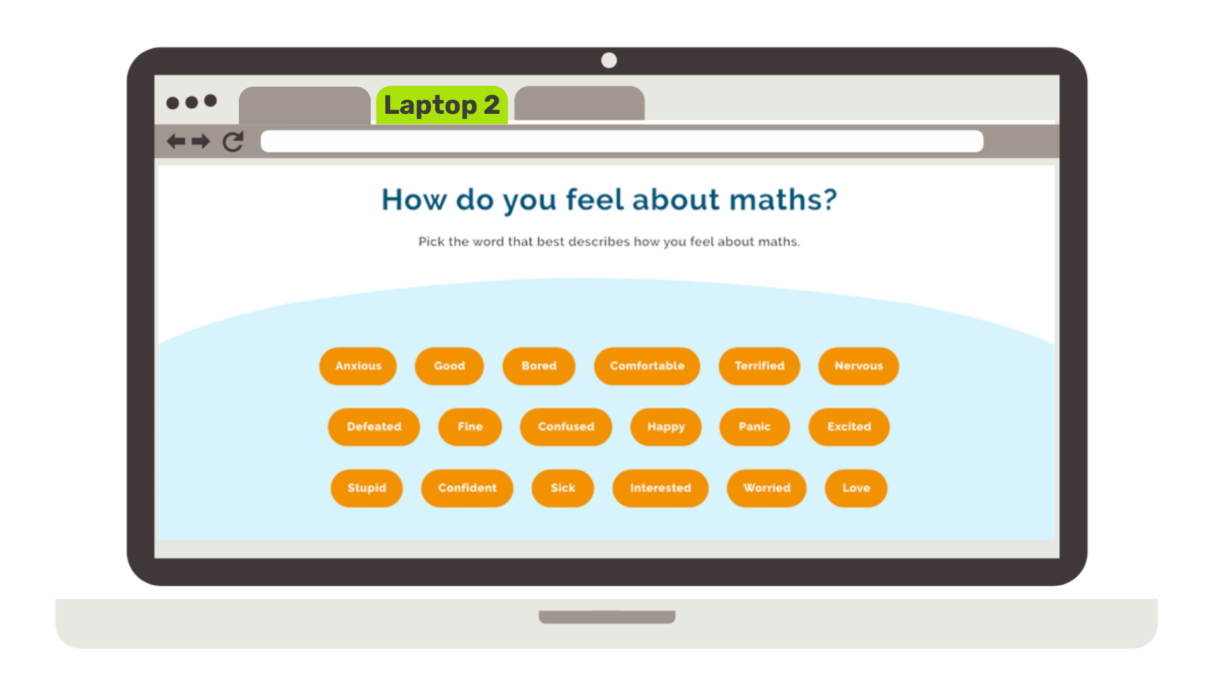
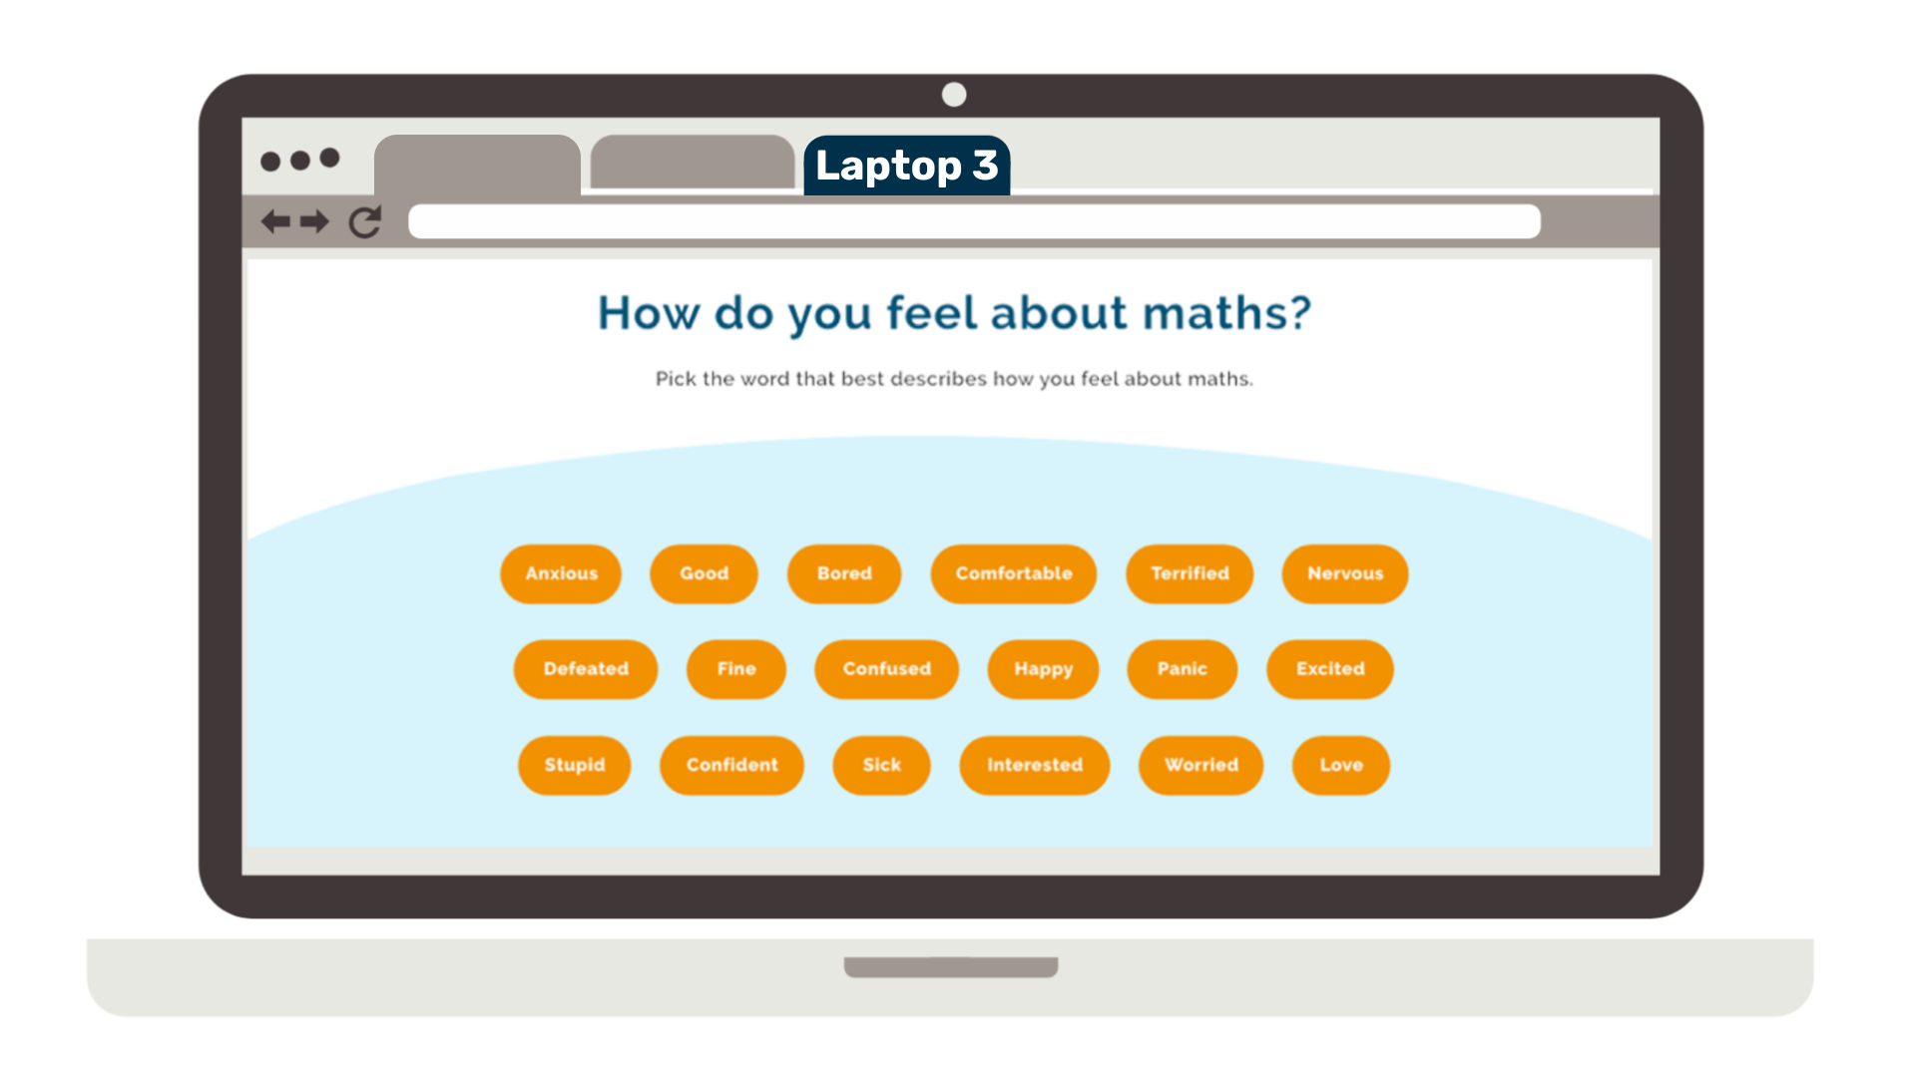
Task 2
Which laptop?
Laptop 1 – low range
Laptop 2 – mid range
Laptop 3 – high range
£180
£650
£1340

Slide 4
Task 2
Savannah needs a laptop for a training course she will be starting in a few months.
She earns a wage of £490 a week.
She decides to put aside 10% of their weekly wage to save for the laptop.

Slide 5
Keywords
Deposit
Instalments
part of the cost of an item that the buyer pays upfront
a small sum of money, paid at regular intervals, until the full price of an item is paid

Slide 6
Task 3
Laptop 2 – mid range
£650
Which Deal?
Shop A
Shop B
Shop C
TechNova Outlet
VoltZone Electronics
Circuit Mart
Spread the cost of the laptop with 20 equal weekly payments
Pay 10% deposit
Then 5 equal monthly instalments
Pay 12% deposit
Then 16 equal weekly instalments

Slide 7
Working Out Table
Cost of laptop =
 | Shop A TechNova Outlet | Shop B VoltZone Electronics | Shop C Circuit Mart
Deposit
Instalment deal
Calculation
Time to pay for laptop
Notes:
Optional ‘working out’ table to support students layout their working out
Can be edited

