Slide 1
THE BIG
NUMBER NATTER
Join the conversation

Slide 2
WHAT IS THE BIG NUMBER NATTER?
WHAT?
WHY?
WHEN?
The Big Number Natter is the UK’s only nationwide conversation about numbers.
It’s an opportunity to talk about how we feel about maths, and love it or loathe it, everyone has something to say!
You won’t be doing any maths in this session – it’s a chance to share your own thoughts and experiences. It’s okay to be honest about how you feel.
Because half of the UK’s working-age adults have the numeracy levels of a primary school child.
This can hold people back in different areas of their life and makes them more vulnerable to things like debt, unemployment, poor health and fraud. It can also make some things harder to deal with, like the rising cost of living.
But everyone can improve their numeracy, and talking about numbers is a fantastic first step to boosting number skills and confidence!
National Numeracy Day on Wednesday 22 May, or anytime throughout May.
The Big Number Natter runs throughout the month of May and is part of the charity National Numeracy’s annual campaign to build brighter futures through confidence with numbers.
Notes:
Notes for facilitator: This slide explains what The Big Number Natter is and why we are taking part.

Slide 3
NUMERACY IN THE UK
The issue
Millions of people leave school lacking number confidence
49%
30%
of working age adults have the numeracy skills expected of children at primary school.
of school leavers (18-24s) feel anxious about using maths and numbers. They are the most
maths-anxious adult group in the UK.
Notes:
Notes for facilitator: This slide reveals a bit about numeracy across the whole of the UK. You can see that a huge proportion of the adult population struggles with numbers and that maths anxiety can often start at school.

Slide 4
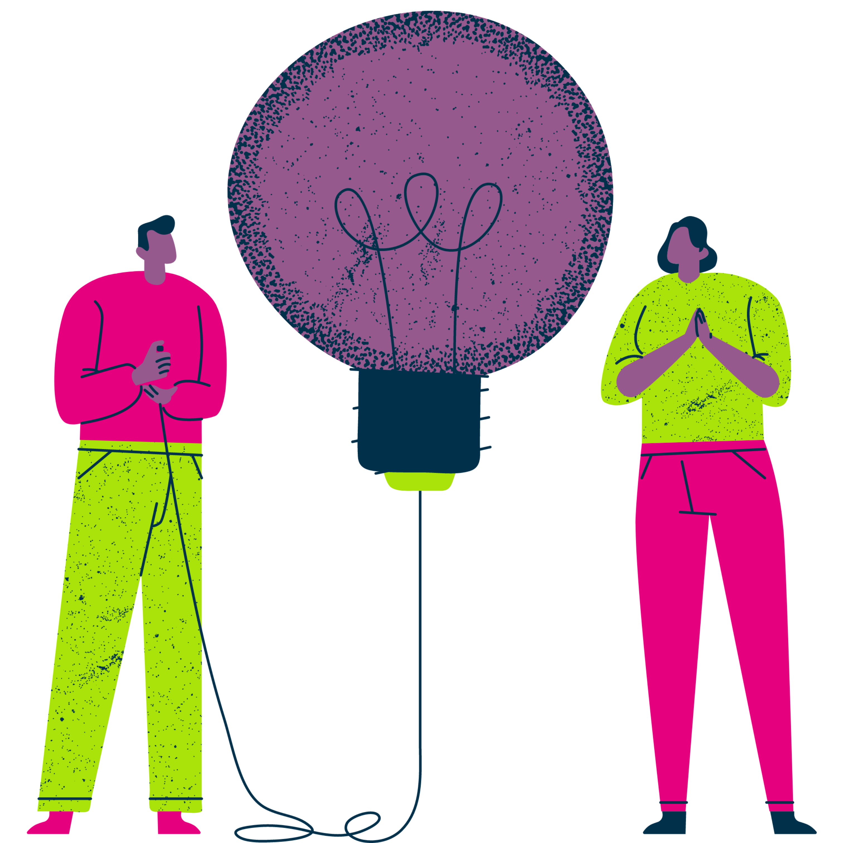
HOW DO YOU FEEL ABOUT MATHS?
Share your thoughts:
Share one word that describes how you feel about maths – positive or negative.
You can write it down on paper.
Take it in turns to share your words – can you pinpoint why you feel that way?
Think about the words you just heard from others – which ones stood out?
Where do these feelings come from?
What experiences can impact our feelings about numbers?
Remember:
Listen to what others have to say.
Everybody’s thoughts are valid, whether they are positive or negative about numbers.
Be patient and kind.
Notes:
Notes for facilitator: Now it’s your turn. Follow the instructions on the slide to get the conversation going. Encourage quieter people to contribute anonymously using pen and paper.

Slide 5
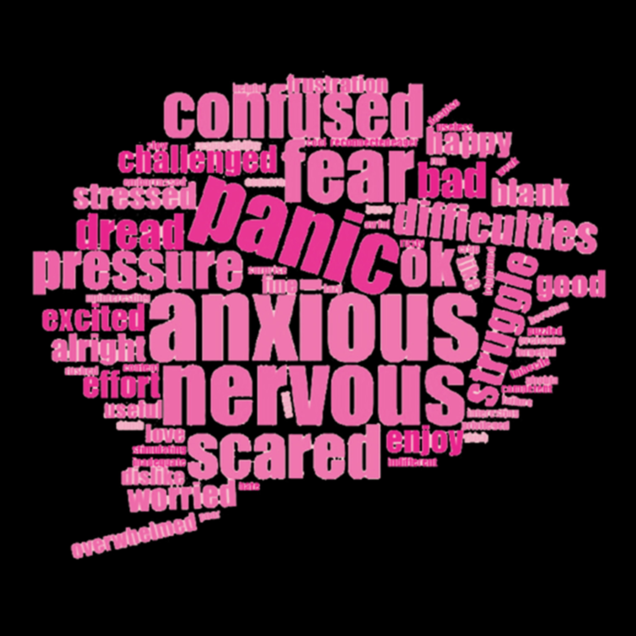
HOW DO YOU FEEL ABOUT MATHS?
Many people respond to this question by telling us that they feel negatively about maths. This could be from a bad experience when they were younger or feeling under pressure from others.
Some might have been told they’re “not a numbers person” or might not have known where to get support.
Remember:
However you feel about maths, you’re not alone.
Feeling a certain way about maths is not the same as being bad at maths.
No matter how you feel right now, you can always build your number confidence and skills.
Notes:
Notes for facilitator: Often, people responding to this question feel negatively about maths – some of the reasons are listed above.
However you feel about numbers, it’s important to remember you’re not alone and you can change the way you feel by taking small steps to improving your numeracy skills and confidence.

Slide 6
MATHS ANXIETY AND DYSCALCULIA
Maths anxiety is thought to affect a large proportion of the population. It has been defined as “the panic, helplessness, paralysis, and mental disorganisation that arises among some people when they are required to solve a mathematical problem.”*
Dyscalculia is often described as ‘dyslexia of numbers’ – it’s a cognitive impairment affecting the understanding of numbers. It’s estimated that 3% of the population have dyscalculia – that’s more than 2 million people.
Plus, 60% of people with dyslexia – 3 million people - have maths learning difficulties too. It’s a lot of people, and we’re in this together!
*Tobias and Weissbrod (1980)
Notes:
Notes for facilitator: This slide talks about some specific challenges around numbers and maths that affect a lot of people in the UK.
A lot of people suffer from maths anxiety – when maths makes people feel panicked. Others have dyscalculia – often described as ‘dyslexia of maths’.

Slide 7
FOCUSED TOPICS

Slide 8
TOPIC: USING NUMBERS IN EVERYDAY LIFE
How do you use numbers and maths in everyday life? Maybe you play sports, help with household tasks, or have a part-time job.
In collaboration with the whole group, list all the different ways you use numbers in everyday life.
Think outside of the box – it might not look or feel like maths.
Examples might include:
Planning journeys or trips
Cooking and baking
Shopping
Arts and crafts
Budgeting and saving
Sports and exercise
How confident do you feel about using numbers in this way?
Share your thoughts and experiences with the group.
Notes:
Notes for facilitator:
This is an important conversation to help us understand that we all use numbers every day, outside of the classroom, often without even thinking about it.
At the end of the conversation, reflect on how many different ways people use maths and numbers in their everyday life. It’s important for everyone to recognise that numeracy is an essential life skill.
If anyone feels that they would benefit from boosting their number confidence to help them at home, they can visit the National Numeracy Day hub or try the National Numeracy Challenge (information at the end of this deck).

Slide 9
TOPIC: USING NUMBERS AT SCHOOL
How do you use maths at school? Think of as many examples as you can where you use maths at school and write them down.
Examples might include:
Time: following your schedule, planning journeys
Shape, space and measure: doing science experiments, creating art, or playing sports
Data: discussing dates, times and statistics in history classes
How does using maths at school make you feel?
Share your thoughts and experiences with the group.
Notes:
Notes for facilitator:
Open up a conversation about using numbers at school.
At the end of the conversation, reflect on how everyone uses numbers in all different school subjects in one way or another.
Remind everyone that ability is not fixed – everyone can improve their numeracy and feel more confident about maths.

Slide 10
TOPIC: GENERAL CONFIDENCE AND SKILLS BUILDING
Improving your numeracy is no different to building up your confidence to learn any other skill.
Thinking about the following questions, please share your experiences:
What is something you struggled to learn at first?
How did it make you feel?
What steps did you take to overcome difficulties?
Did you get there in the end?
Why did/didn’t you give up?
Notes:
Notes for facilitator: Get the group to think about confidence and skills building more generally by answering these questions. Think about experiences like sports or games, learning to play an instrument, baking or cooking… whatever it is, we all need to build up our confidence and skills over time when doing something we’re not comfortable or familiar with.

Slide 11
NEXT STEPS

Slide 12
7 TIPS FOR FEELING GOOD ABOUT NUMBERS
However you feel, you’re not alone.
Have a go and stick with it. You might find that the way you feel about maths changes over time.
Keep practising and your confidence and skills can grow.
Find a comfortable space to be in, without distractions.
It’s ok to be honest at school and at home about how you feel.
Challenge your own beliefs.
Try not to compare yourself to others.
Take your time.
Notes:
Notes for facilitator: Share these top tips and encourage your students to visit the National Numeracy Day website for more resources, information and support.

Slide 13
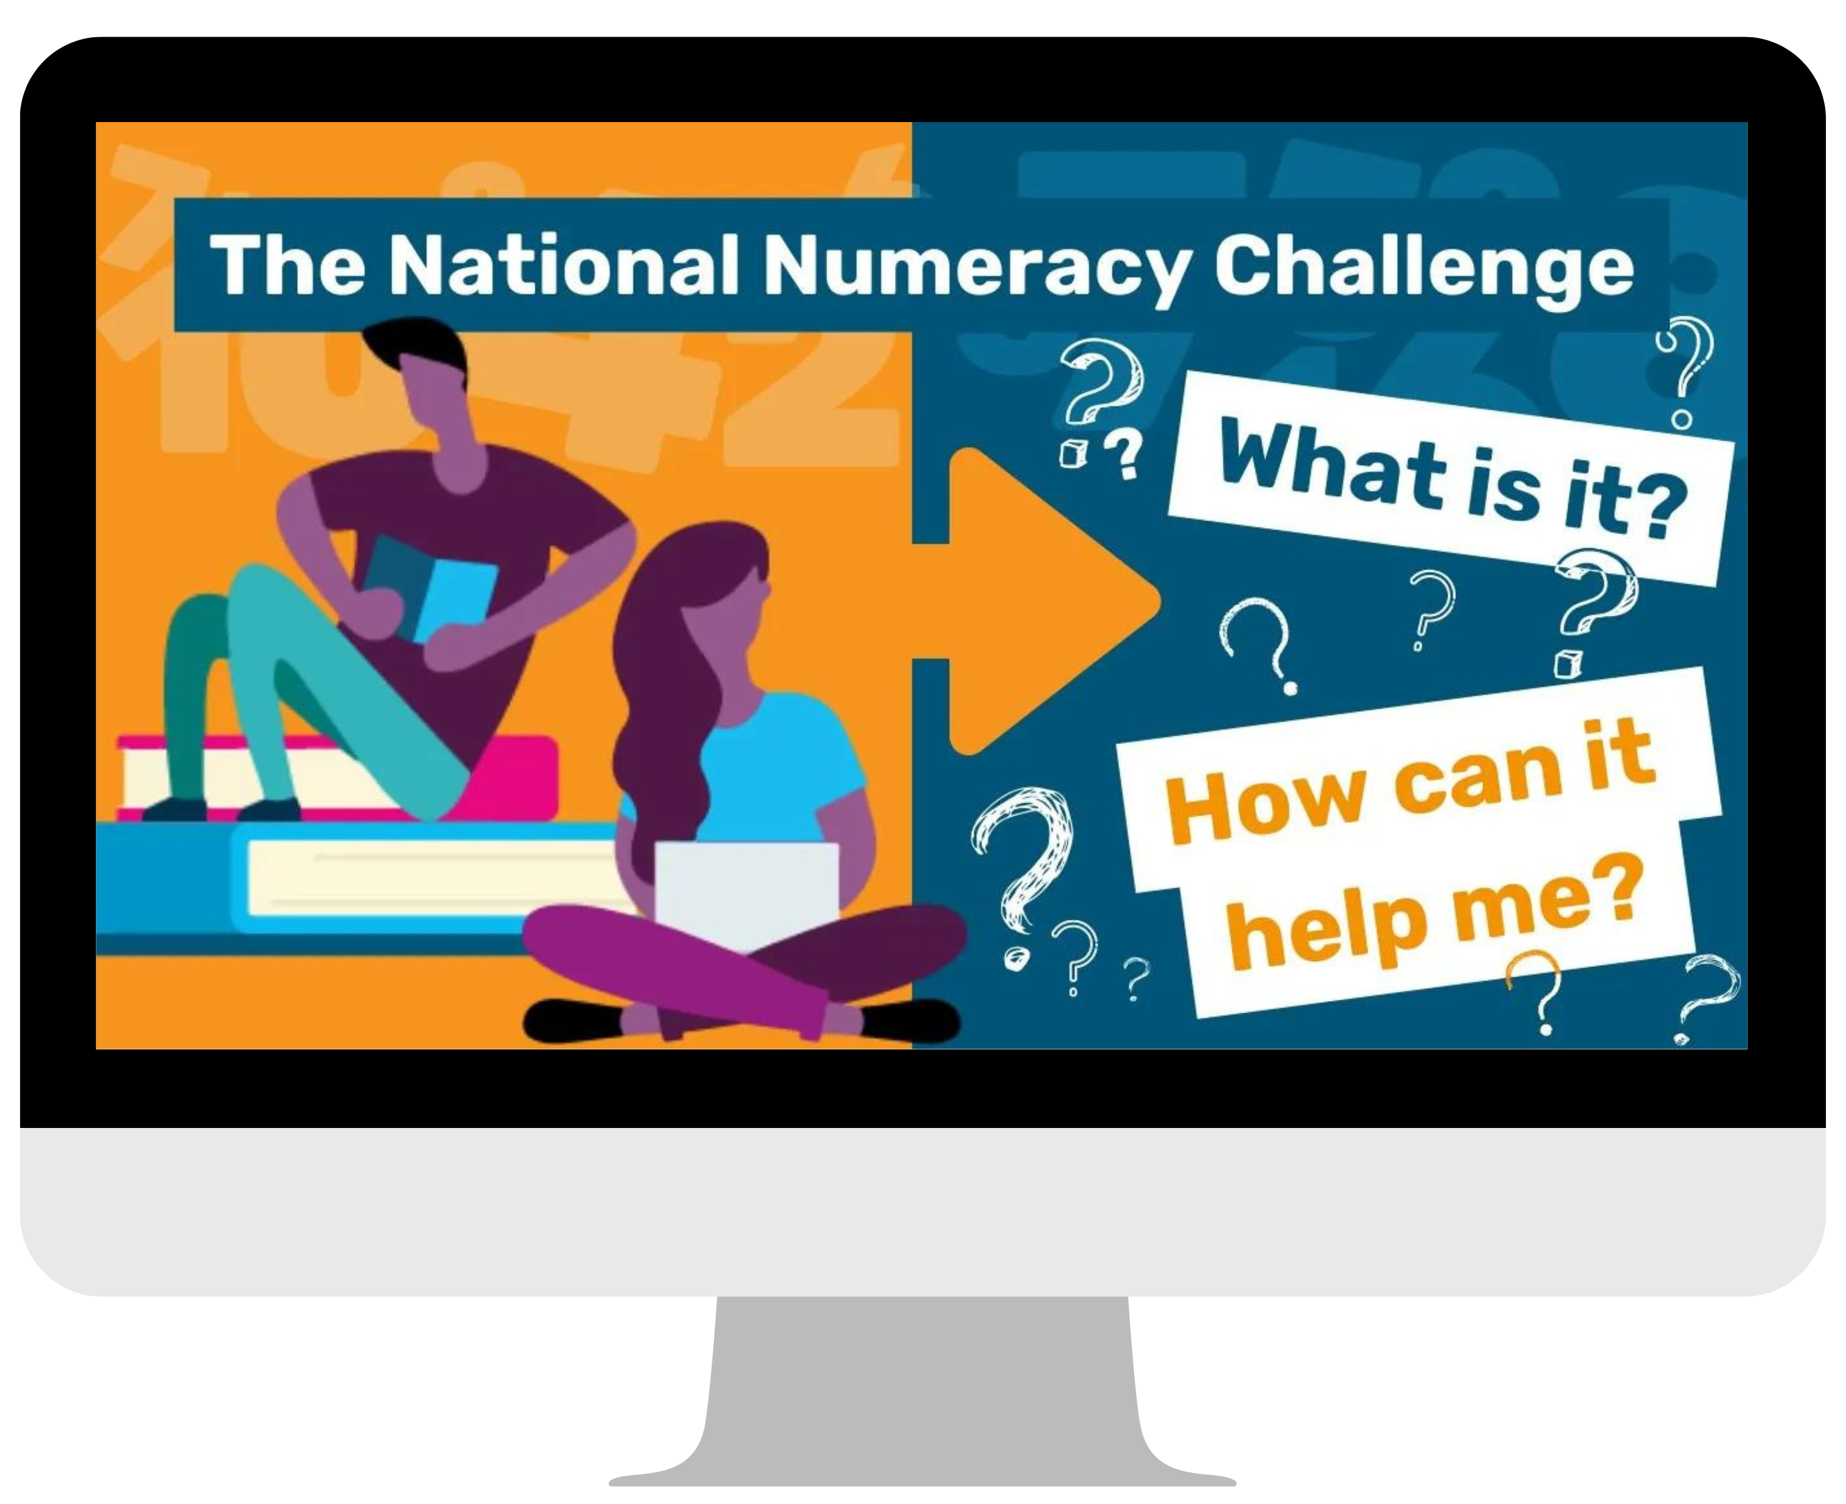
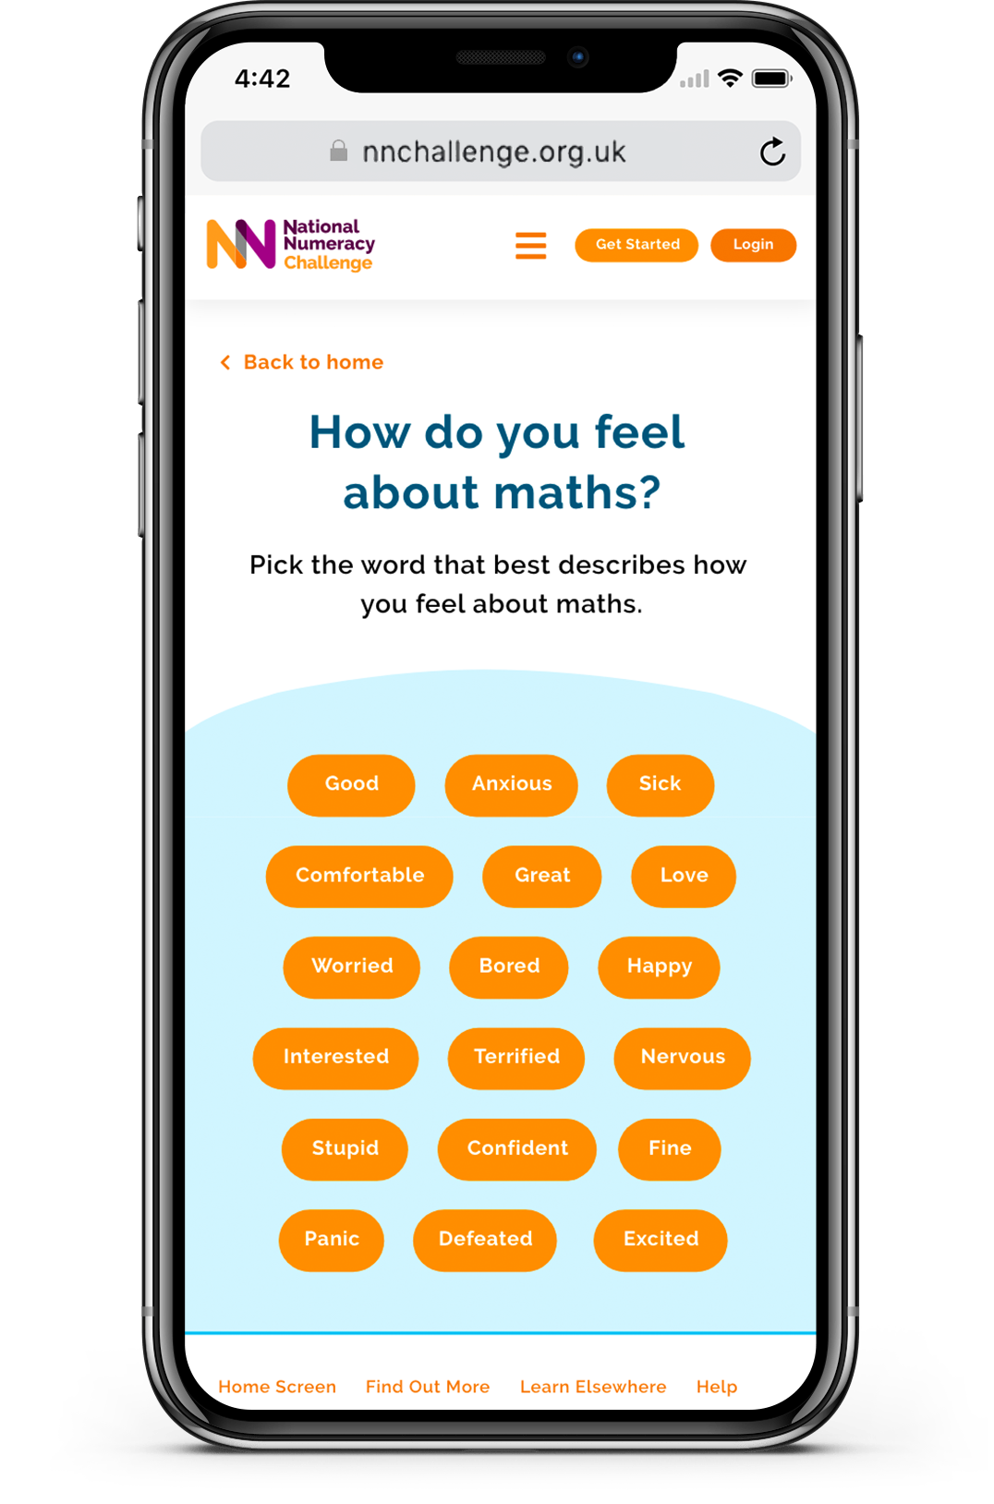
IMPROVE YOUR NUMERACY
Visit the National Numeracy Day hub to get lots of free and useful resources for children and adults.
Try the National Numeracy Challenge – a free online tool where you can check your numeracy skills using any device, at your own pace. Start improving in just 10 minutes, anytime, anywhere.
Watch this video to find out how the Challenge can help you!
Notes:
Notes for facilitator: Encourage your students to access National Numeracy Day resources, including videos and activity sheets, and encourage them to have a go at the National Numeracy Challenge – a free, online tool that helps people aged 13+ to boost their number skills and confidence at their own pace.

Slide 14
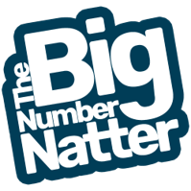
JOIN THE WIDER CONVERSATION
Whether you’re chatting about how maths makes you feel, or nattering about all the ways you use numbers in your favourite subject or hobby, we want to hear it!
At school: Create a space where everyone can share how they feel, to show others that they’re not alone. If your school has social media accounts, why not share some examples online using photos or videos? Share them with us using #BigNumberNatter
At home: Keep number nattering with your family…ask them how they feel about numbers, what their experiences were when they were younger, and how they use numbers in their everyday lives.
Notes:
Notes for facilitator: Encourage people to continue the conversation in different ways.

Slide 15
THANK YOU FOR TAKING PART

