Slide 1
TIME TO TALK NUMBERS SLIDE DECK
Number Confidence Week

Slide 2
ABOUT THIS SESSION
Number Confidence Week runs from Monday 6 to Friday 10 November and is part of the charity National Numeracy’s annual campaign to encourage the nation to get more comfortable and confident with numbers.
What? This session is an opportunity to chat about how you feel about maths. Love it or hate it, we all have something to say! There are no calculations in the session, just chance to share your thoughts and experiences. It's ok to be honest – good or bad.
Why? 49% of the UK’s adults have the numeracy skills expected of a primary school child. This holds people back in multiple areas of their life and makes challenges like the current cost-of-living crisis even tougher to face. But everyone can improve their numeracy and talking about numbers is a fantastic first step.
Notes:
Notes to facilitator:
Use this slide to set the scene – introduce Number Confidence Week, your session and why it’s important

Slide 3
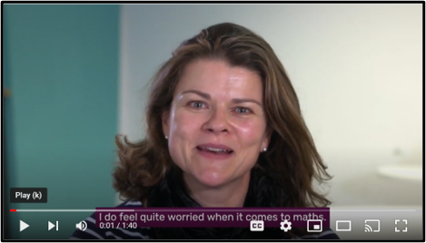
HOW DO OTHER PEOPLE FEEL ABOUT MATHS?
This video features people talking about how they feel about maths. Let’s start by listening to them – just click on the picture or this link.
Notes:
Notes for facilitator:
Start the session by sharing the video
Share the link to our hub after the session, for anyone who’d like to hear more from other people

Slide 4
HOW DO YOU FEEL ABOUT MATHS?
Now it’s your turn to share your thoughts…
Share one word that describes how you feel about numbers and maths – positive or negative.
You can share it out loud, write it down on paper or share it in an online chat.
Take it in turns to share your words – can you pinpoint why you feel that way?
Think about the words you just heard from others – which ones stood out?
Where do these feelings come from? What experiences can impact our feelings about numbers?
Remember: Listen to what others have to say – everyone’s thoughts are valid, whether they are positive or negative. Be patient and kind when others share their experiences.
Notes:
Notes for facilitator:
Ask the group to share their thoughts and feelings and follow the instructions on the slide to get the conversation going.
You’ll likely find that some participants feel anxious or fearful of numbers, whilst some will have had more positive experiences. It can be useful to reflect on past experiences, helping people to see that ‘natural ability’ is not something that shapes our feelings, but the experiences we’ve had at school, home and work.
If people aren’t comfortable sharing openly, encourage them to contribute anonymously.
Remind people to be respectful of others’ feelings and experiences.

Slide 5
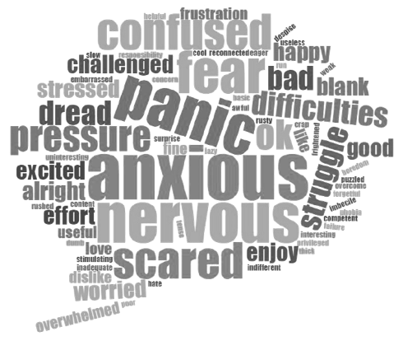
Many people respond to this question by telling us they feel negatively about maths. Sometimes they have bad experiences at school, or they feel under pressure from others or fear failure.
Some people might have been told they’re “not a numbers person” or haven’t known where to get support.
Remember:
However you feel about maths, you are not alone.
Feeling a certain way about maths is not the same as being bad at maths.
No matter how you feel right now, you can always build your number confidence and skills.
Notes:
Notes for facilitator:
This word cloud shows how many other people respond to the question ‘How do you feel about maths?’
The largest words are those shared most often. This demonstrates that many people responding to this question feel negatively about maths – some of the reasons are listed above.
Remind people that however they feel, they are not alone. And they can improve the way they feel by taking small steps to build their confidence with numbers.
At the end of the conversation, acknowledge that many people feel worried, afraid or dislike maths – this is not unusual, but you can find ways to help you feel better about numbers.

Slide 6
FOCUSED TOPICS
Notes:
Notes for facilitator:
If you’re hosting a longer session or are focusing on a specific audience group, use the next few slides to open up the conversation about a focused topic.
If hosting the session in person, you could ask participants to record ideas on post it notes and display them.
If hosting the session virtually, you could use the chat function or set up a virtual whiteboard where everyone can share their ideas.

Slide 7
TOPIC: USING NUMBERS AT WORK
How do you use maths in your job? Think of as many examples as you can where you use maths in your job and write them down. Examples might include:
Time: scheduling meetings and appointments, managing shift rotas, annual leave
Money: handling money, managing budgets
Data: tracking stock levels, analysing and presenting data, setting targets
How does using maths at work make you feel? Share your thoughts and experiences with the group.
Notes:
Notes for facilitator:
Open up a conversation about using numbers at work – whether it’s in a current job or a future role.
If you are holding the conversation within an organisation, then participants who do similar jobs may be able to work together. If you are in a setting where participants have different careers, then you may wish to share some general ideas from the list below.
At the end of the conversation, reflect on how everyone uses numbers in their job in one way or another.
Remind everyone that: ability is not fixed – everyone can improve their numeracy; maths we use in the real world is different from the maths we learned at school; and it doesn’t mean you’re bad at maths if you don’t have a qualification.

Slide 8
TOPIC: USING NUMBERS IN EVERYDAY LIFE
How do you use numbers and maths in everyday life? From managing our bills and budgeting, to completing household tasks and helping our kids with homework.
Think of as many examples as you can where you use maths in everyday life and write them down. Examples might include:
Planning journeys or trips
Cooking and baking
Shopping
DIY
Budgeting and saving
How confident do you feel about using numbers in this way? Share your thoughts and experiences with the group.
Notes:
Notes for facilitator:
This is an important conversation to help adults move away from the idea that ‘I haven’t done any maths since school.’ We all use numbers every day, often without evening thinking about it.
At the end of the conversation, reflect on how many different ways people use maths and numbers in their everyday life. It’s important for everyone to recognise that numeracy is an essential life skill.
If anyone feels that they would benefit from boosting their number confidence to help them at home, they can visit our Number Confidence Week hub and try the National Numeracy Challenge (information at the end of this deck).

Slide 9
TOPIC: MYTH BUSTING
Myth #1: Everybody uses maths every day, whether they think about it or not
Myth #2: Learning maths as an adult would be just like going back to school
Myth #3: Some people are maths people, others are not
Myth #4: You don’t need maths if you have a calculator
Myth#5: Everyone can improve their maths with the right support
For participants:
Make your vote by stating true/false or agree/disagree
Expand on your thinking by sharing with the group
For facilitators:
Reveal the myth statement
Share the Myth Busters worksheet with participants after the session
Notes:
Notes for facilitator: Use the Myth Buster cards in your Engagement Pack to facilitate this conversation – it’s a great way to get people talking during small sessions or at in-person events.
Present each myth statement one at a time
Ask participants to share whether they agree or disagree with the statement. At in person events, participants could share their thoughts by a raising their hands or standing at different ends of the room. For virtual events, participants could write ‘true’ or ‘false’ in the chat or use an online poll
Give participants the opportunity to share why they agree or disagree with the statement. They will likely refer to their own experiences of maths.
Read our the ‘true’ or ‘false’ statement on the back of the myth buster card
Share the Myth Busters worksheet with participants after the session

Slide 10
TOPIC: GENERAL CONFIDENCE AND SKILLS BUILDING
Improving your numeracy is no different to building up your confidence to learn any other skill.
Thinking about the following questions, please share your experiences:
What is something you struggled to learn at first?
How did it make you feel?
What steps did you take to overcome difficulties?
Did you get there in the end?
Why did/didn’t you give up?
Notes:
Notes for facilitator: Get the group to think about confidence and skills building more generally by answering these questions. Think about experiences like learning to drive, riding a bike, learning to knit, trying a new sport, class or activity… whatever it is, we all have to build up our confidence and skills over time when doing something we’re not comfortable or familiar with.

Slide 11
NEXT STEPS
Notes:
Notes for facilitator: The next few slides include information on what steps participants can take next to build number confidence and improve their numeracy.

Slide 12
7 TIPS FOR FEELING GOOD ABOUT NUMBERS
Have a go and stick with it, you might find that the way you feel about maths changes over time
Keep practising and your confidence and skills can grow
Find a comfortable space to be in, without distractions
It's ok to be honest at work and at home about how you feel
Challenge your own beliefs
Try not to compare yourself to others
Take your time
Want to know more? Visit the Number Confidence Week hub for more top tips and loads of free, practical resources to help give your number confidence a boost.
Notes:
Notes for facilitator: Share these top tips and encourage participants to visit the Number Confidence Week hub for more resources, information and support.

Slide 13
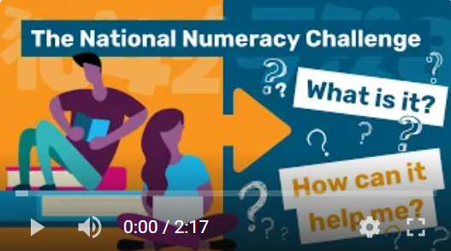
IMPROVE YOUR NUMERACY
Try the National Numeracy Challenge, a free online tool from National Numeracy that helps you improve your numeracy.
You can get started in just 10 minutes using any device. Have a go anytime, anywhere, at your own pace.
Watch this short video to see how it can help you.
Notes:
Notes for facilitator: The National Numeracy Challenge is one of the best ways to get started with building your number skills and confidence. It’s free, online tool that helps you improve your numeracy at your own pace.

Slide 14
NUMERACY FOR EVERYDAY LIFE VIDEOS
Watch one or more of our Confidence Conversation video series.
Use the links below to hear from others as they discuss the most popular themes for improving numeracy:
Getting on at work
Managing money
Supporting children
Greater confidence in everyday life
Watch the full video series on YouTube.
Notes:
Notes for facilitator: We have some videos that you can share with participants to watch after the session or as a way to close the session. The videos cover the main reasons for why people want to improve their numeracy to help in everyday life: for work, managing money, supporting children and for everyday confidence.

Slide 15
THANK YOU FOR TAKING PART

