Slide 1


Slide 2
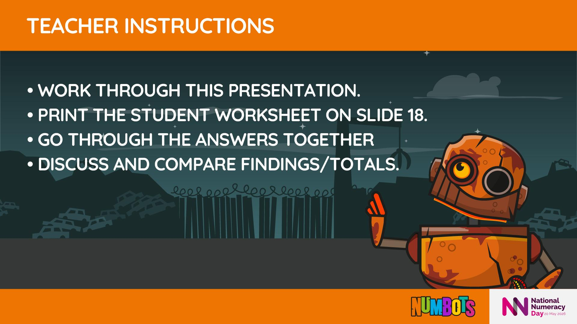

Slide 3

Notes:
Explain that pupils will help Rusty by choosing between different amounts of money.
Emphasise that this is about thinking, not speed.

Slide 4
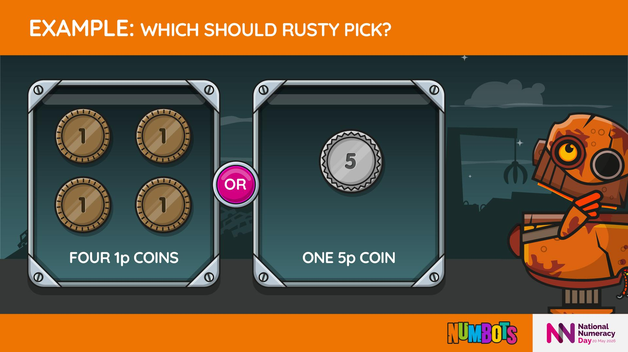

Slide 5
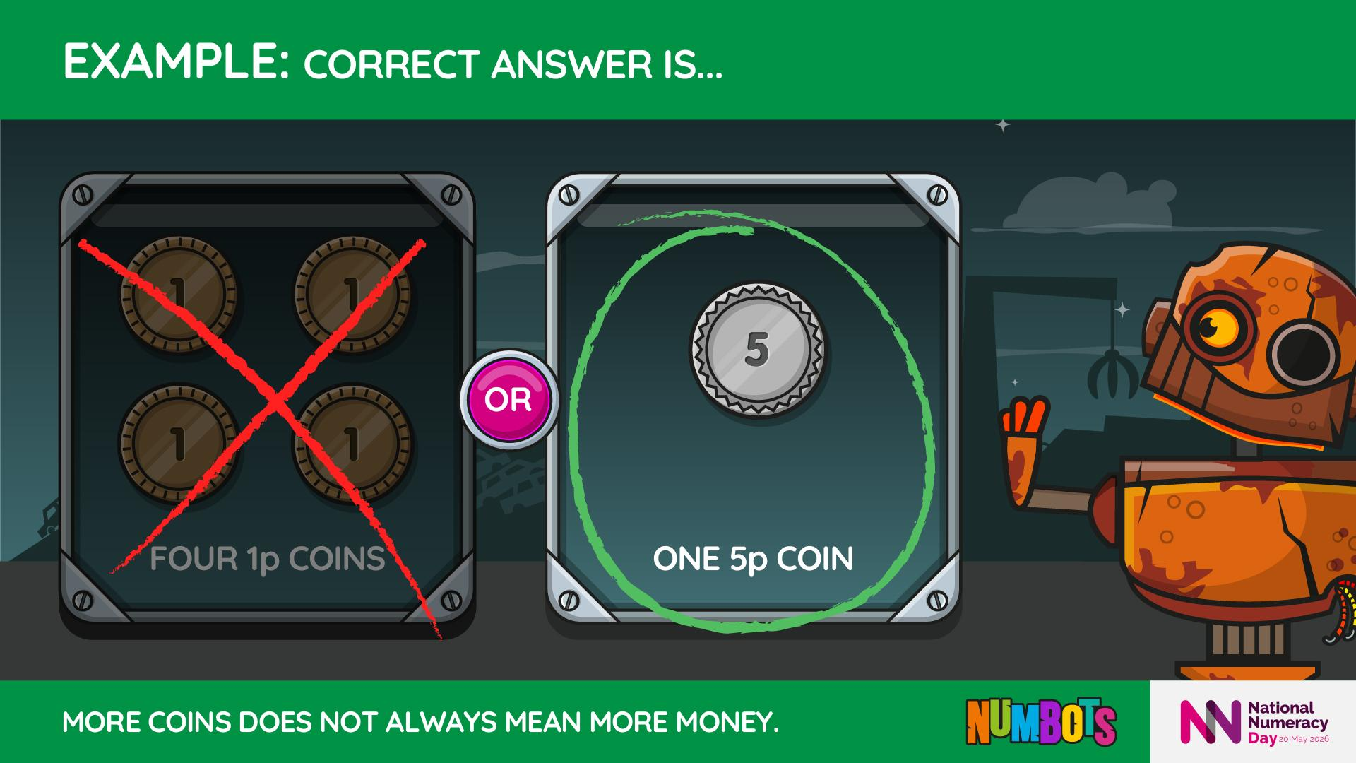
Notes:
Let’s count the value, not the number of coins.
Four 1p coins are worth 4p.
One 5p coin is worth 5p, which is more.
Even though there are fewer coins, the value is higher.
Vocabulary to model: value, worth, compare

Slide 6
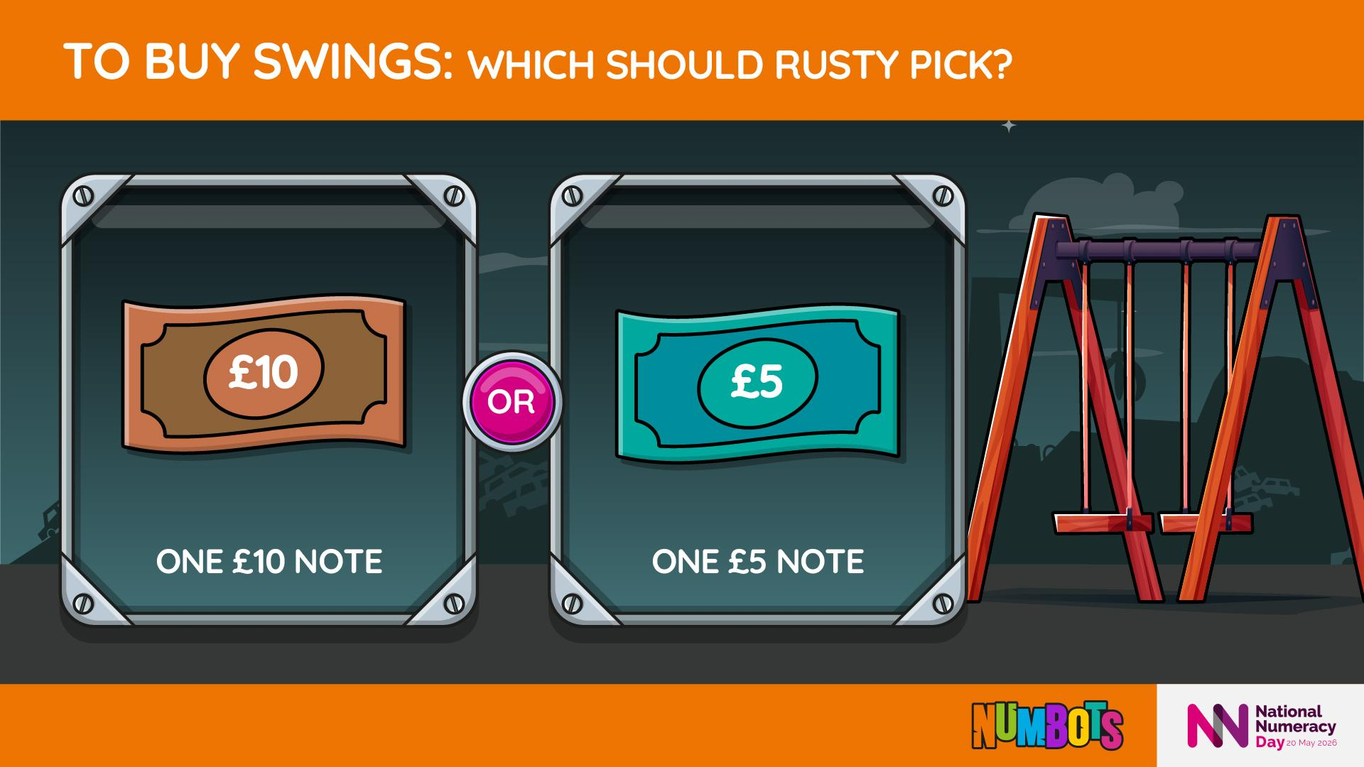

Slide 7
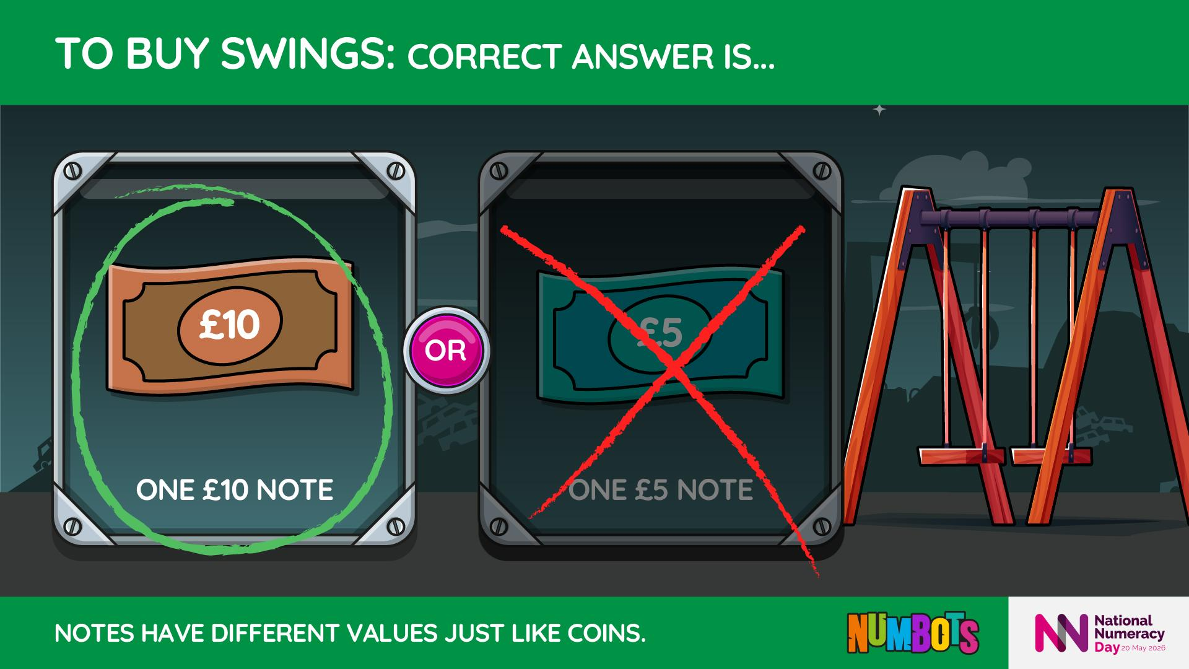
Notes:
£10 is double £5.
A larger value lets Rusty buy bigger or better equipment.
This choice practises comparing notes.

Slide 8
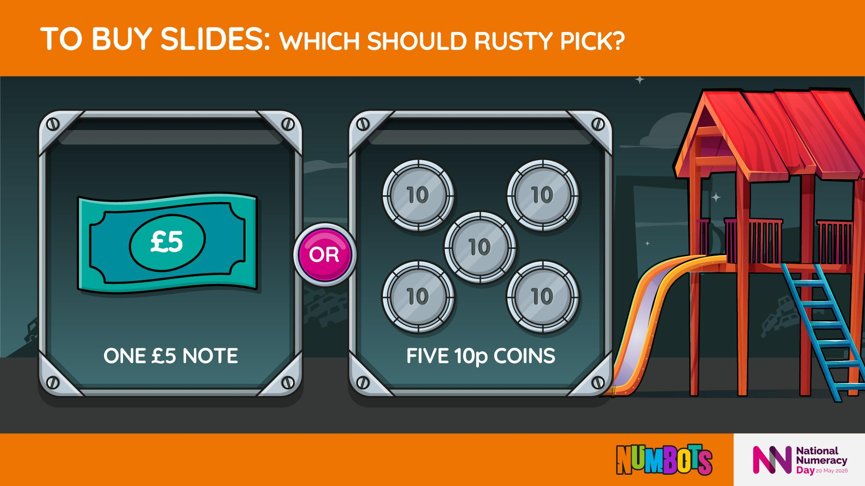

Slide 9
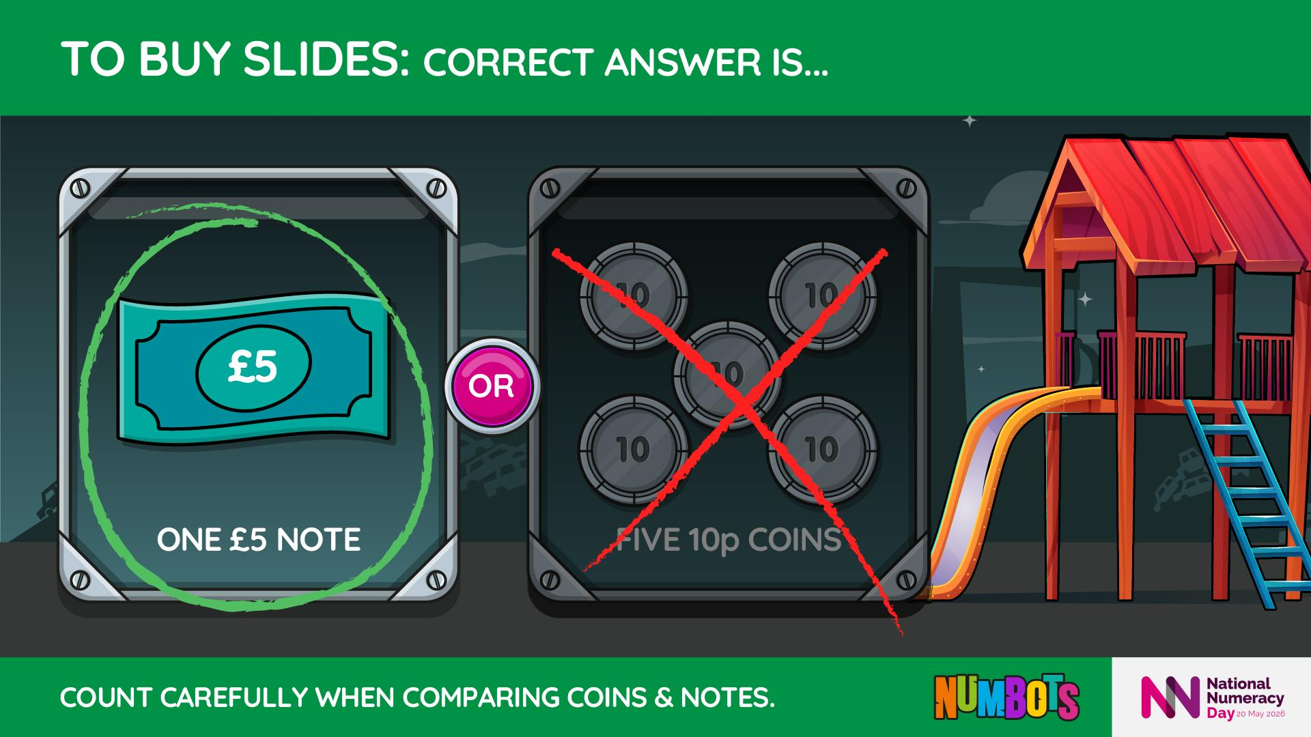
Notes:
Five 10p coins = 50p.
£5 = 500p.
500p is much more than 50p.
Counting in tens helps us find the total.
Misconception: Bigger-looking money is not always worth more.

Slide 10
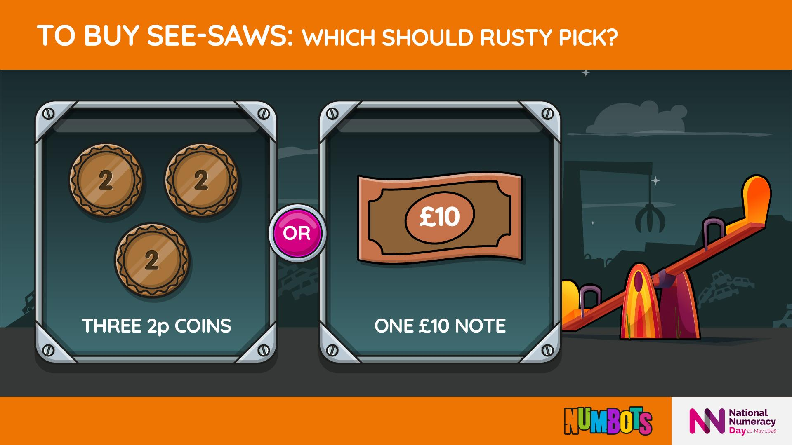

Slide 11
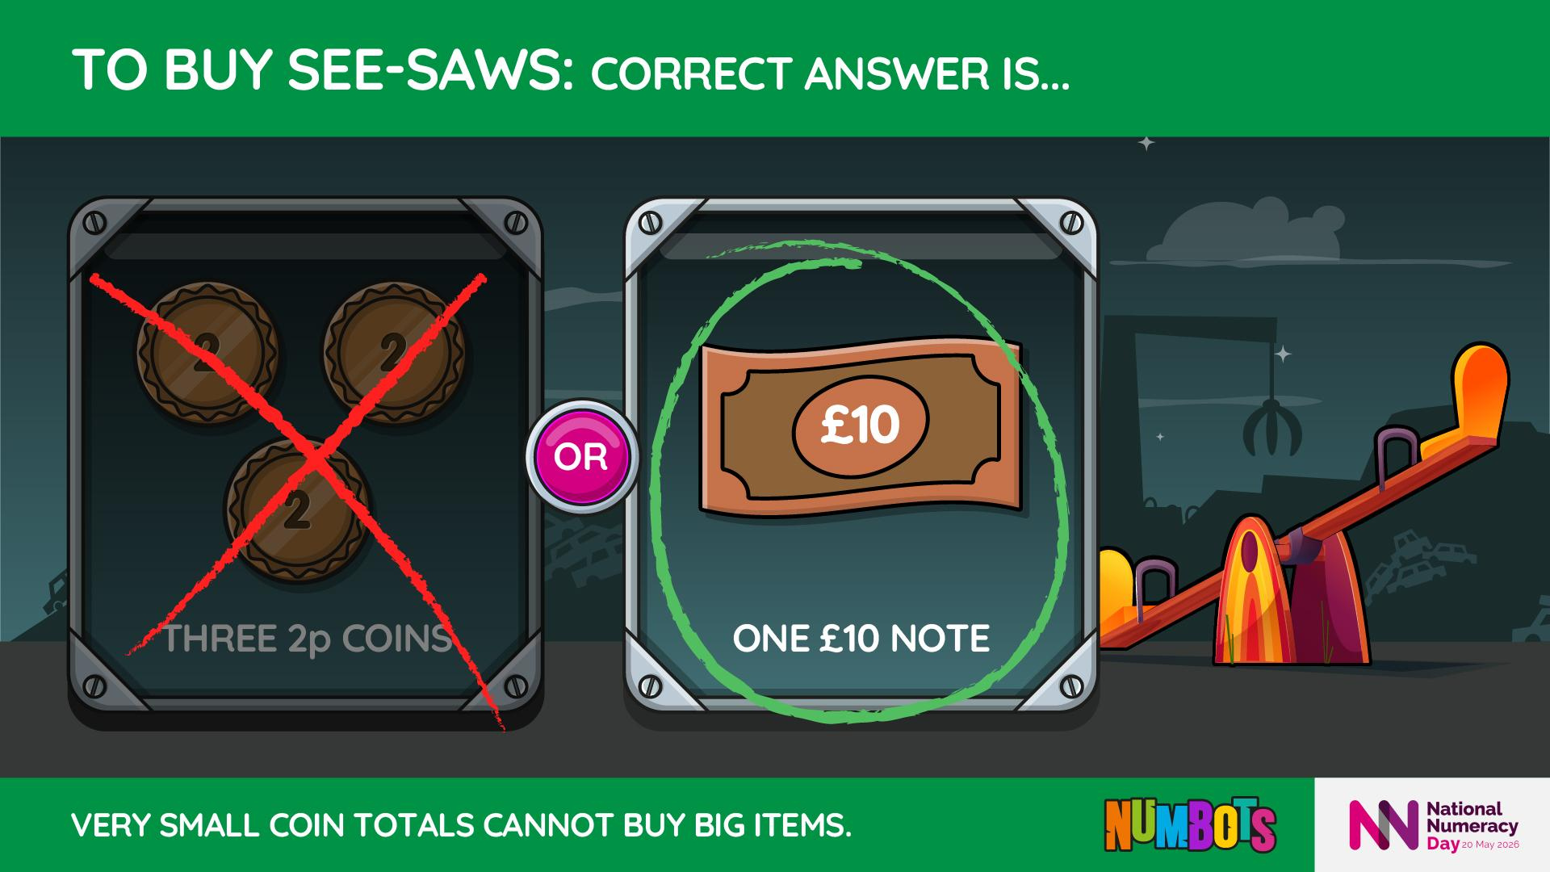
Notes:
Three 2p coins are worth 6p.
£10 is worth 1000p.
These values are not close.

Slide 12
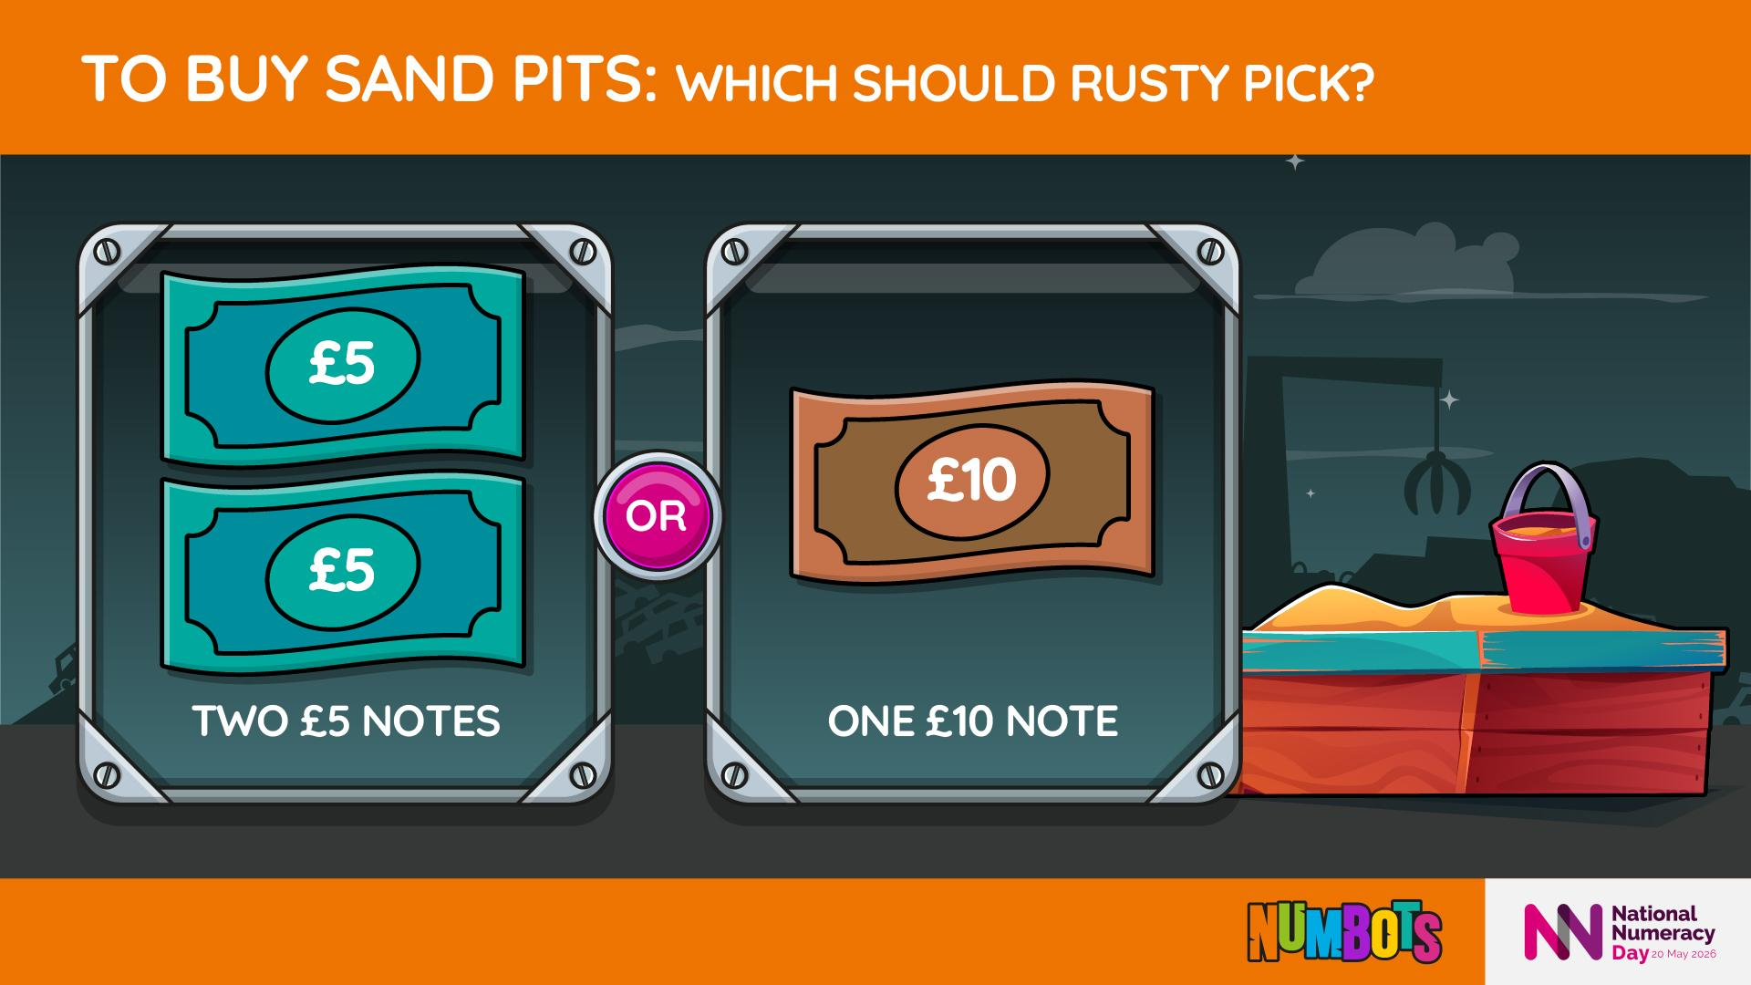

Slide 13
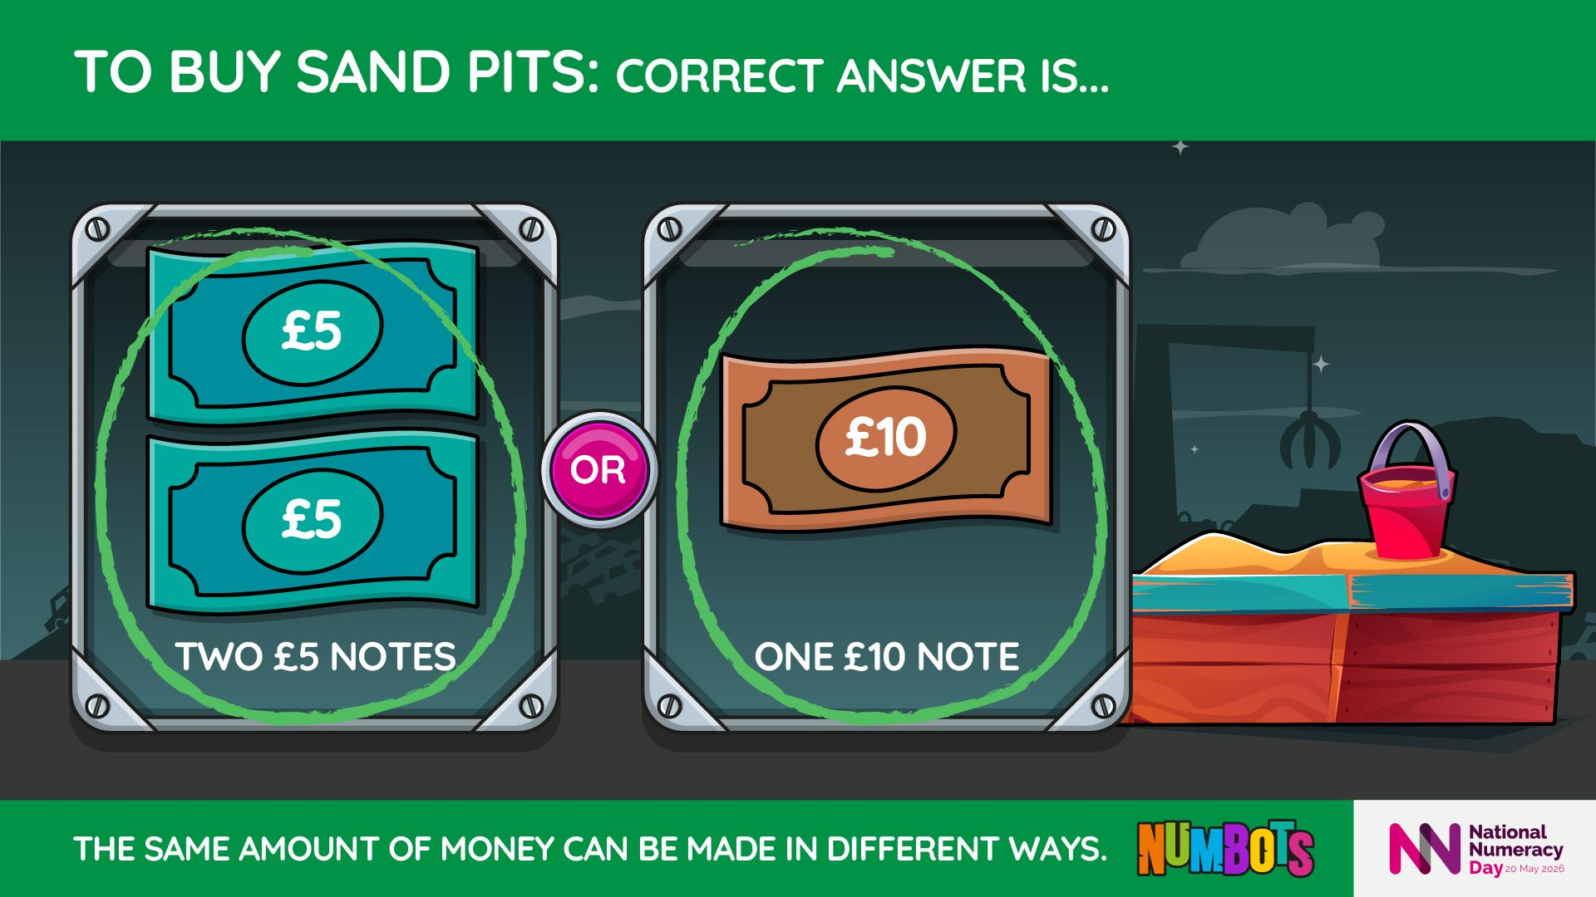
Notes:
Two £5 notes add together to make £10.
This shows equal value in different forms.
Rusty can buy the same thing either way.

Slide 14
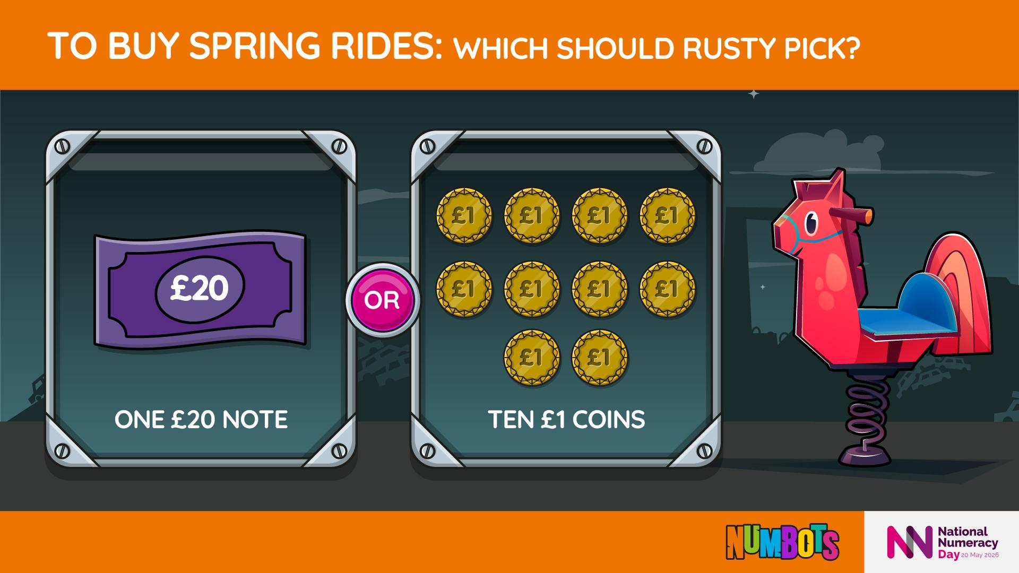

Slide 15
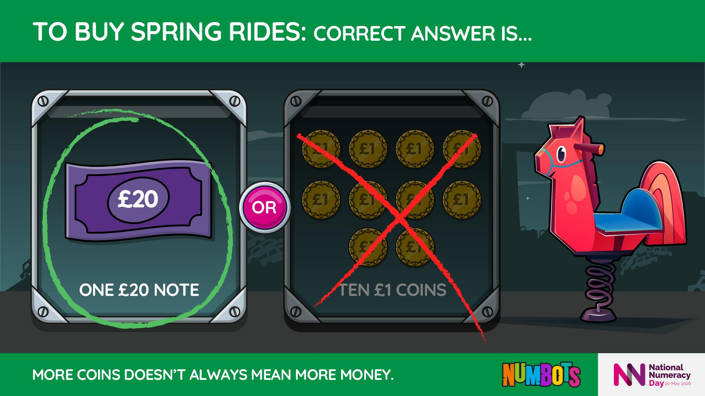
Notes:
Ten £1 coins = £10, not £20.
Always count and check before deciding.
The £20 note is worth more.

Slide 16
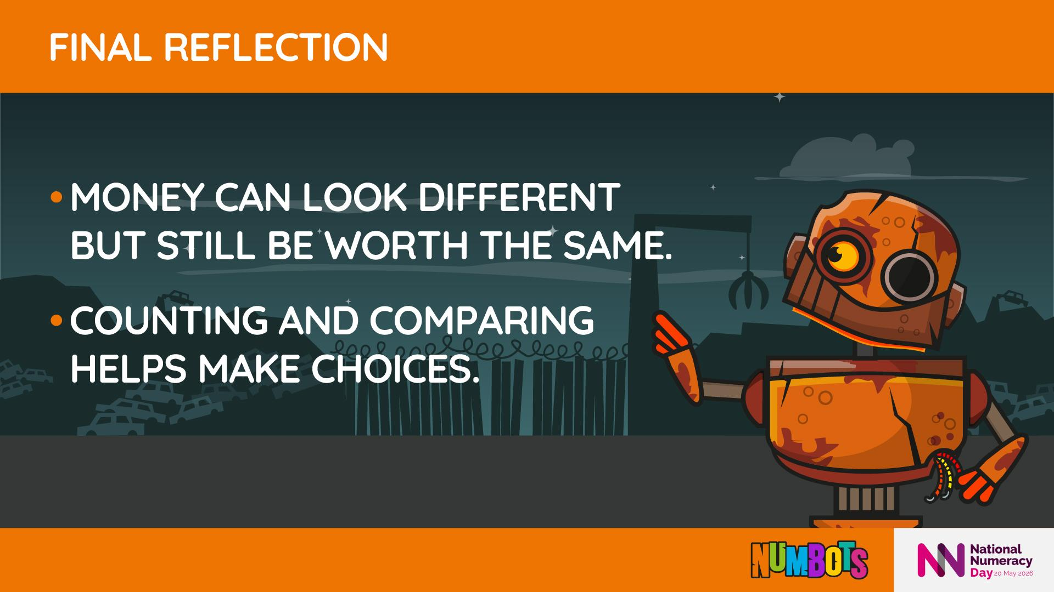

Slide 17

Notes:
Money can look different but still be worth the same
Counting and comparing helps make choices

Slide 18
