Slide 1


Slide 2
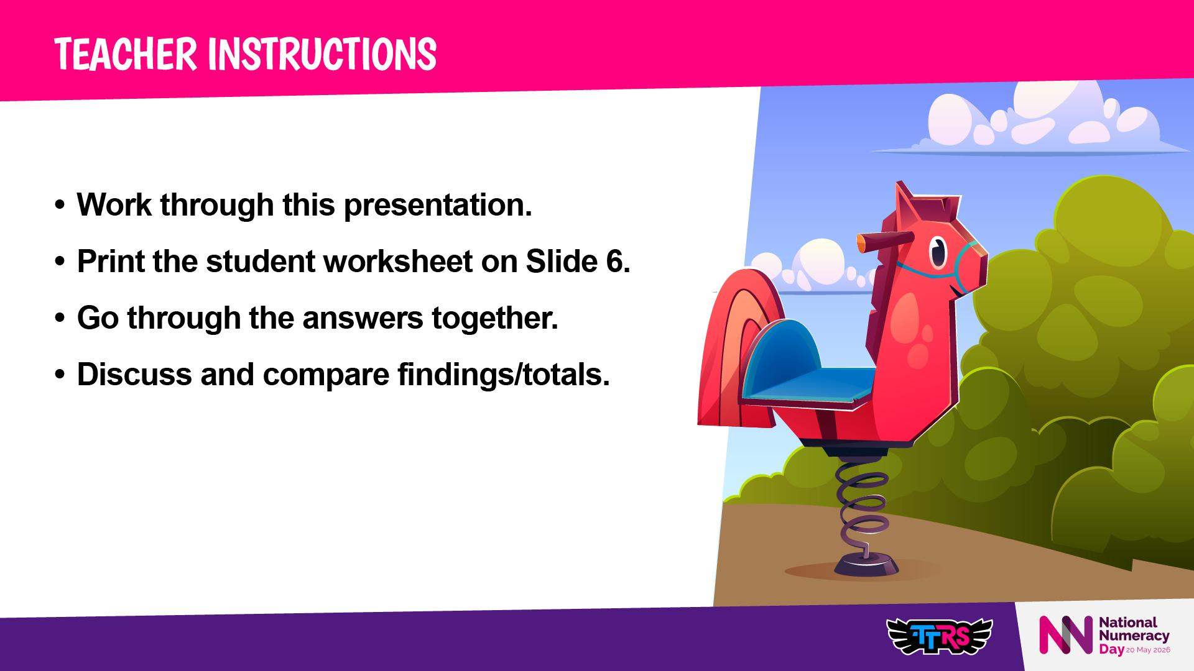

Slide 3
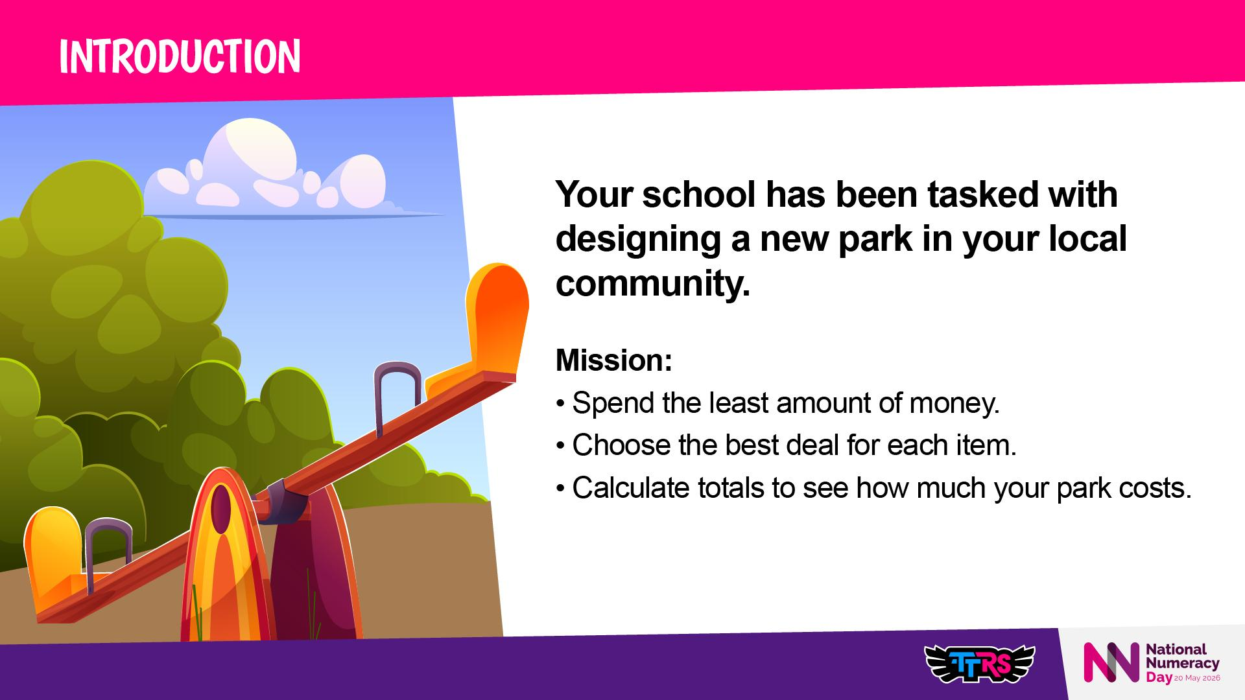
Notes:
Introduce the idea of discounts and promotions
Key vocabulary: promotion, discount, total cost, cheapest, savings

Slide 4
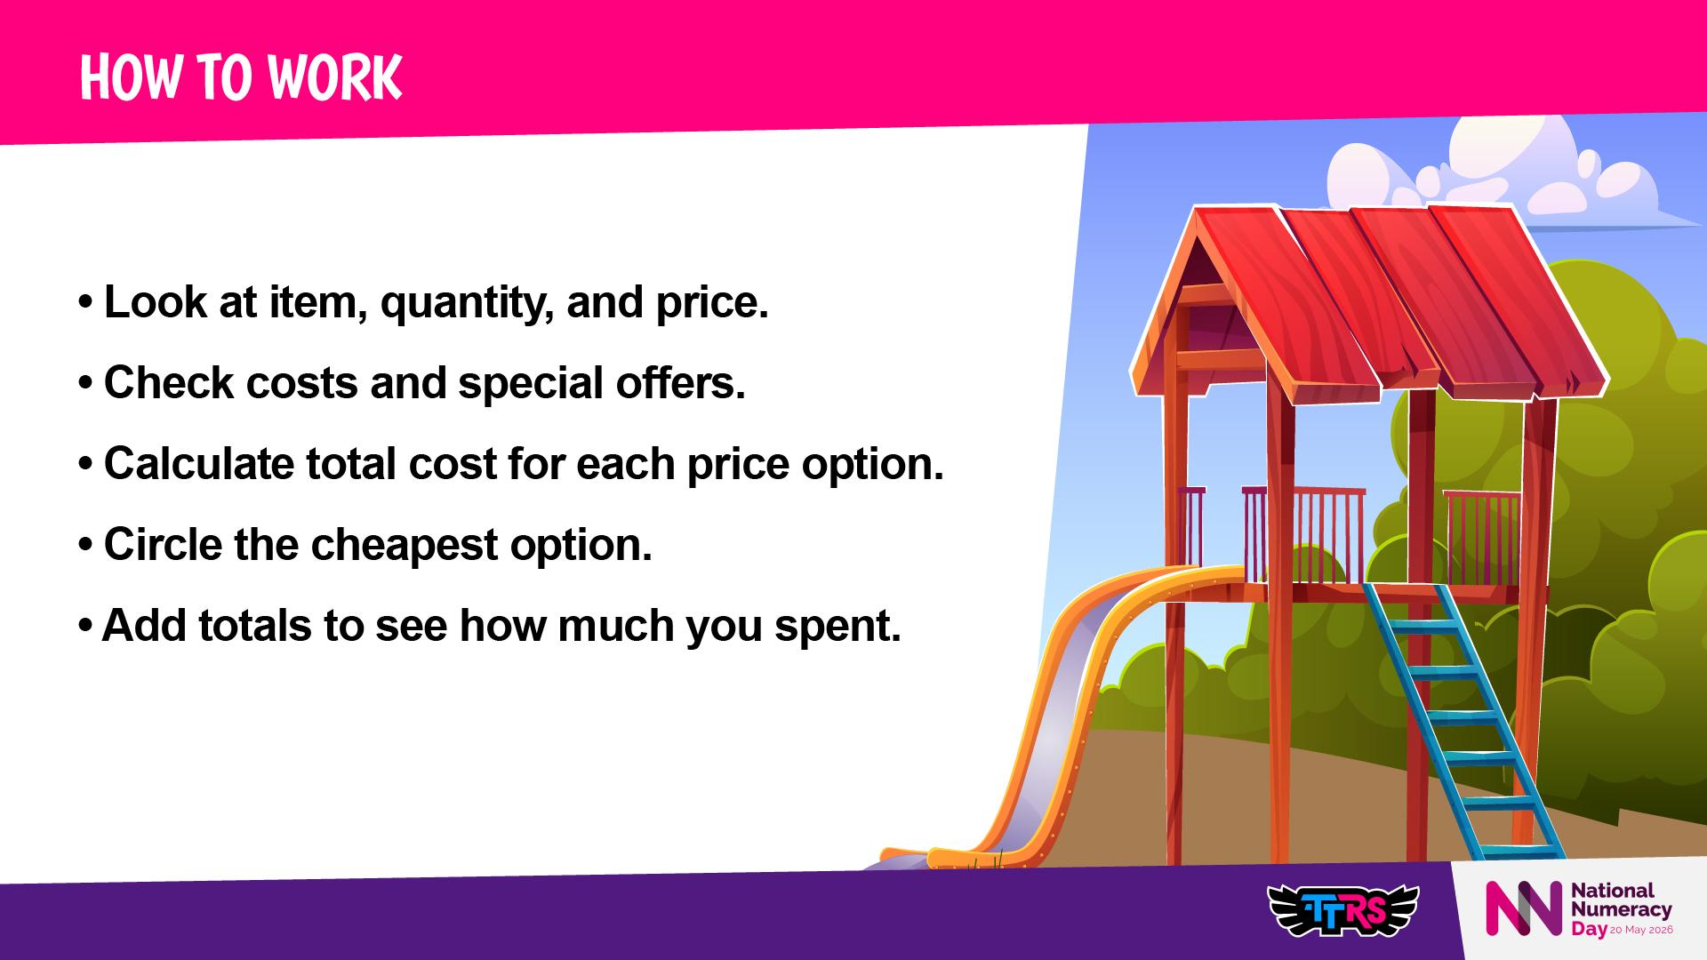

Slide 5
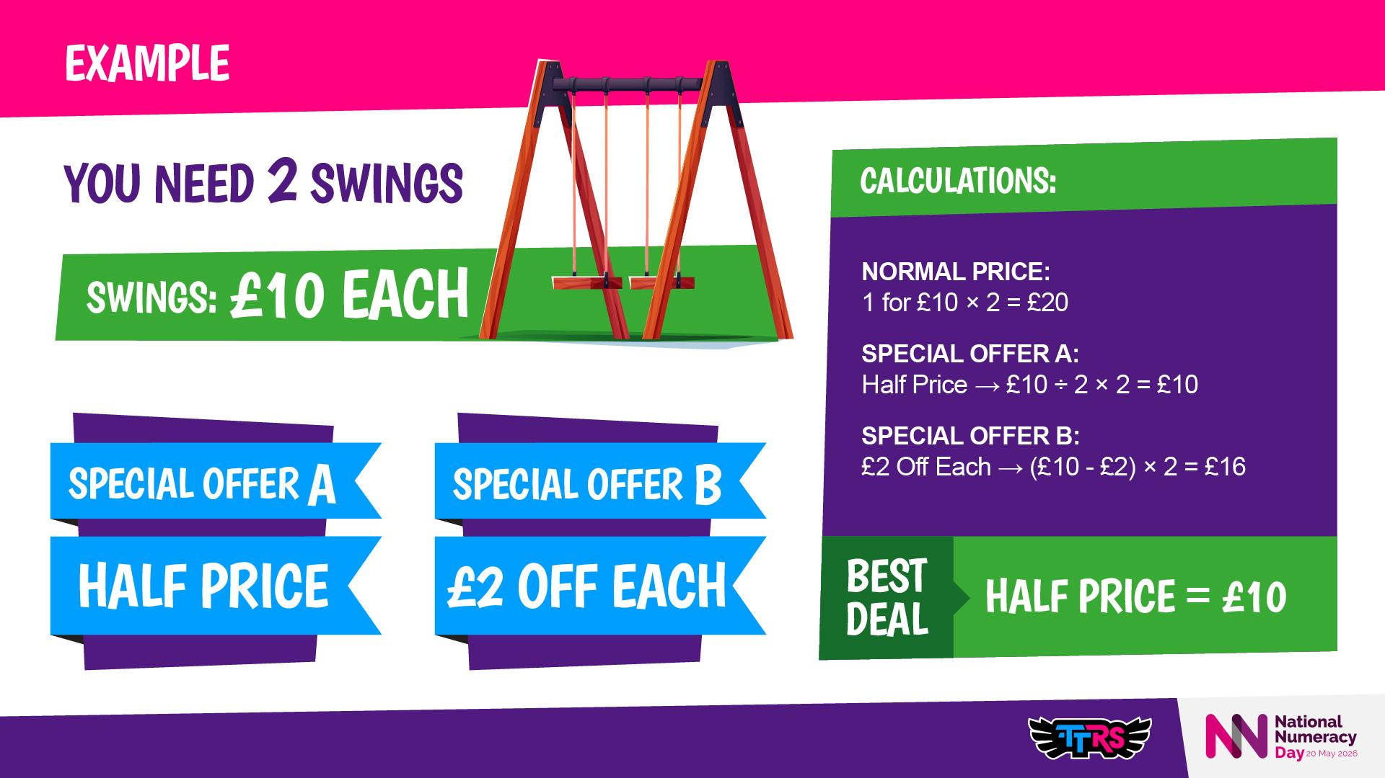
Notes:
Model example on the board (e.g., Swings)
Emphasise step-by-step calculations
Show why Half Price is cheaper than £2 Off
Highlight: Always calculate before choosing

Slide 6
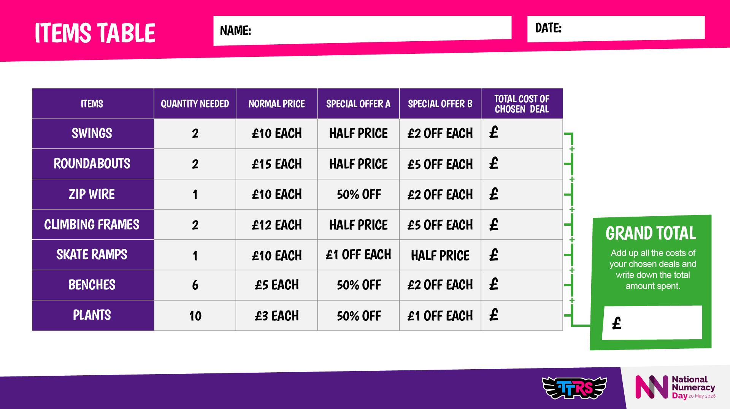
Notes:
Encourage students to show all working
Ask: Which promotion is cheaper and why?

Slide 7
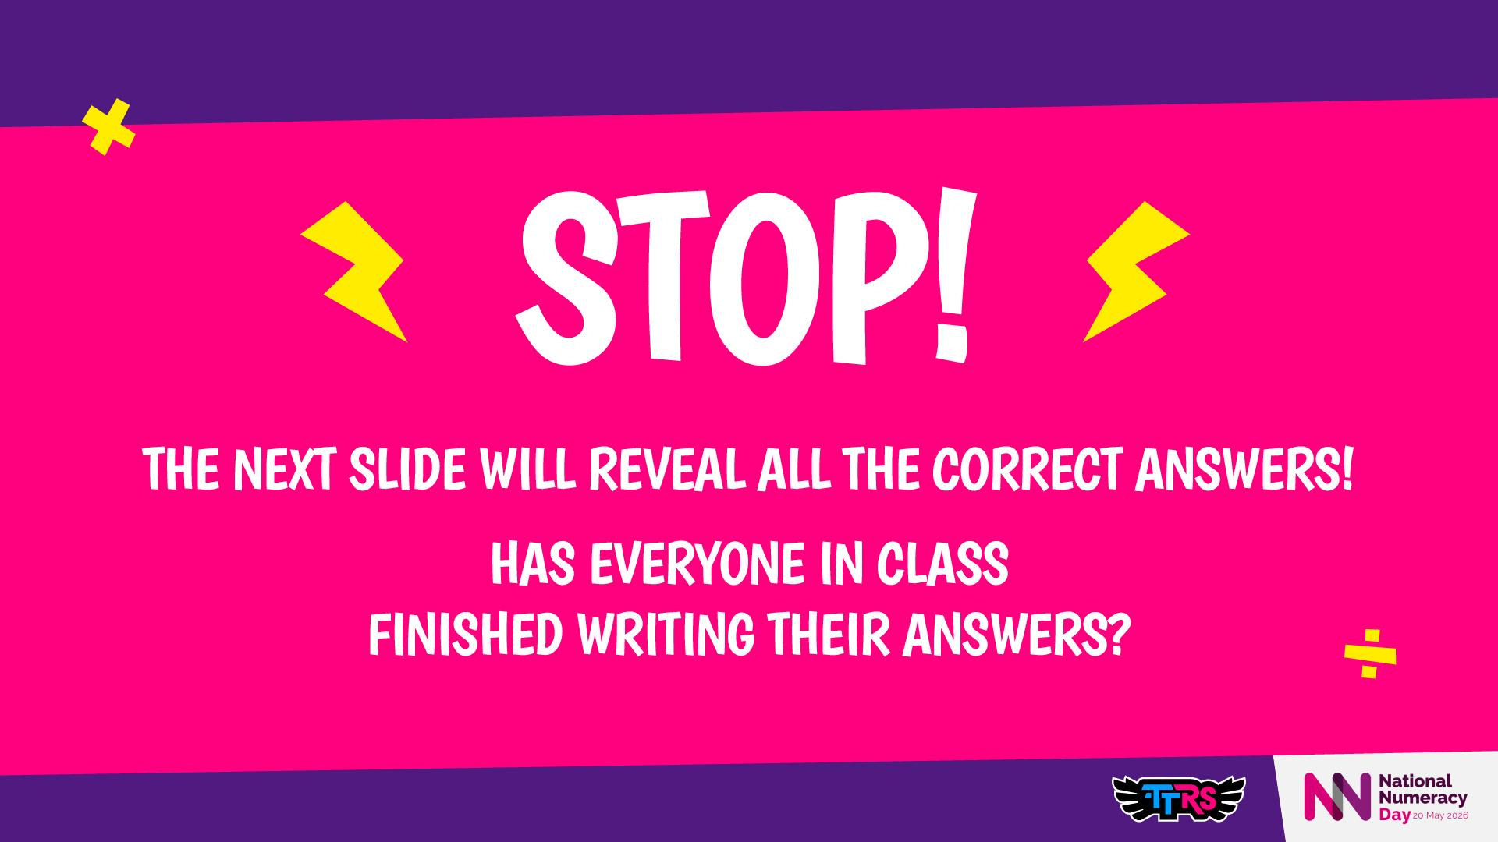

Slide 8
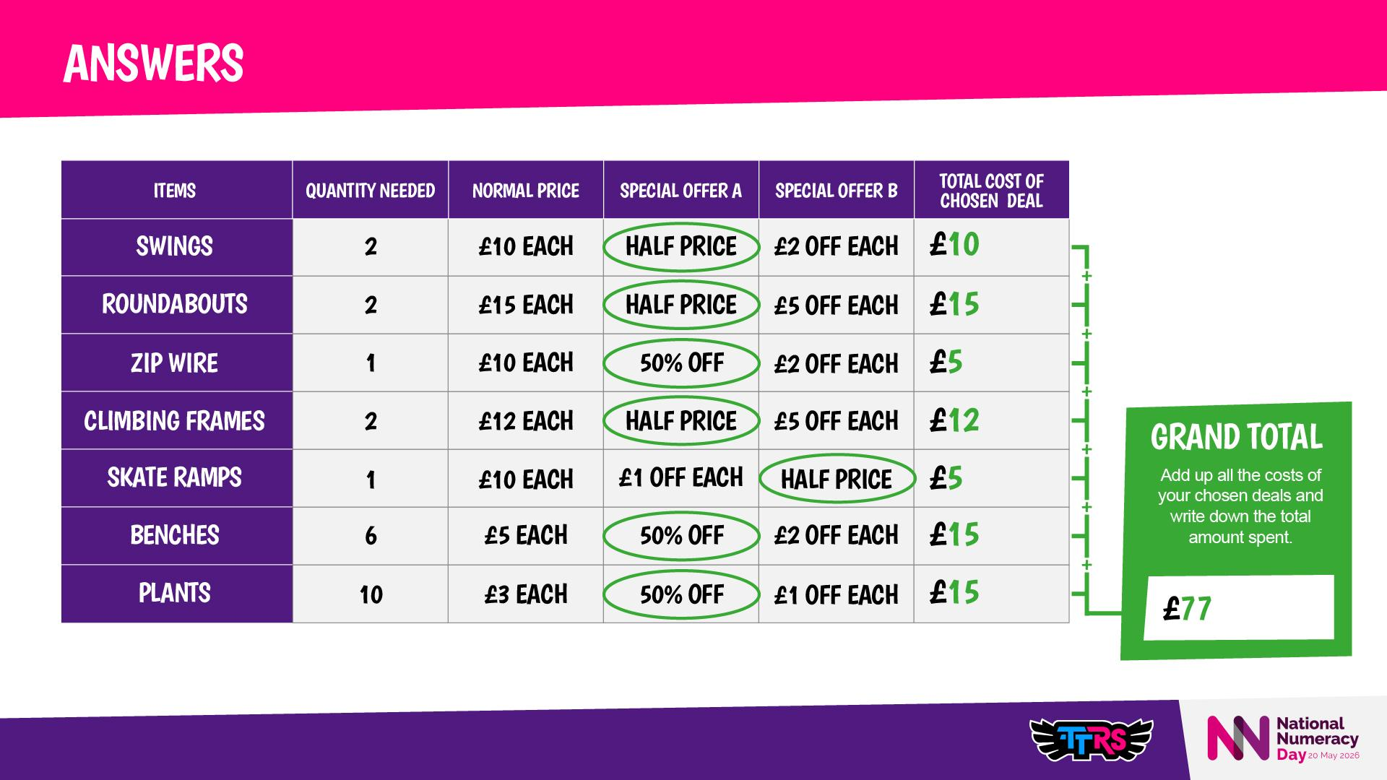
Notes:
Teacher Notes / Talking Points:
Step-by-step calculation for each promotion
Explain why Half Price or 50% Off can be better than flat discounts
Discuss trade-offs: cheapest deal = more items, bigger deals = fewer but fancier items
Optional Reflection Prompt: 💭 Would you rather spend £77 and have all these items, or spend more on fewer, bigger items? Why?

Slide 9
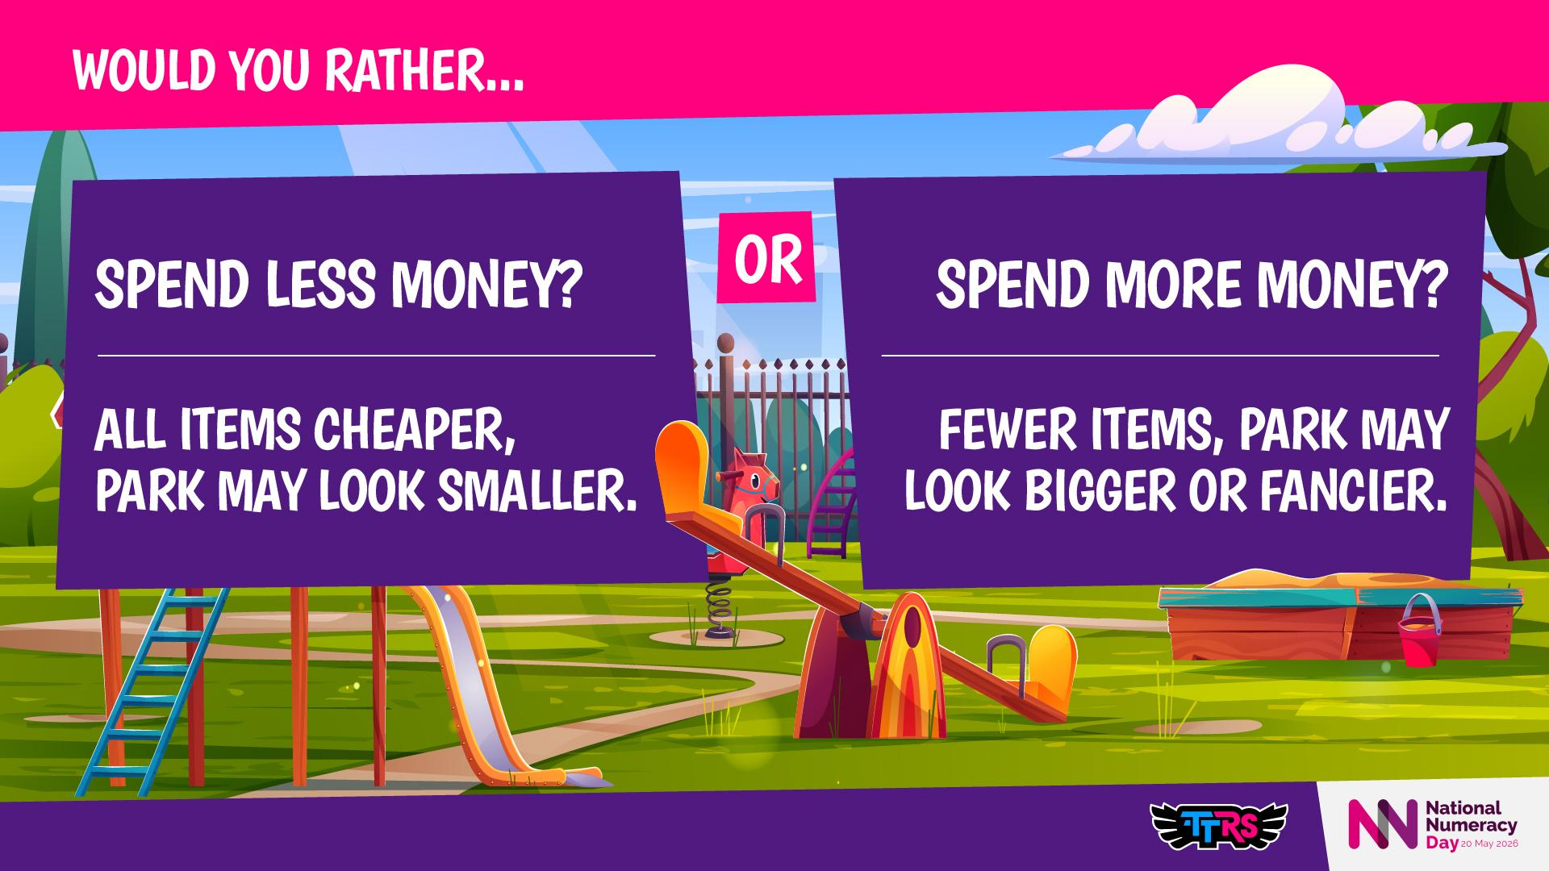
Notes:
💭 Which option makes your park the most fun for children?
Encourage reasoning and discussion about trade-offs
Focus on real-life maths decision-making

Slide 10
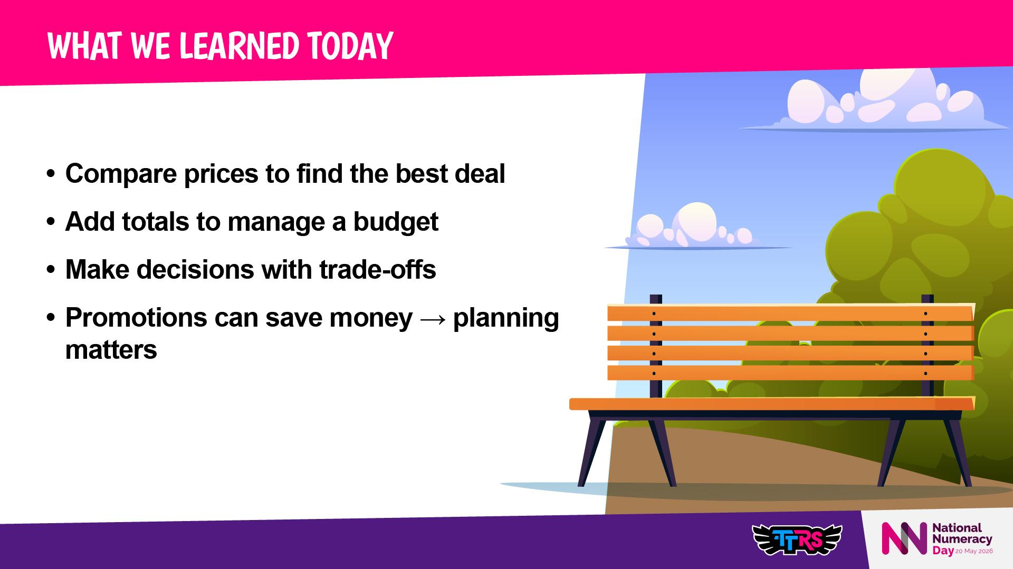
Notes:
Discussion prompts:
Did your park cost more or less than classmates?
Did cheaper items change the park’s appearance or fun factor?
Next step option: Draw your park!

