Slide 1


Slide 2
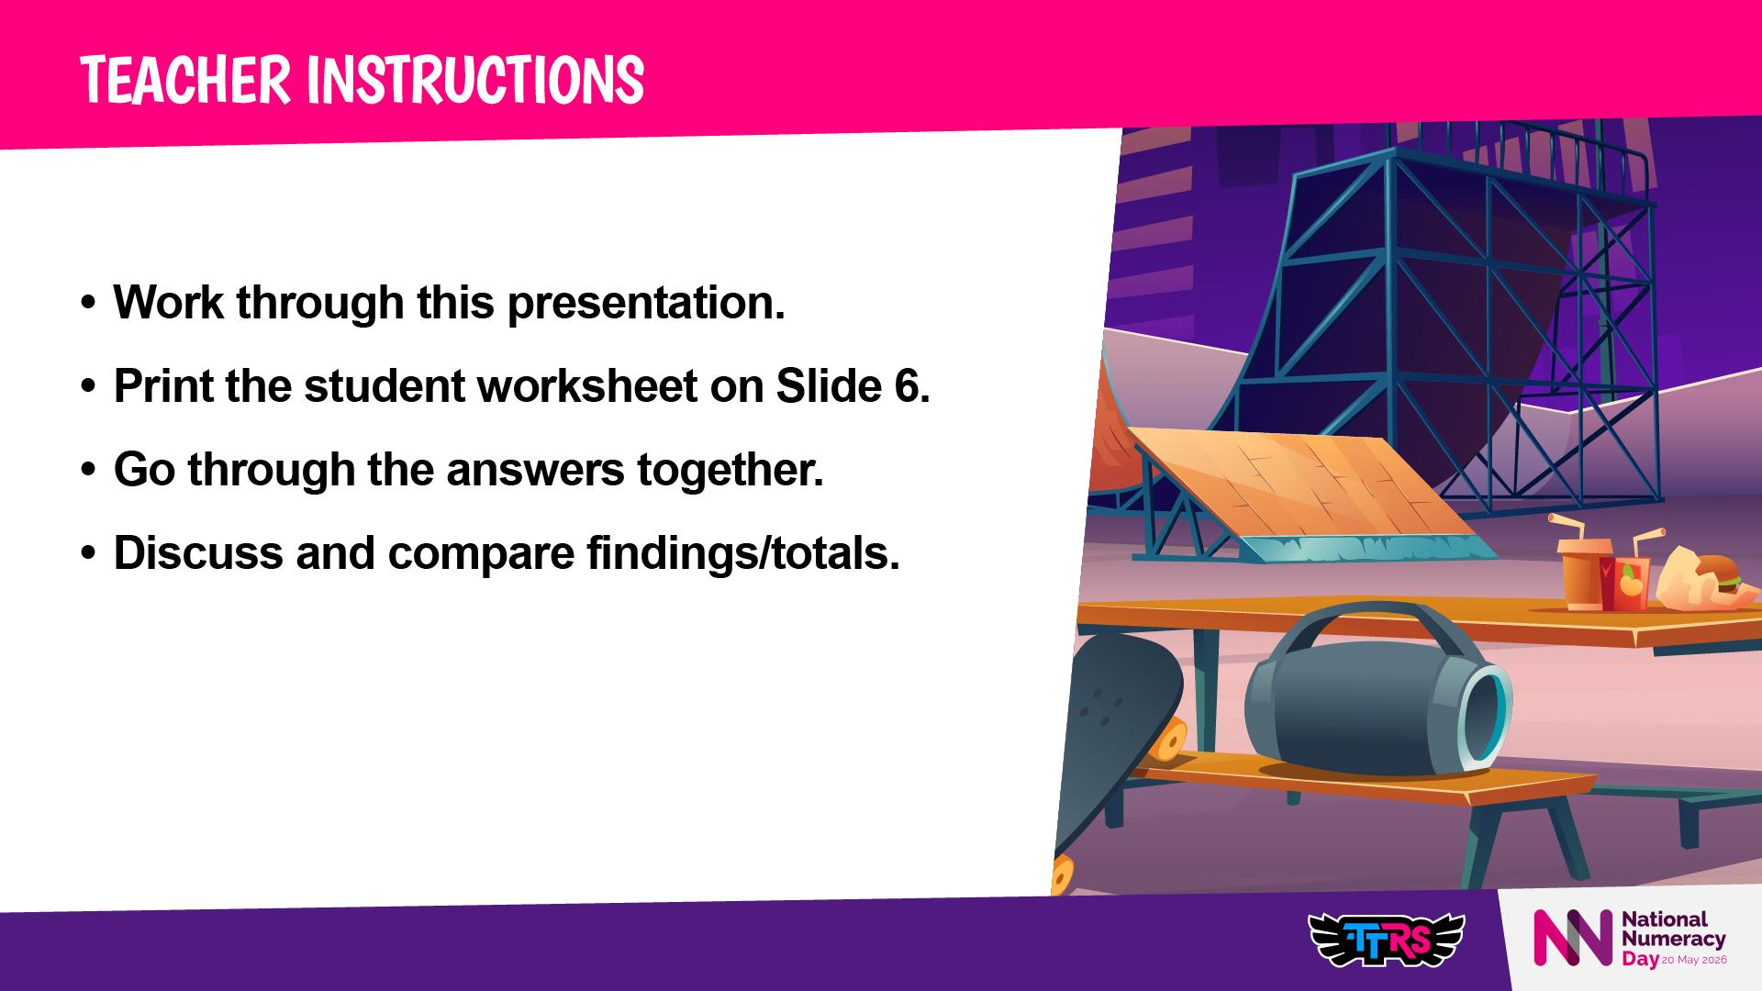

Slide 3
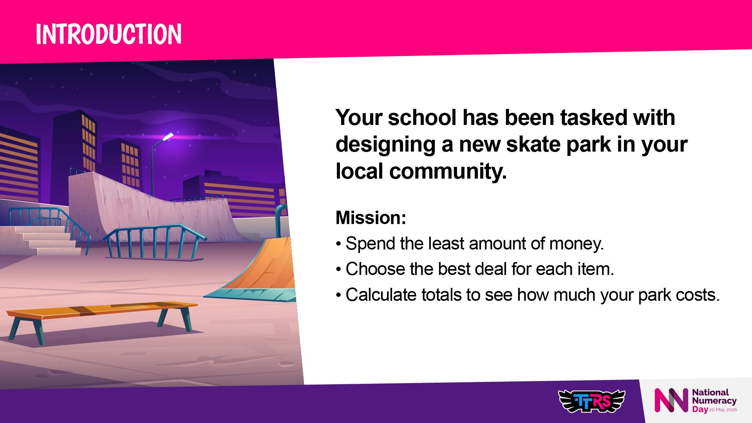

Slide 4
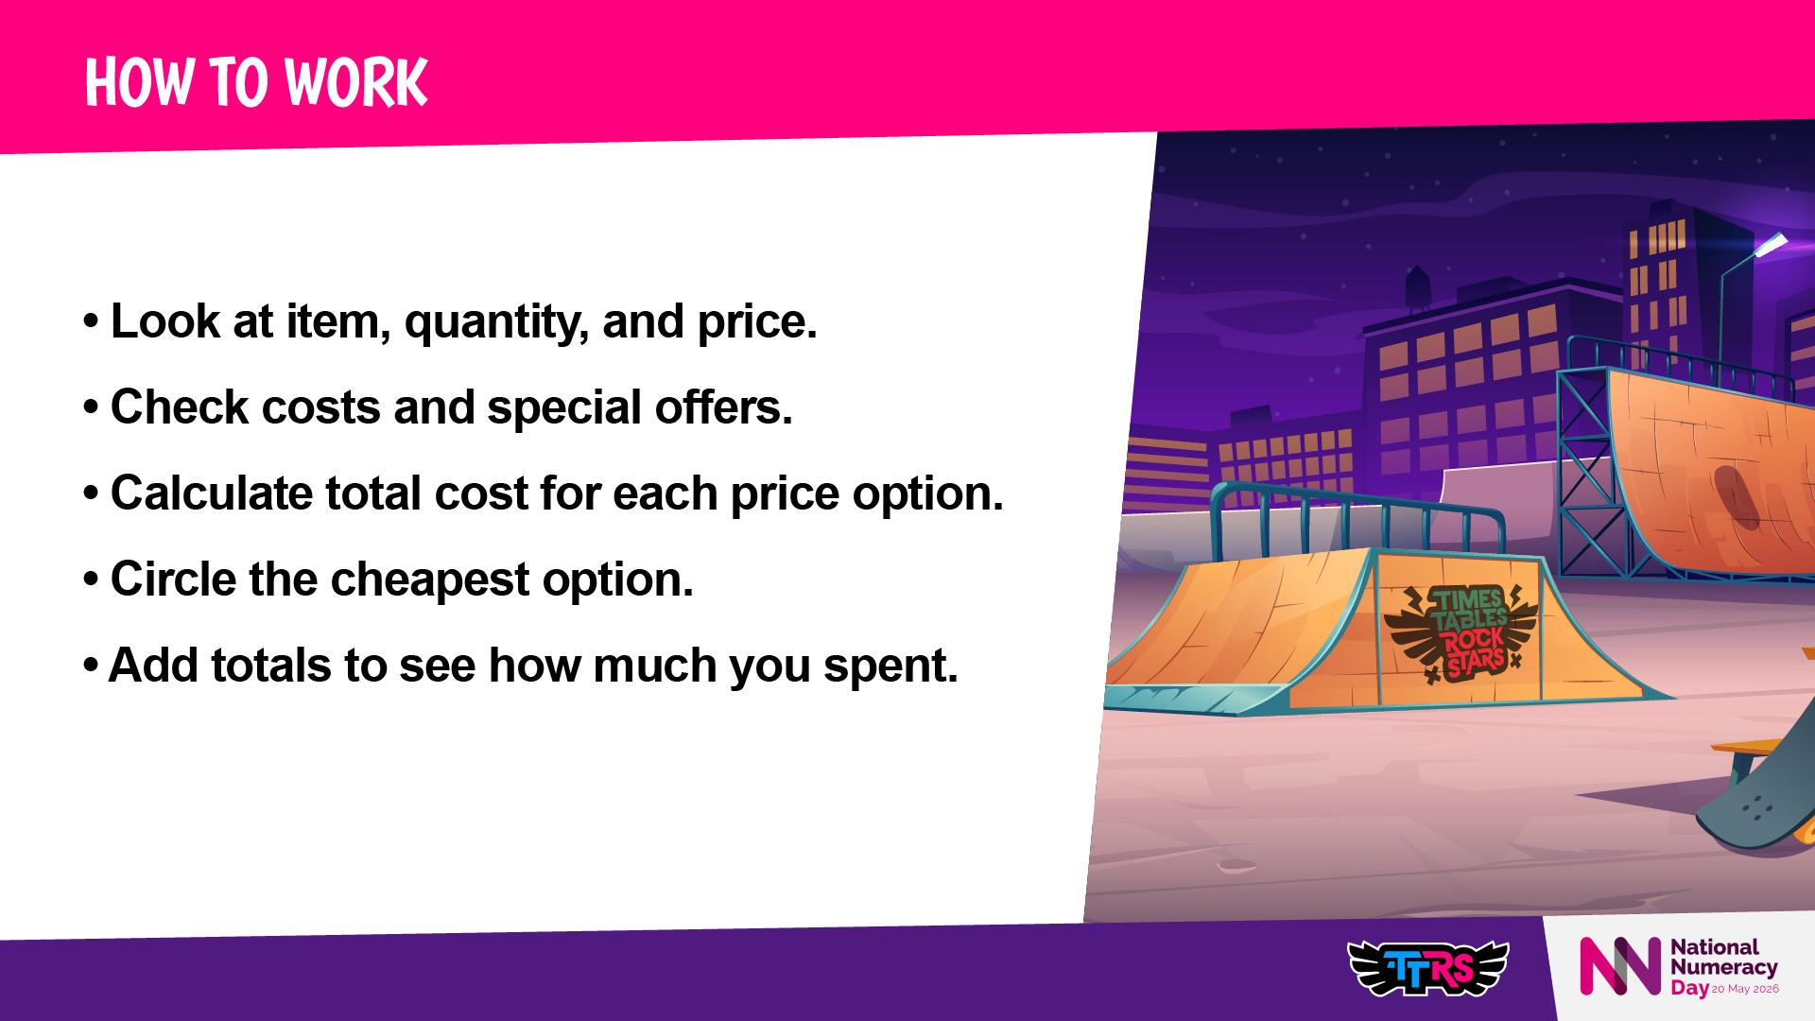
Notes:
Introduce advanced promotions (percentage off, multi-buy deals)
Key vocabulary: promotion, discount, total cost, cheapest, multi-buy, percentage off

Slide 5
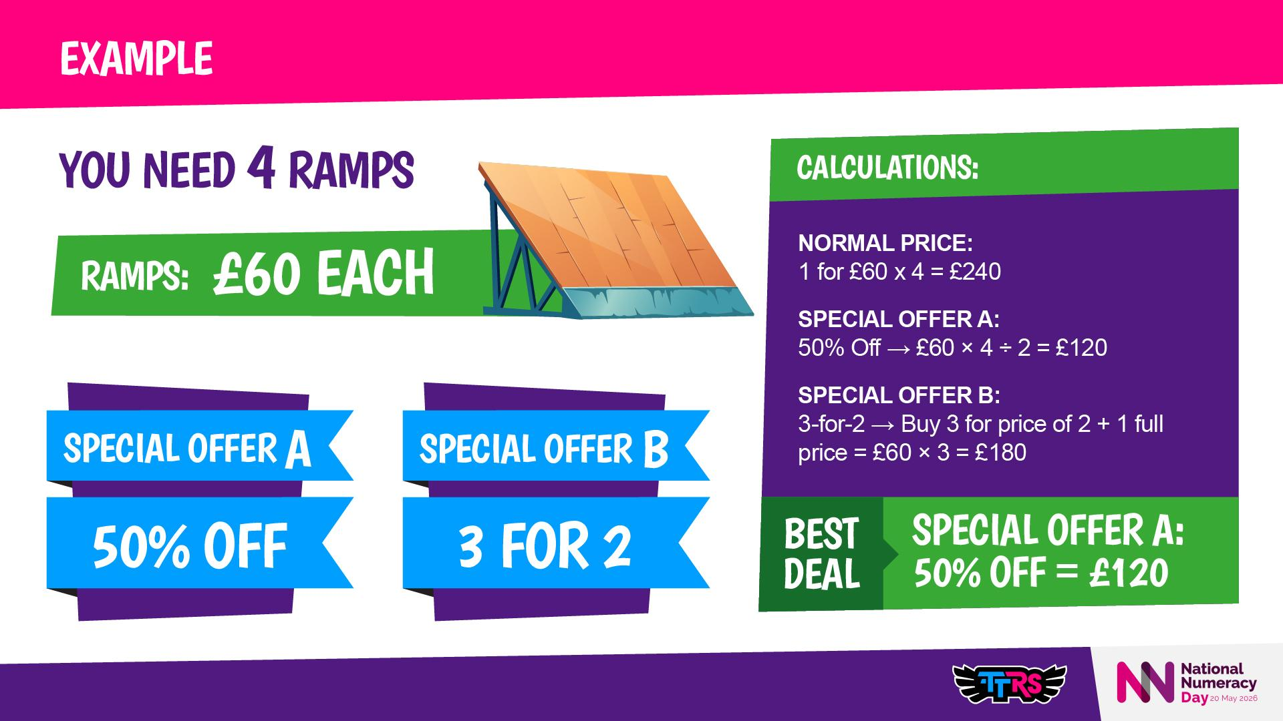
Notes:
Explain how to calculate percentage discounts
Demonstrate multi-buy deals step-by-step
Reinforce always check which promotion is cheaper

Slide 6
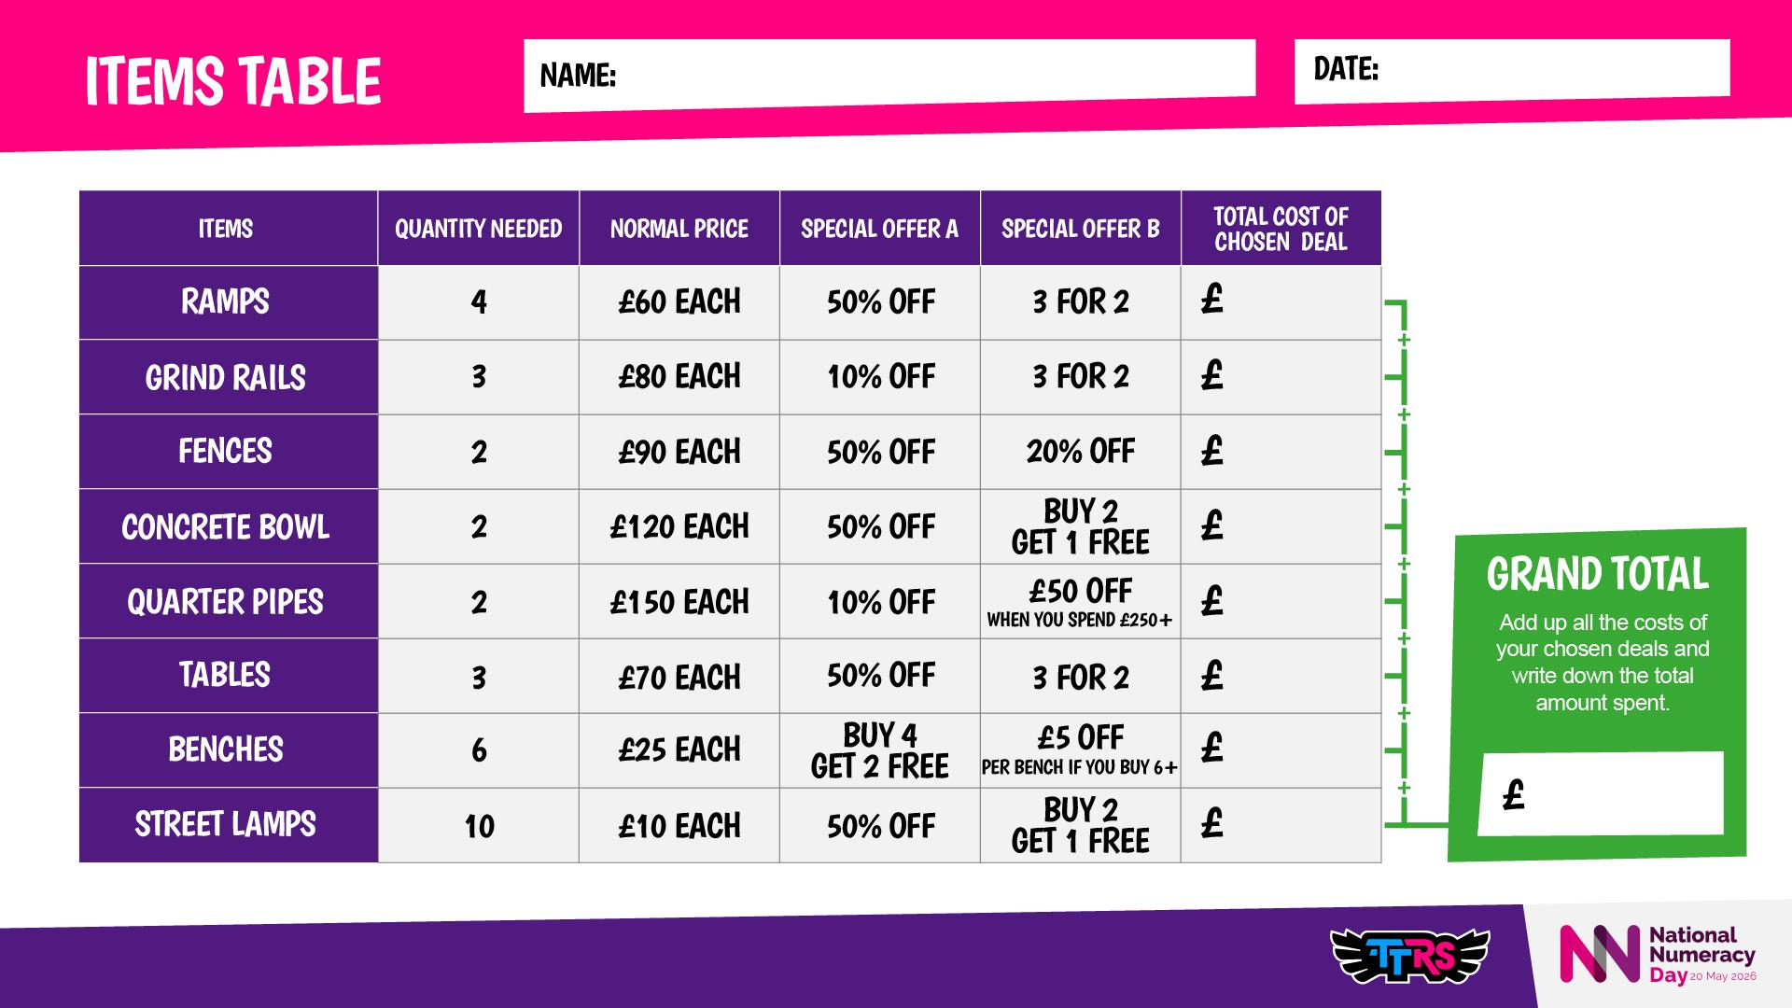

Slide 7
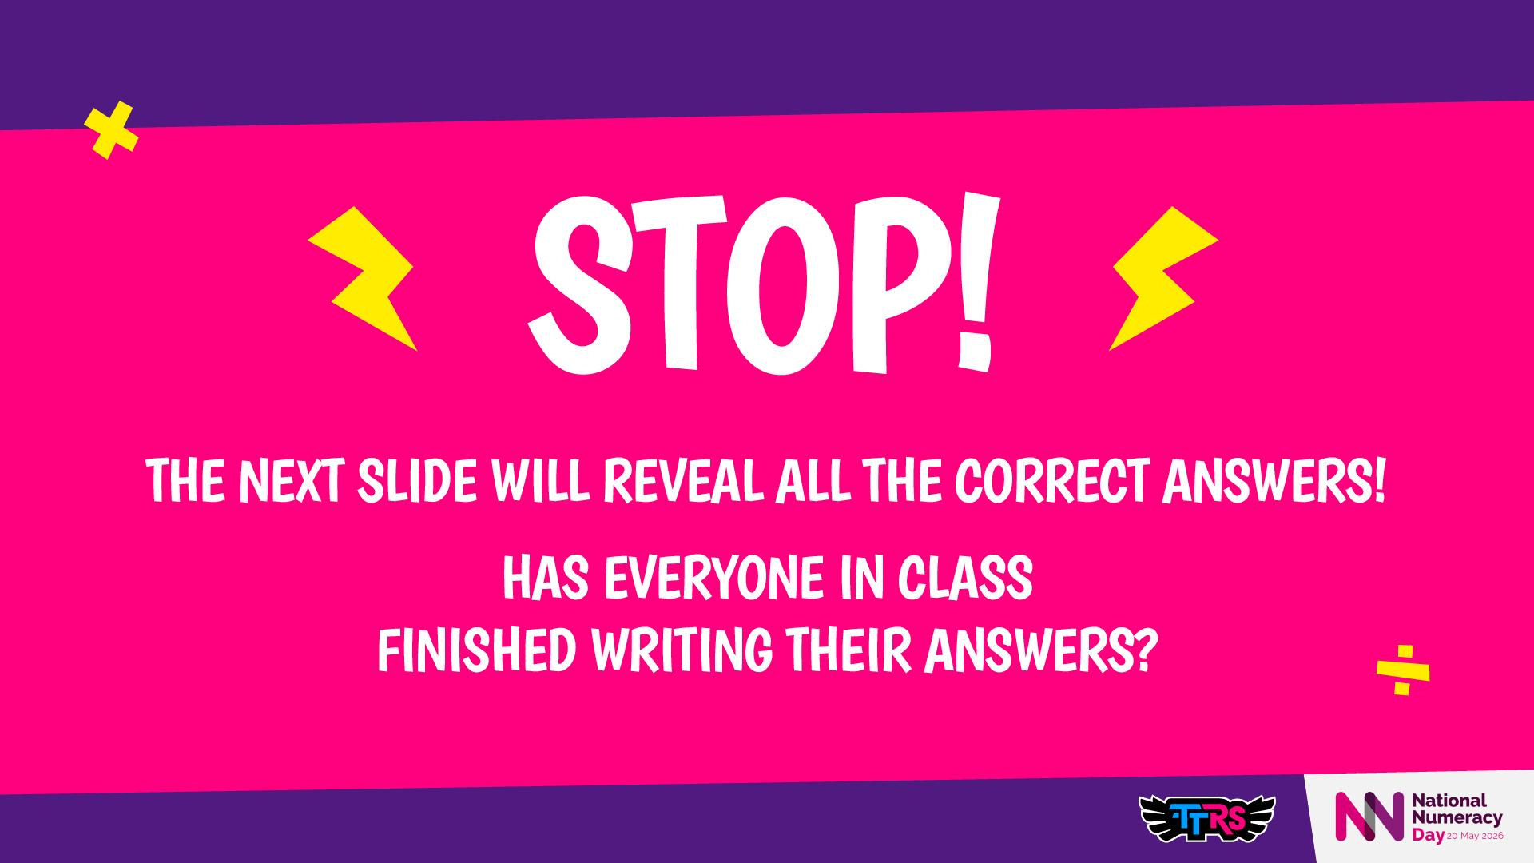

Slide 8
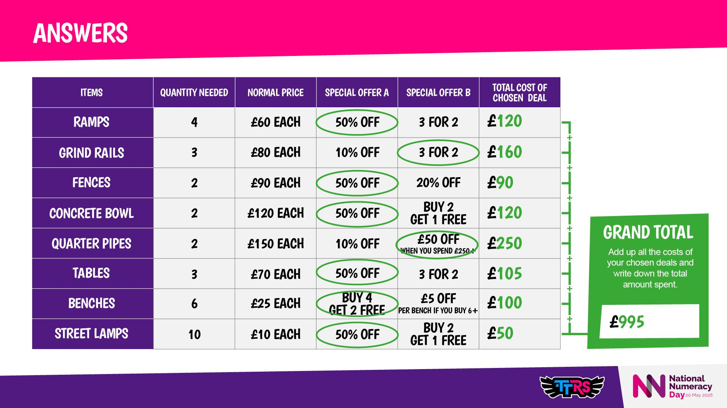
Notes:
Step-by-step calculation for percentage off and multi-buy and money off if you buy.
Discuss trade-offs: cheapest deal = more items, bigger deals = fewer but more impressive items
Optional Reflection Prompts:
💭 Would you rather spend £995 and have all these items, or spend more on fewer, bigger items? Why?

Slide 9
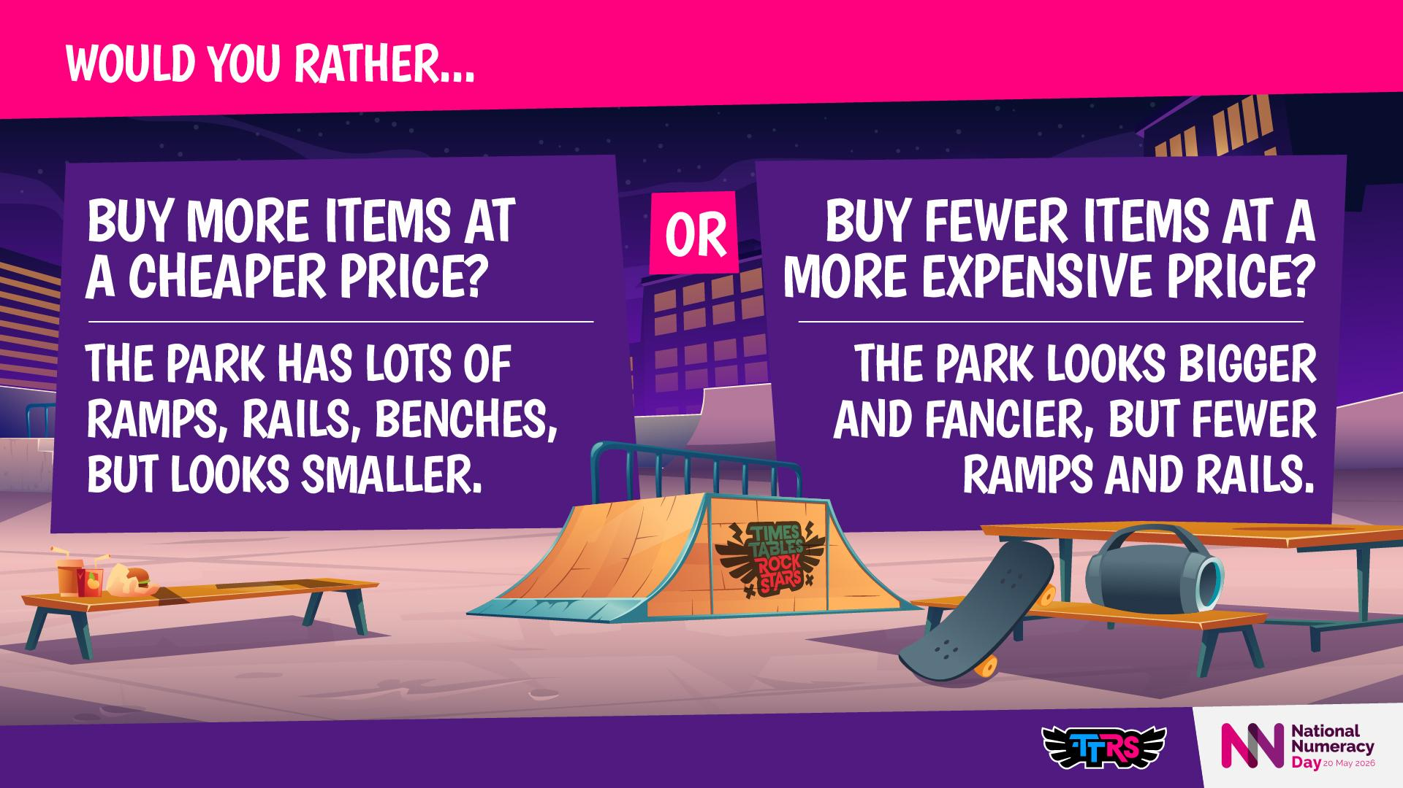
Notes:
💭 Which option would make your park most fun for children?
Could you save money and add/ improve something elsewhere in your community?
Encourage reasoning and discussion about trade-offs and priorities
Discuss how budget decisions affect the park design

Slide 10
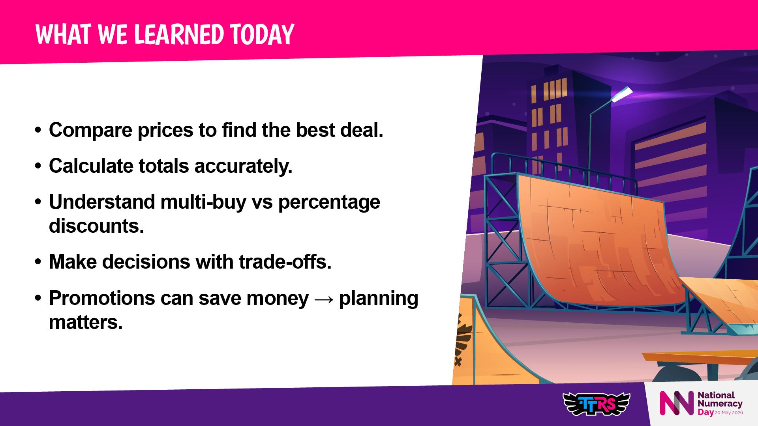
Notes:
Discussion prompts:
Which item had the biggest saving?
Did your cheapest options give enough items for a fun park?
Next optional step: Draw your skate park!

